Slide 1

Prof. Dudley E. Shallcross ACRG & PSTT
Tim G. Harrison Bristol ChemLabS
Atmospheric Chemistry Research Group, School of Chemistry, University of Bristol
Primary Science Teaching Trust
An Overview of Air Pollution and Climate Change

Slide 2

Contents
Climate Change
What can we do?
Slides 3-20
Slides 21-28

Slide 3
Climate Change

Slide 4
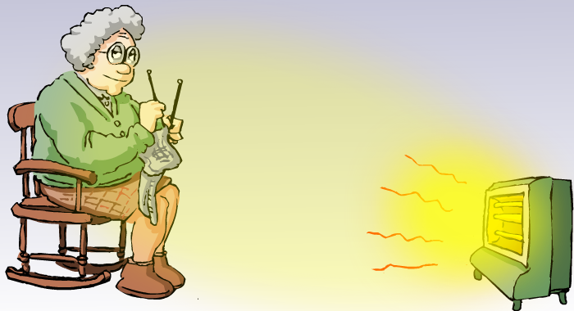
Granny’s model of climate 1
Earth Sun
Temperature of the Earth approx. 10º C

Slide 5

Big problem: clouds and ice
From sun (100%)
Scattered back to
space by clouds (24%)
Scattered back to space
by the surface (6%)
Surface Land/water Ice
30% of incoming solar radiation reflected back out to space without being absorbed (Earth’s albedo A = 0.3)

Slide 6
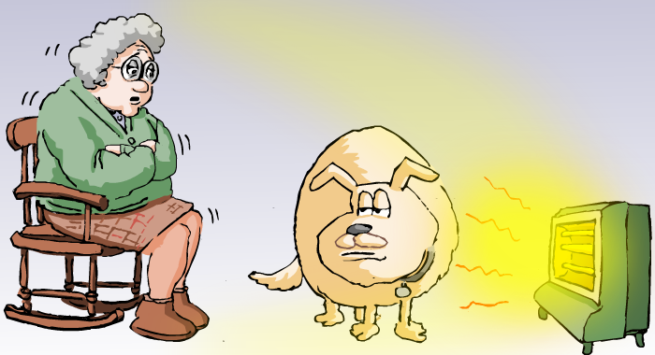
Granny’s model of climate 2
Earth Sun
With clouds and ice
Temperature of the Earth approx. - 18º C

Slide 7
Granny is now very cold
What can she do to warm herself up?
Remove the dog?
Move closer?
Get a blanket?

Slide 8
CO2
O3

Slide 9
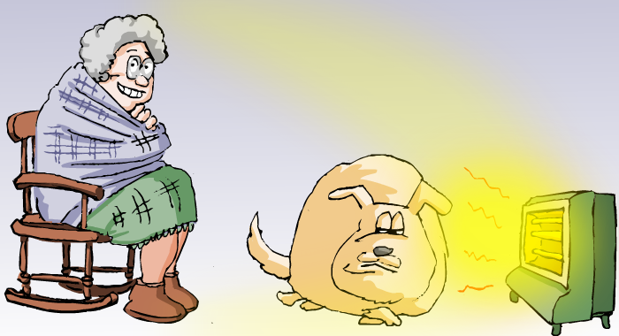
Granny’s model of climate 3 with blankets
Earth Sun
with clouds and ice and greenhouse gases
Temperature of the Earth approx. 16º C

Slide 10
Thanks to Mike Stuart
www.disphoria.co.uk
For the granny cartoons

Slide 11

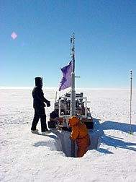
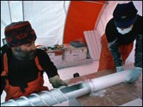
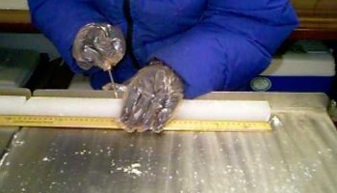
Secrets in the Ice
Snow accumulation lays down a record of environmental conditions
Compacted to ice – preserving the record
Drill ice core & date

Slide 12

CO2 levels over the last 1000 years
Gases are extracted from bubbles trapped in ice cores and provide record of past atmospheric concentrations

Slide 13
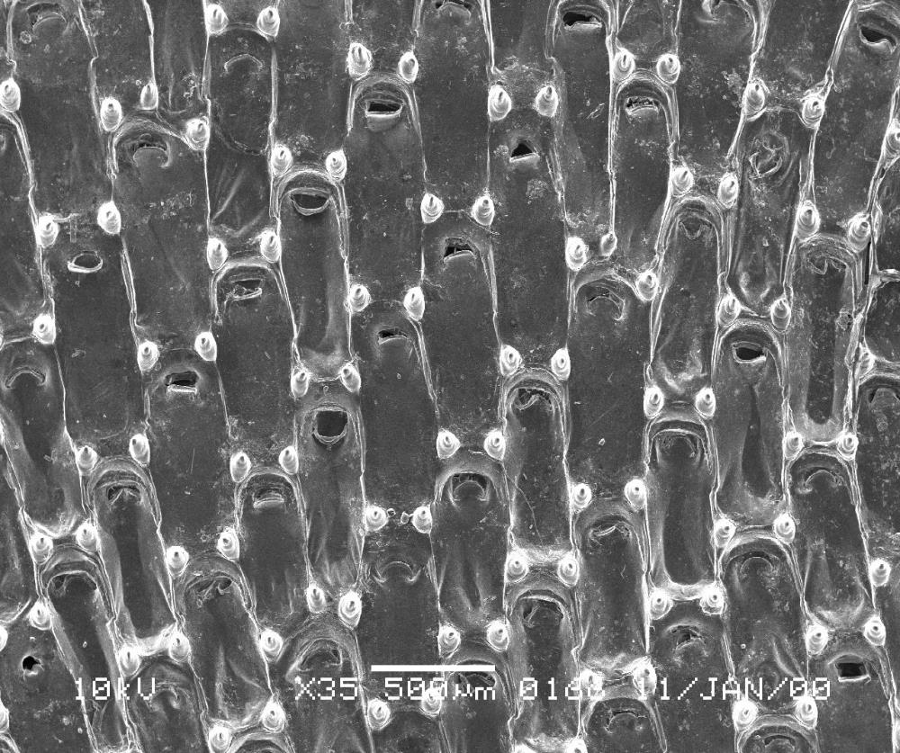
Frog chorus by Dr. Simon Hall

Slide 14
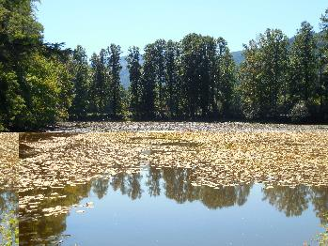
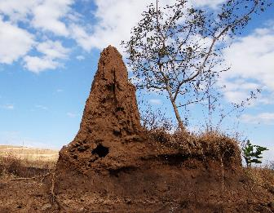
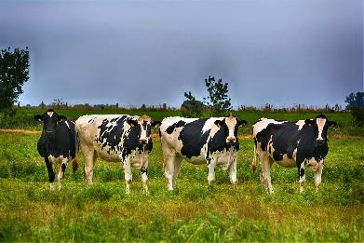
Methane (CH₄) and Nitrous Oxide (N₂O)

Slide 15
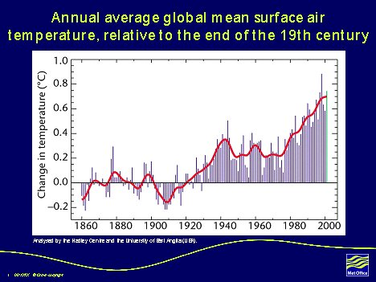
Increased global temperature

Slide 16
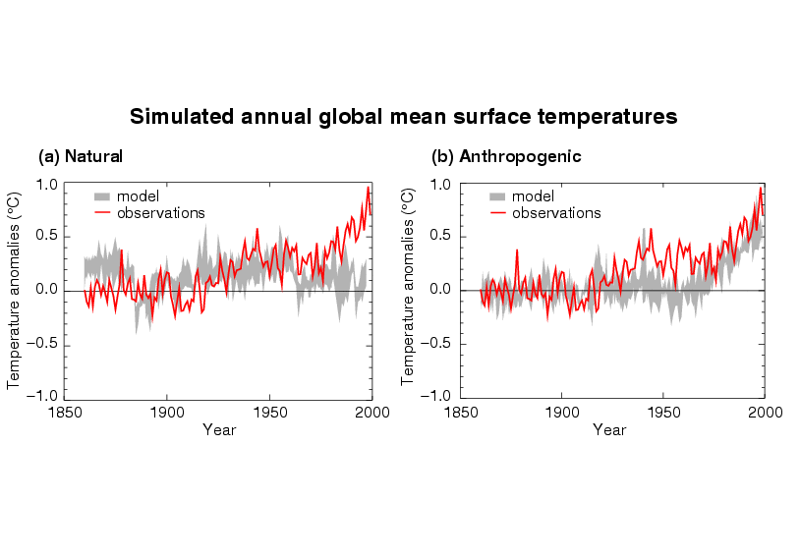
Model simulation of recent climate
Natural changes only
(solar, volcanic etc. variability)
Anthropogenic changes only
(human-induced changes)

Slide 17
Simulated global warming 1860-2000:
natural & anthropogenic (human) factors
1.0
Observed
simulated by model
0.5
Temperature rise º C
0.0
Hadley Centre
1850 1900 1950 2000

Slide 18
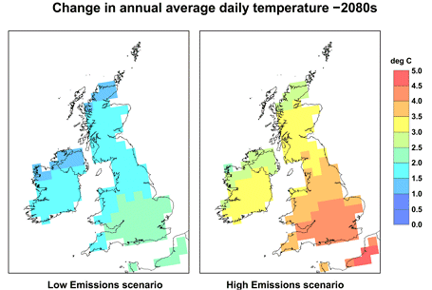
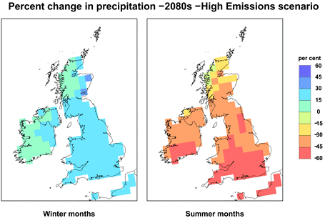
Impacts of Climate on the UK
UK will become warmer
High summer temperatures more frequent
Very cold winters increasingly rare
Winters will become wetter
Summers may become drier

Slide 19

Billion of Tons of Carbon Emitted per Year
14
14 GtC/y
Currently projected path
Seven “wedges”
Historical
emissions
7 GtC/y
7
Flat path
0
1955
2005
2055
2105
Notes:
Notes
• The stabilisation triangle is divided into seven wedges. Each ‘wedge’ represents an activity that reduces emissions to the atmosphere. Each activity starts at zero today and increases linearly until it accounts for 1 GtC/year of reduced carbon emissions in 50 years. Not filling the stabilisation wedge will put the 500ppm stabilisation out of reach.
• For example, in one simple model that begins with the stabilization triangle but looks beyond 2005, 500-ppm stabilization is achieved by 50 years of flat emissions, followed by a linear decline of about two-thirds in the following 50 years, and a very slow decline thereafter that matches the declining ocean sink. There will be an ocean sink of 2 GtC/y for centuries, as deep water finds its way to the surface. Having last seen the surface centuries before, it has a CO2 concentration in equilibrium with the old atmosphere, not the new one, and is thus able to pick up CO2 when it meets the new atmosphere.
• Another way to look at this is that stabilization (say at 500 ppm) is still a recipe for further acidification of the ocean for centuries. The goal chosen at Rio (stabilization) may not be the one we ultimately choose.
• To develop the revolutionary technologies required for such large emissions reductions in the second half of the century, enhanced research and development would have to begin immediately.

Slide 20
Billion of Tons of Carbon Emitted per Year
14
14 GtC/y
Currently projected path
Seven “wedges”
Historical
emissions
7 GtC/y
7
Flat path
0
1955
2005
2055
2105
Notes:
Notes
• The stabilisation triangle is divided into seven wedges. Each ‘wedge’ represents an activity that reduces emissions to the atmosphere. Each activity starts at zero today and increases linearly until it accounts for 1 GtC/year of reduced carbon emissions in 50 years. Not filling the stabilisation wedge will put the 500ppm stabilisation out of reach.
• For example, in one simple model that begins with the stabilization triangle but looks beyond 2005, 500-ppm stabilization is achieved by 50 years of flat emissions, followed by a linear decline of about two-thirds in the following 50 years, and a very slow decline thereafter that matches the declining ocean sink. There will be an ocean sink of 2 GtC/y for centuries, as deep water finds its way to the surface. Having last seen the surface centuries before, it has a CO2 concentration in equilibrium with the old atmosphere, not the new one, and is thus able to pick up CO2 when it meets the new atmosphere.
• Another way to look at this is that stabilization (say at 500 ppm) is still a recipe for further acidification of the ocean for centuries. The goal chosen at Rio (stabilization) may not be the one we ultimately choose.
• To develop the revolutionary technologies required for such large emissions reductions in the second half of the century, enhanced research and development would have to begin immediately.

Slide 21
What can we do?

Slide 22
Current Technology Options to Provide a Wedge
Improve fuel economy
Reduce reliance on cars
More efficient buildings
Improved power plant efficiency
Decarbonisation of electricity and fuels
Substitution of natural gas for coal
Carbon capture and storage
Nuclear fission
Wind electricity
Photovoltaic electricity
Biofuels
Notes:
Notes
• A wedge is a cumulative total of 25GtC of reduced emissions over the next 50 years.
• Some suggestions, using currently available technology are provided here, but the list is by no means exhaustive.
• Full details of all the assumptions made are given in the Science Paper¹ and the supporting on-line materials.
1. Pascala, S. and Socolow, R. "Stabilization Wedges: Solving the Climate Problem for the Next 50 Years with Current Technologies", Science, 13 August 2004, Vol. 305, No. 5686, pp 968-972

Slide 23
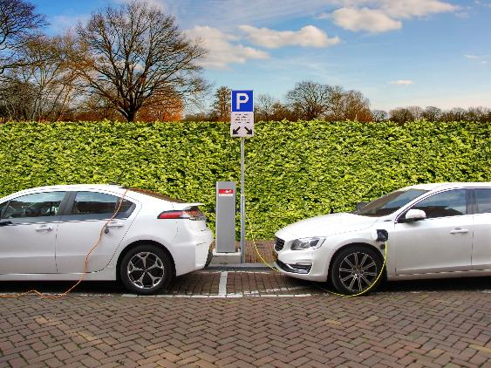
Improve Fuel Economy
  Increase fuel economy for 2 billion cars from 30 to 60 mpg.
  A typical car emits a ton of carbon into the air each year.
  If a fuel efficiency of 60 mpg was achieved, decarbonisation of the fuel would offer the potential of saving two wedges.
Double the fuel efficiency of the world’s cars or
halve the miles travelled.
Notes:
Notes
• US Energy Information Agency gives figures of 530 million cars in 1999. Growth rate is taken as 2.4% per year, giving 2 billion cars in 2054. A light-duty vehicle (“car”) consumes 330 gallons of gasoline per year if it goes 10,000 miles with a fuel economy of 30 mpg. Transport statistics from the UK Department for Transport
• The carbon content of a gallon of gasoline is about 2.4 kg (specific gravity = 0.74; 85% carbon by weight), leading to 3 kg of carbon emissions per gallon of gasoline when one adds about 25% carbon “overheads” incurred at production, at the refinery and further downstream. Thus a typical car emits around one ton of carbon into the air each year.
• Therefore, if fuel efficiency is doubled, using these baseline figures, there is the potential to produce one wedge.
• The figures are strongly dependent on the average fuel economy assumed. If it is actually 24mpg, then a wedge is achieved by raising fuel efficiency to 40mpg.
• Since decarbonization of the fuel is strenuous (whether hydrogen or biofuels), it should never happen that we put decarbonized fuel into 30 mpg cars. We would want to change the cars to get 60 mpg first, whereupon one would attribute one wedge to efficiency and one wedge to decarbonization of fuels.
For more information on Road Transport, see the ImpEE Resource "Road Transport".

Slide 24
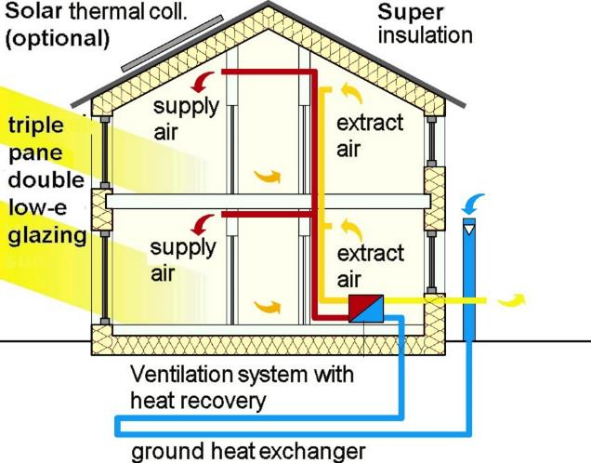
More Efficient Buildings
Need to cut the carbon emissions from buildings by 25% by 2055.
This can be achieved using known and established approaches to energy efficiency.
The largest savings are in space heating and cooling, water heating, lighting, and electric appliances.
Replacing all the world’s incandescent bulbs with compact fluorescent lights would provide 1/4 of one wedge.
Notes:
Notes
• Two of the most important uses of fuel, from the standpoint of carbon emissions, are heating of living spaces and heating of water, and both involve supplying heat at a temperature not very different from nearby “ambient” temperatures (the temperatures of nearby outside air or ground water, for example). Here we note that one strategy is to pursue passive and active solar energy management, the domain of solar architecture, to heat buildings in winter and to heat water year round. A full wedge is probably available from judicious combinations of solar design, careful construction, substantial insulation, and broad use of efficient heat pumps.
• The jobs of space heating and water heating rarely involve boosting the temperature, relative to ambient temperature, more than 50 degrees C. Thermodynamics identifies the combustion of fuels for such purposes as intrinsically inefficient¹.
For more information, see the ImpEE Resource on "Domestic Energy ".
1. Ford, K.W., et al., eds. 1975. "Efficient Use of Energy". New York: American Institute of Physics. Part I – A Physics Perspective.

Slide 25
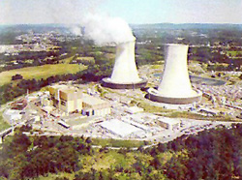
Decarbonisation of Electricity and Fuels:
Nuclear Fission
Add 700 GW (twice the current capacity).
Issues are nuclear proliferation, terrorism and waste.
Graphic courtesy of NRC
The rate of installation required for a wedge from electricity is equal to the global rate of nuclear expansion from 1975-1990.
Phasing out of nuclear electric power would create the need for another half wedge of emissions cuts.
Notes:
Notes
• Issues concerning nuclear power generation as outlined above are always worthy of discussion. Myths abound and public perception is a major issue providing value for consideration by engineers. Here is an issue where there are no ‘right answers’.
• The global pace of nuclear power construction from 1975 to 1990 would yield a wedge.

Slide 26
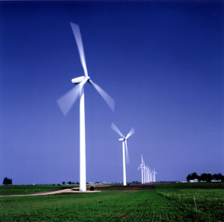
Decarbonisation of Electricity and Fuels:
Wind Energy
Installed wind capacity has been growing at about 30% per year for more than 10 years.
It is currently about 50 GWp.
A wedge of wind electricity would thus require 40 times today’s deployment.
The wind turbines would “occupy” about 30 million hectares (about 3% of the area of the United States), some on land and some offshore.
Because windmills are widely spaced, land with windmills can have multiple uses.
Photo courtesy of DOE
An electricity wedge would require a combined land area the size of Germany.
Notes:
Notes
• For both wind and PV, deployment can be measured in peak watts (Wp), a measure of the power output at the cut-off wind speed for wind and in direct sun normal to the surface for PV. A simple way to estimate intermittency is to match peak watts to baseload watts by dividing by three. (A typical capacity factor for wind or PV is about one quarter, as compared to somewhat more than three-quarters for a baseload plant).
• In 2055, we imagine a 30% capacity factor for PV and wind and a 90% capacity factor for baseload plants. Thus, a wedge is achieved by about 2000 GWp of peak wind or PV power displacing coal by 2055, or 4000 GWp displacing natural gas. The rate of deployment, for a linear ramp, is 40 GWp per year if coal is displaced and 80 GWp per year if natural gas is displaced. The current global deployment of PV is about 3 GWp.
• To estimate the spatial demands of future wind farms on land or in the sea, we use data for Denmark’s new 160 MW Horns Rev wind farm off the west coast of Jutland. This offshore wind farm has 80 turbines in an 8x10 rectangular array, each with 80m-diameter blades and 2 MWp output. The turbines are seven blade-diameters apart both in the prevailing wind direction and transverse to it. Thus, each of the inner 2-MWp turbines “occupies” 310,000 m2, and its power density is 6 Wp/m2, from the perspective of surface area required. A wedge in the form of 2000 GWp of wind-for-coal would then require 30 million hectares of surface. If all were on land, this would be between one and two percent of the world’s 1800 million hectares of land estimated to have winds of Class 4 and above. Thirty million hectares is also 3% of the land area of the United States. Land from which wind is harvested can be used for many other purposes, notably for crops or pasture.

Slide 27
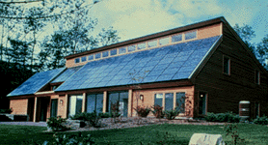
Decarbonisation of Electricity and Fuels:
Photovoltaic Electricity
The current global deployment of PV is about 3GWp.
The growth factor is around 30% per year.
To save 1GtC per year would require an increase in the deployment of PV by a factor of 700 by 2054 giving 2000 GWp.
This requires 2 million hectares assuming an output of 100Wp/m² for peak power or 2 to 3 m² per person.
Photo courtesy of DOE Photovoltaics Program
A wedge would require an array of photovoltaic panels with a combined area about 12 times that of metropolitan London.
Notes:
Notes
• For both wind and PV, deployment is measured in peak watts (Wp), a measure of the power output at the cut-off wind speed for wind and in direct sun normal to the surface for PV. A simple way to estimate intermittency is to match peak watts to baseload watts by dividing by three. (A typical capacity factor for wind or PV is about one quarter, as compared to somewhat more than three-quarters for a baseload plant.)
• For the past several years, installed global PV capacity, like wind capacity, has been growing at 30% per year (say, 0.7 GWp/y). Thus, a wedge of PV-for-coal requires increasing the deployment of PV by a factor of 700 by 2054, or increasing the current deployment rate by a factor of 60.
• The land demand for PV is inversely related to the conversion efficiency of sunlight. Here we choose 100 Wp/m² for the peak power output from PV divided by the area of the collection site,15 times greater than for wind. Then, a wedge in the form of 2000 GWp of PV-for-coal requires two million hectares, or 20,000 km², of site surface, either dedicated land or multiple-use surfaces such as the roofs and walls of buildings.

Slide 28
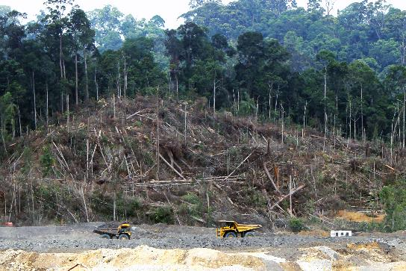
Natural Sinks:
Reduced Tropical Deforestation
Estimates of tropical forest lost per year in the 1990s vary from 6 to 12 million hectares.
This leads to a factor of two difference in emissions to the atmosphere: ~1 vs. ~2GtC/y.
At least half a wedge could be obtained by eliminating deforestation.
Another half could be created by reforesting 250 million hectares in the tropics or 400 million in the temperate zone.
One wedge would require new forests over an area the size of the continental U.S.
Notes:
Notes
• For both wind and PV, deployment is measured in peak watts (Wp), a measure of the power output at the cut-off wind speed for wind and in direct sun normal to the surface for PV. A simple way to estimate intermittency is to match peak watts to baseload watts by dividing by three. (A typical capacity factor for wind or PV is about one quarter, as compared to somewhat more than three-quarters for a baseload plant.)
• For the past several years, installed global PV capacity, like wind capacity, has been growing at 30% per year (say, 0.7 GWp/y). Thus, a wedge of PV-for-coal requires increasing the deployment of PV by a factor of 700 by 2054, or increasing the current deployment rate by a factor of 60.
• The land demand for PV is inversely related to the conversion efficiency of sunlight. Here we choose 100 Wp/m² for the peak power output from PV divided by the area of the collection site,15 times greater than for wind. Then, a wedge in the form of 2000 GWp of PV-for-coal requires two million hectares, or 20,000 km², of site surface, either dedicated land or multiple-use surfaces such as the roofs and walls of buildings.

