Slide 1

Prof. Dudley E. Shallcross ACRG & PSTT
Tim G. Harrison Bristol ChemLabS
Atmospheric Chemistry Research Group, School of Chemistry, University of Bristol
Primary Science Teaching Trust
An Overview of the Atmosphere

Slide 2

Contents
The Atmosphere
The Ozone Layer
The Ozone Hole
Air Pollution
Slides 3-7
Slides 8-12
Slides 13-31
Slides 32-36

Slide 3

The Atmosphere

Slide 4
3 most abundant gases in each planetary atmosphere
Jupiter H2 (93%) He (7%) CH4 (0.3 %)
Saturn H2 (96%) He (3%) CH4 (0.45 %)
Uranus H2 (82%) He (15%) CH4 (2.3 %)
Neptune H2 (80%) He (19%) CH4 (1-2 %)
Venus CO2 (96%) N2 (3.5%) SO2 (0.015 %)
Mars CO2 (95%) N2 (2.7%) Ar (1.6 %)
Earth N2 (78%) O2 (21%) Ar (0.93 %)

Slide 5
Nitrogen, N2
N≡N
78% of the atmosphere inert
Gas at 25 ^{O}C, liquid at – 196 ^{O}C
Inert but still essential

Slide 6
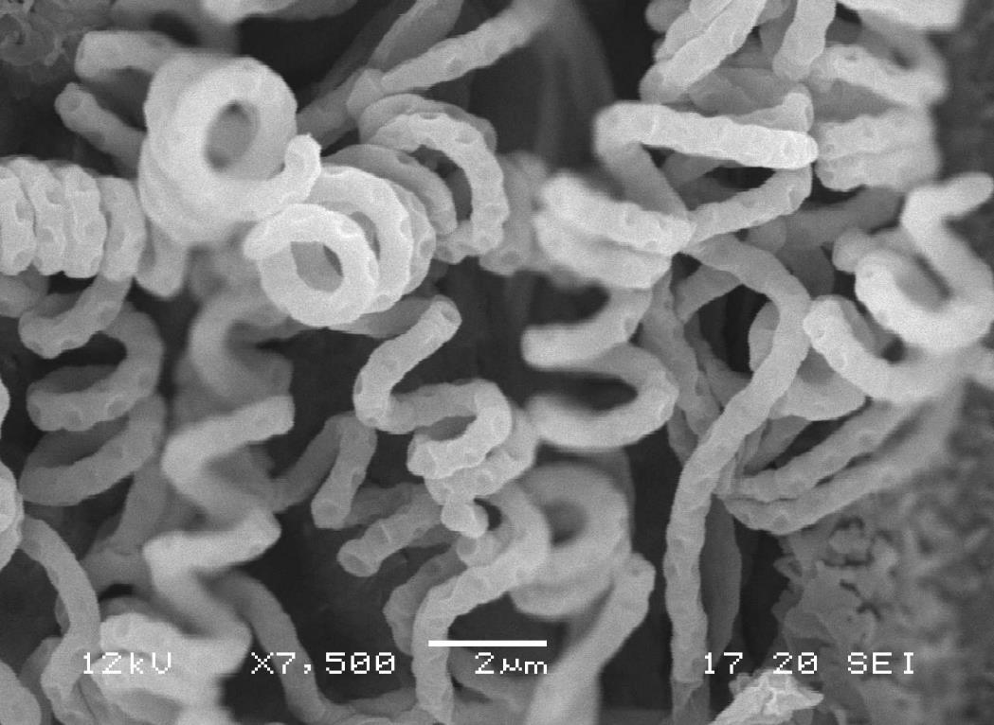
Bacterial scrapheap challenge
by Dr. Hazel Mottram

Slide 7
Oxygen, O2
O=O
21% of the atmosphere
Gas at 25 ^{O}C, liquid at -183 ^{O}C
Plants (not just trees) produce oxygen.
Photosynthesis is the main source of O2
6CO₂ + 6H₂O + sunlight → C₆H₁₂O₆ + 6O₂
Carbon dioxide + water + sunlight → sugar + oxygen

Slide 8
The Ozone Layer
(Stratosphere 10-50 km)

Slide 9
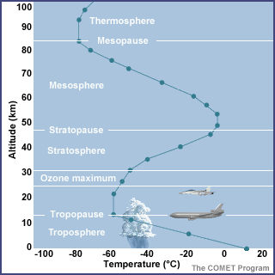

Slide 10
The Chapman Mechanism for ozone production and removal
O
O
O
O
O
O
O
O
O
O

Slide 11
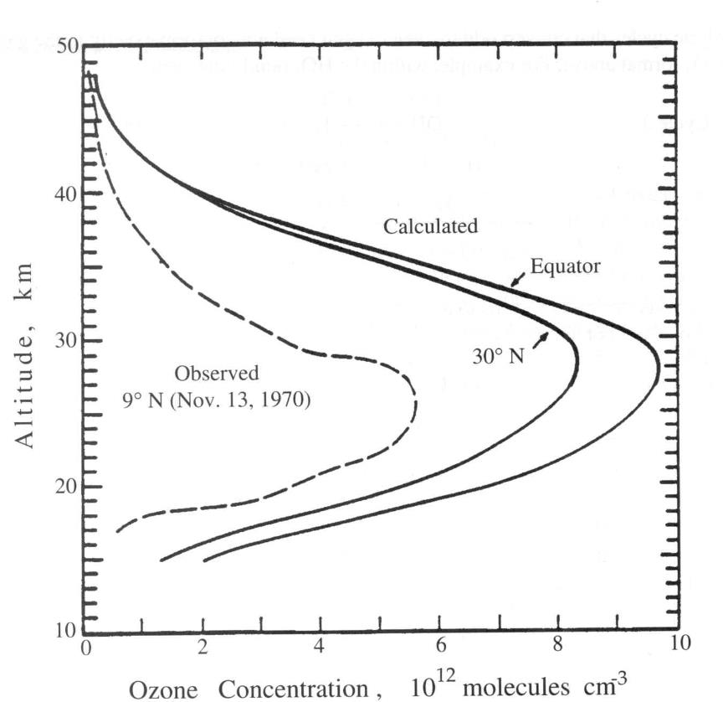
Until 1964 the Chapman reactions were thought to be the principal processes governing the ozone balance in the stratosphere. However, measurements indicated that the actual concentration of ozone is smaller than that predicted by about a factor of two to four.
Predictions of ozone concentrations by the Chapman mechanism compared with observations at Panama, 1970.

Slide 12

Catalytic Ozone Destruction
For a chemical to significantly affect the overall concentration of ozone it either must be present in great abundance or must be involved in a catalytic cycle. Breakthroughs in the 1970’s identified a number of NATURAL catalytic processes that all have the form:
X . + O3 → XO . + O2
XO . + O . → X . + O2
net : O3 + O . → 2O2
Where X = H, OH, NO, Cl or Br.

Slide 13
The Ozone Hole
Over 30 years since the landmark paper
Farman et al. Nature 1985

Slide 14
CFCs
Chlorofluorocarbons (CFCs) were excellent chemicals for refrigeration and propellants and were believed to be inert (unreactive). However, once released into the atmosphere they would be transported very slowly up to around 40 km in altitude and then experience high enough energy photons (hv) from the Sun to break their C-Cl bonds:
CFCl3 + hv → CFCl2 + Cl
CF2Cl2 + hv → CF2Cl + Cl

Slide 15
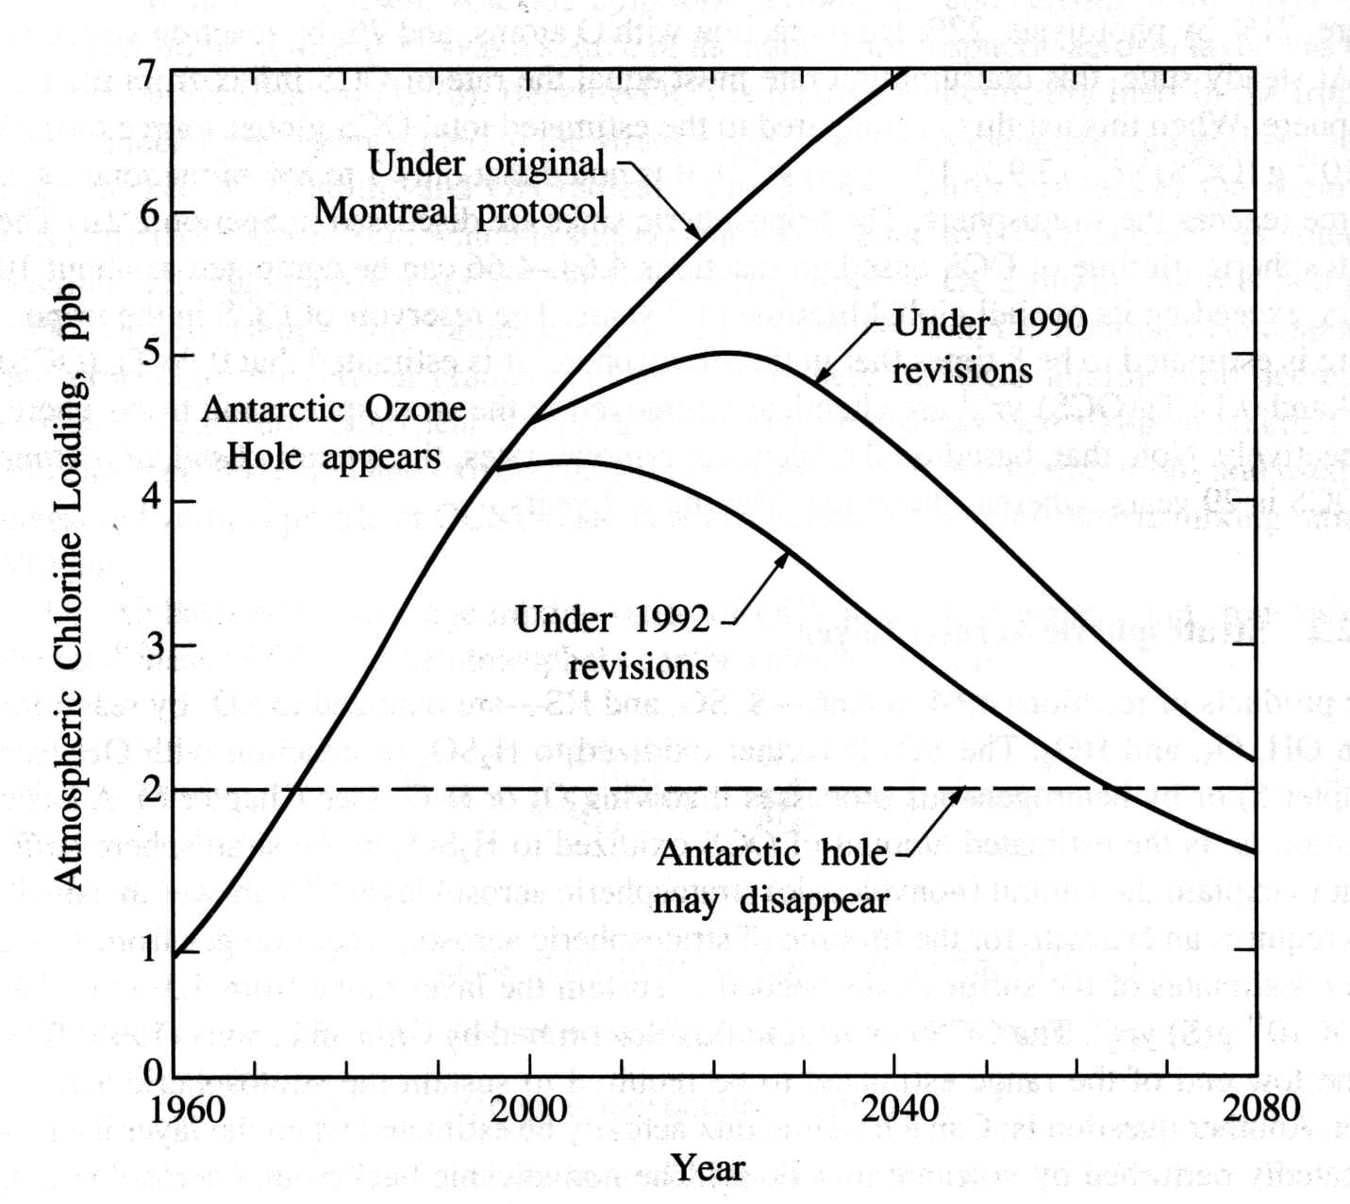

Slide 16
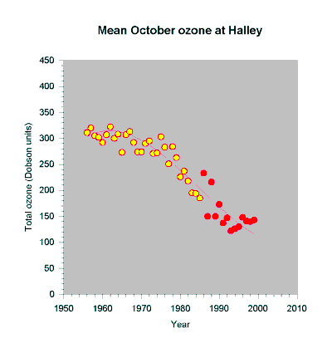
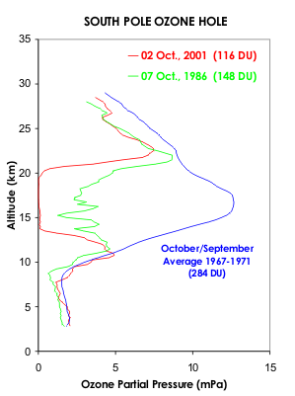
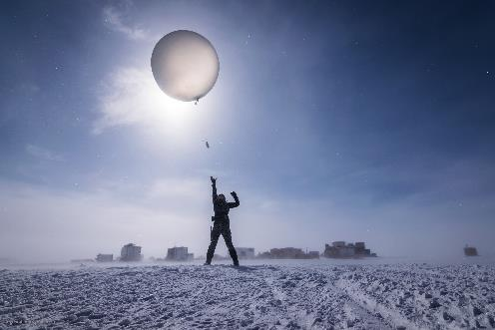
Ozone observations
Stratospheric ozone loss was first measured by British scientists in Antarctica - dramatic fall after 1975 due to use of man-made chemicals called ‘halocarbons’ (e.g. CFCs)
Mid-latitude and Arctic ozone depletion also observed
Photo from NSF: August Allen, Polar Field Services

Slide 17
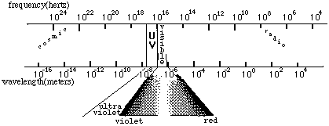
Excessive UV radiation has a number of damaging effects:
Skin cancer
Eye cataracts
Damage to the immune system
Damage to plants, including phytoplankton that live in the oceans
Damages building materials (photo-oxidation)
As a rule of thumb a 1% decrease on ozone leads to a 2% increase in UV penetration.

Slide 18
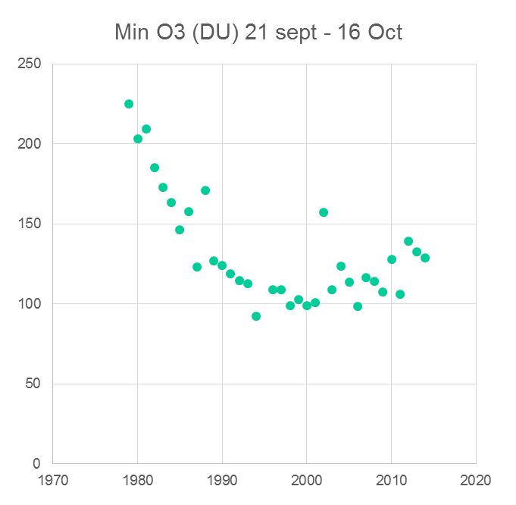
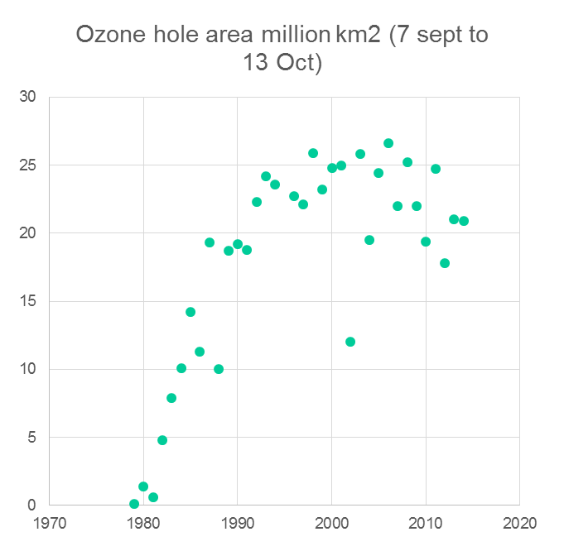
Historic data on (south) polar ozone
Area of the hole
Ozone minimum

Slide 19
CCl₃F Lifetime ~ 45 years
CCl2CF2 Lifetime ~ 100 years

Slide 20
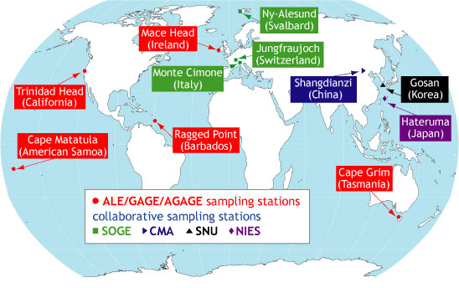
NASA AGAGE Network

Slide 21
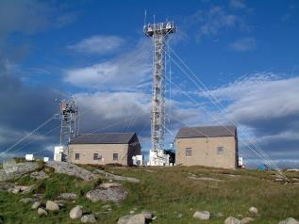
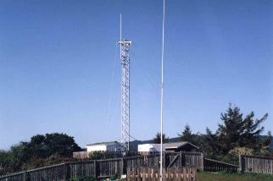
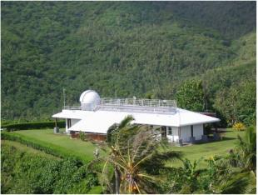
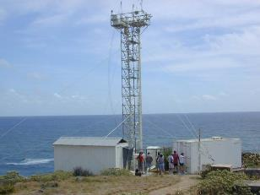

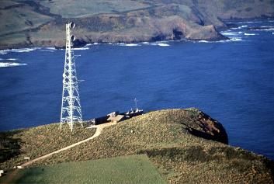

Global AGAGE GHG and ODP measurement network
Mace Head, Ireland
Trinidad Head, California
Cape Matatula, Samoa
Ragged Point, Barbados
Cape Grim, Tasmania
Notes:
Mace Head is not solely a UK DECC Network station, it is a GAW global station and one of AGAGEs five primary stations
Many of the advances in measurement capabilities, calibration, intercomparison stem from the association with AGAGE.

Slide 22
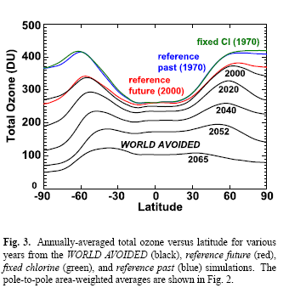
What might have happened if we did nothing about CFCs?
Newman et al. Atm. Chem. Phys., 9, 2113 (2009)

Slide 24
Air Pollution
10 km
The Tropopause
The Boundary Layer
1 km
VOCs
NO, NO2, SO2 VOC
?
0 km
Compounds of both biogenic and anthropogenic origin

Slide 25
Pollutant removal dominated by the OH radical
O3 + sunlight → ●O* + O2 [wavelength λ < ~ 330 nm]
●O* + H2O → ●OH + ●OH
●OH + R-H → ●R + H2O

Slide 26
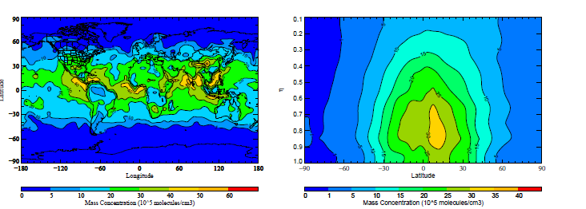
Hydroxy free radical (OH) surface and altitude distribution

Slide 27
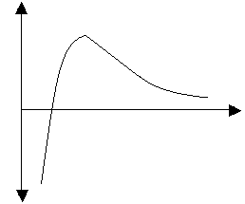
Ozone Chemistry- low NO_{x} environment
O₃ + hυ → O (¹D) + O₂ (wavelength, λ ≤ ~ 330 nm)
O (¹D) + M → O (³P) + M
O (¹D) + H₂O → 2 OH
CO + OH → CO₂ + H
H + O₂ + M → HO₂ + M
HO₂ + O₃ → OH + 2O₂
Net: CO + O₃→ CO₂ + O₂
Δ[O3]
[NOx]
Notes:
27

Slide 28
Ozone Chemistry- higher NO_{x} environment
  NO competes with O₃ for reaction with HO₂
NO + HO₂ → NO₂ + OH
NO₂ + hυ → NO + O(³P)
O(³P) + O₂ + M → O₃ + M
Net: CO + 2O₂ → CO₂ + O₃
Δ[O3]
[NOx]
Notes:
28

Slide 29
Air measurements in Bristol of NO
Data from 21st January 2001: here, combustion is the main source of NO.

Slide 30
Photochemical smog
NO2 + sunlight → O * + NO λ < ~ 400 nm
O* + O2 + M → O3 + M

Slide 31
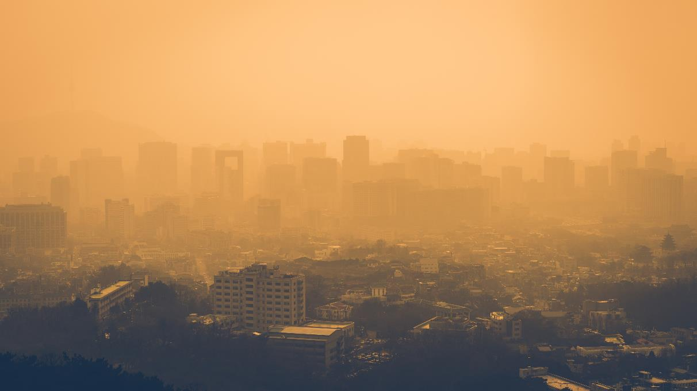
Photochemical Smog

Slide 32
2 minute challenge
Air Pollution in the U.K.
Which day of the year is the cleanest? Which day of the year is the most polluted?

Slide 33
Particulates (‘dust’), PM_{2.5} and PM₁₀
PM_{2.5} (airborne particles with a diameter less than 2.5 µm)
PM₁₀ (airborne particles with a diameter less than 10 µm)
µm = 1000th of a millimetre.
A human hair is 18-80 µm.

Slide 34
https://uk-air.defra.gov.uk/
Marylebone Road in London

Slide 35
Bonfire night

Slide 36
Long term carbon dioxide (CO2) measurements
CO2 measurements have been made at Mauna Loa (Hawaii) for many years and show that CO2 has been rising steadily for some time.

