Slide 1
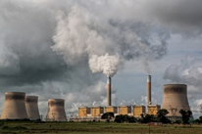
Is there anything we can do?
Prof. Dudley Shallcross PSTT & University of Bristol
Tim Harrison, Bristol ChemLabS, University of Bristol, UK
Dr. Alison Trew, Primary Science Teaching Trust (PSTT)
Please note that the content of this PowerPoint is ©PSTT 2020 but may be freely reproduced by teachers in schools for educational purposes.
Notes:
PPT5.
This PowerPoint could be used as a classroom presentation and is suitable for primary children (ages 9-11).
Note: To investigate air pollution more fully with children, the following PowerPoints (which can be used as classroom presentations) are available from the Primary Science Teaching Trust (PSTT) Free Teaching Resource - Air Pollution Research:
PPT 1A. What is air?
PPT1B. What is pollution?
PPT 2. What does BIG data look like?
PPT 3. What do levels of air pollutants look like across the UK?
PPT4. What happened to levels of air pollutants during national lockdown in 2020?
PPT5. What can we do?
https://pstt.org.uk/resources/curriculum-materials/citizen-science-air-pollution

Slide 2
Overview for Teachers
This PowerPoint looks at the big picture in terms of what can be done by all of us, and governments, to reduce the quantity of green house gases that are put into the atmosphere.
This will require political, social and economic will power to enact.
Aim/learning objectives for children:
To understand that human activity affects the levels of carbon released into the atmosphere.
To understand that changes in human behaviour could reduce future levels of carbon released into the atmosphere.
To be able to describe some current technologies which might reduced carbon emission levels.
The Climate Stabilization Wedges is an approach produced by Princeton University researchers Stephen Pacala and Robert H. Socolow, looking at Climate change mitigation scenarios.
Further reading:
Wikipedia has a good article about this: https://en.wikipedia.org/wiki/Climate_stabilization_wedge
Notes:
This PowerPoint presentation is divide into 3 sections:
The Earth’s gas problem
A graphical model to explain levels of carbon released since 1955 and predicted emissions
Technologies which might reduce carbon release

Slide 3



Sun
The Earth’s gas problem
Light energy
The atmosphere
Carbon dioxide
Methane
Heat energy
Water vapour
Earth
Greenhouses gases such as water vapour, carbon dioxide and methane are vital to life on Earth. So what’s the problem?
Watch this film clip from NASA to find out more.
Notes:
The growing concentrations of certain gases in the Earth’s atmosphere (such as carbon dioxide) are causing the temperature of the Earth to rise. Why?
This NASA film clip is < 2 minutes and is suitable for upper primary children.
Light energy (yellow arrows) emitted by the Sun warms the Earth’s surface.
The Earth’s surface reflects the energy as heat (red arrows) and warms the atmosphere around the Earth.
Some of the heat is captured by greenhouse gas molecules such as water vapour and carbon dioxide and methane and does not escape.
It’s a bit like having a blanket of molecules around the Earth to keep it warm.
This is good because it stops the Earth freezing.
It’s been like this for thousands of years.
When we burn fossil fuels (coal, oil and natural gas), carbon is released.
This carbon joins with oxygen to make more carbon dioxide that goes into the atmosphere.
The more carbon dioxide in the atmosphere, the more heat that is trapped in the atmosphere and the warmer it gets.
And the warmer it gets on Earth, the more the climate changes.
And the ice will melt - the ocean will rise.
And growing food crops could be difficult – there could be food shortages.

Slide 4

What has happened to carbon dioxide levels in the last century?
14
How much carbon dioxide was produced in 1955?
How much carbon dioxide was produced in 2005?
Why do you think the levels of carbon dioxide have increased from 1955 - 2005?
How much carbon dioxide do you think will be produced in 2055 and 2105?
Billion Tonnes of Carbon Released per Year
7
0
1955
2005
2055
2105
Year
Notes:
What has happened to carbon dioxide levels in the last century?
This graph shows how much carbon dioxide was emitted each year from 1955 to 2005.
Ask children to predict what might happen after 2005 – they could draw their own graph to show what they think has happened between 2005 and now, and what will happen in the future.
Approx. answers:
1955 = 1 billion tonnes/yr
2005 = 7 billion tonnes/yr
2055 = 14 billion tonnes/yr?
2105 = 21 billion tonnes/yr?
Reasons for increased emissions:
More vehicles across the world – burning fossil fuels
More power stations across the world – burning fossil fuels
More industries – burning fossil fuels

Slide 5
What might happen to carbon dioxide levels in the future?
14
Currently predicted path
Billion Tonnes of Carbon Released per Year
Historical
emissions
7
0
1955
2005
2055
2105
Year
Notes:
What might happen to carbon dioxide levels in the future?
In 2005, using the real data from1995 to 2005, two scientists predicted the rise of carbon dioxide emissions over the next 100 years.
If we take no action, by 2055, it is predicted that global annual carbon emissions will double to 14 gigatonnes of carbon (GtC).
The prediction is based on:
an expectation of increased power use (produced by burning fossil fuels) per person.
an expectation of worldwide population increase.
i.e. more people using more power each.
Note:
1 billion tonnes = 1,000,000,000 tonnes = 10⁹ tonnes = 1 Gigatonne (Gt)
A gigatonne is often used when discussing human carbon dioxide emissions.
This is roughly the mass of all land mammals (other than humans) in the world.
It's also roughly twice the mass of all of the people in the world.

Slide 6
Can we stop increasing the amount of carbon released?
14
Currently predicted path
What does the yellow triangle represent?
Billion Tonnes of Carbon Released per Year
Historical
emissions
7
Flat path
0
1955
2005
2055
2105
Year
Notes:
Can we stop increasing the amount of carbon released every year?
Scientists (Pacala and Socolow) suggested that we try to keep carbon emissions at the levels of 2005.
This means aiming for a flat path from 2005 and keeping carbon emission levels at 7 GtC per year.
What does the yellow triangle on the graph represent?
The yellow triangle is the difference between the predicted carbon release and the ‘hoped for’ carbon release between 2005 and 2055.
In other words, it is the carbon that we do not want to produce between 2005 and 2055.

Slide 7
Can we follow the flat path?
14
14 GtC/y
Currently predicted path
7 wedges
Billion Tonnes of Carbon Emitted per Year
Historical
emissions
7 GtC/y
7
Flat path
0
1955
2005
2055
2105
Year
Notes:
Can we follow the flat path?
There is no one technology or action we can take to reduce carbon dioxide emissions and to remove this triangle of carbon.
So, the scientists introduced the idea of stabilisation wedges and cut the carbon triangle into 7 wedges.
One stabilisation wedge represents an activity or technology that will reduce carbon emissions to the atmosphere (e.g. using wind turbines to generate electricity).
A combination of seven wedges (several activities/new technologies) could keep annual emissions at 7 GtC/yr in 2055.
1 gigatonne of carbon = 1 billion tonnes of carbon.
Ask the children:
How many G tonnes of carbon must we avoid producing between 2005 and 2055?
7 GtC/year
How many Gt of carbon in each wedge?
1 Gt carbon/year by 2055
What do you think we could do to reduce carbon release?
Note – lots of ideas on the next slide.

Slide 8
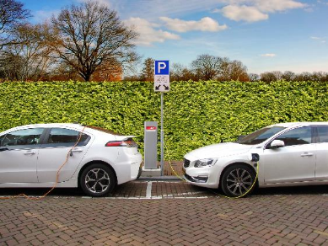
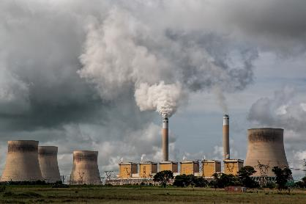
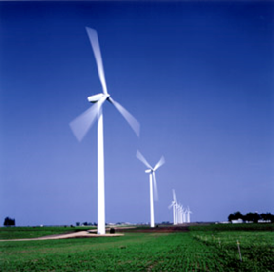
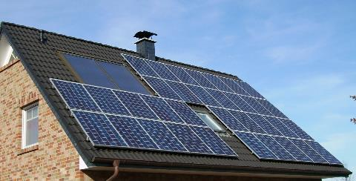
What can we do?
Improve fuel economy
Reduce reliance on cars
More efficient buildings
Nuclear fission
Wind electricity
Photovoltaic electricity
Biofuels
Decarbonisation of Electricity and Fuels
Substitution of Natural gas for coal
Carbon capture and storage
Improved power plant efficiency
Notes:
What can we do?
Some suggestions, using currently available technology are provided here, but the list is by no means exhaustive.
Ask the children: Which of these technologies have you heard of?
Perhaps a bar chart of awareness could be drawn up.
Not all these technologies are easy to understand, so some are omitted from further explanation in this PPT.
Later slides discuss:
Cars
Buildings
Nuclear power
Wind power
Solar power

Slide 9
Where are we now?
14
14 GtC/y
Currently predicted path
7 wedges
Billion Tonnes of Carbon Emitted per Year
Historical
emissions
7 GtC/y
7
Flat path
0
1955
2005
2055
2105
Year
Notes:
Where are we now?
Currently, because of actions we have already taken, we are below the currently predicted path – this is good.
However, levels are much higher than if we had managed to stay on the flat path.
We now have a new path to travel (green arrow) if we are to make the target of 7 GtC/y by 2055.
Beyond 2055 it would be good to reduce atmospheric carbon even more.
What could happen after 2055?
If new technologies have prevented carbon levels increasing and levels are kept at 7GtC/year (the 2005 level), then carbon levels might then start to decrease after 2055..
To develop the revolutionary technologies required for such large emissions reductions in the second half of the century, enhanced research and development would have to begin immediately.

Slide 10
What happens after 2055?
14
14 GtC/y
Currently projected path
7 wedges
Billion Tonnes of Carbon Emitted per Year
Historical
emissions
7 GtC/y
7
Flat path
0
1955
2005
2055
2105
Year
Notes:
What could happen after 2055?
After 50 years, if new technologies have prevented carbon levels increasing and levels are kept at 7GtC/year (the 2005 level), carbon levels might then start to decrease in the next 50 years.
In one simple model that begins with the stabilization triangle but looks beyond 2005, 500-ppm stabilization is achieved by 50 years of flat emissions, followed by a linear decline of about two-thirds in the following 50 years, and a very slow decline thereafter that matches the declining ocean sink. There will be an ocean sink of 2 GtC/y for centuries, as deep water finds its way to the surface. Having last seen the surface centuries before, it has a CO2 concentration in equilibrium with the old atmosphere, not the new one, and is thus able to pick up CO2 when it meets the new atmosphere.
• Another way to look at this is that stabilization (say at 500 ppm) is still a recipe for further acidification of the ocean for centuries. The goal chosen at Rio (stabilization) may not be the one we ultimately choose.
• To develop the revolutionary technologies required for such large emissions reductions in the second half of the century, enhanced research and development would have to begin immediately.

Slide 11
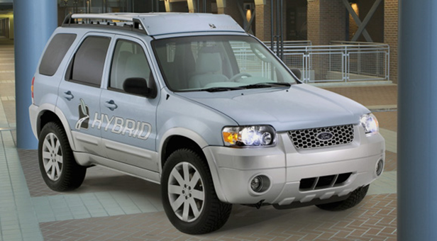


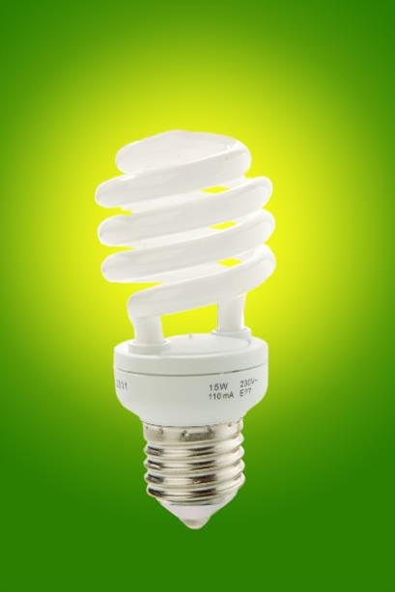
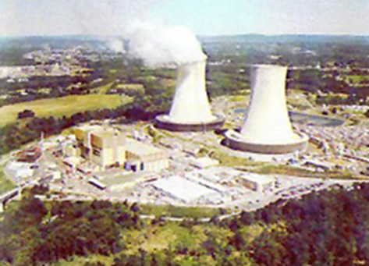
Let’s find out about…
Fuel
Solar panels
Photo courtesy of DOE
Graphic courtesy of NRC
Wind turbines
Saving electricity
Nuclear power
Notes:
The following slides will explore these technologies which the children may be aware of.

Slide 12

1. Improve fuel economy in vehicles / drive less
  A typical car emits 1 tonne of carbon into the air each year.
  And there are >1.4 billion cars in the world now (probably 2 billion by 2055)!
  To save 2 wedges of carbon:
  Double the fuel economy of all cars from 30 to 60 miles per gallon
  Or
  Half the miles travelled
Notes:
Comments and questions for children to consider:
Reduction in cars in general will help.
Is it possible to reduce the number of cars on the roads? How?
Does it depend whether you live in a city or countryside?
Could we all use electric cars? Is this the answer? What are the problems?
How is the electricity made in electric cars?
Perhaps use the internet to look up fuel economy of 5 or 6 different petrol/diesel/electric cars.

Slide 13

2. More energy efficient buildings
We need to cut the carbon emissions from buildings by 25% by 2055.
This can be achieved using known and established approaches to energy efficiency.
The largest savings are in space heating and cooling, water heating, lighting, and electric appliances.
  To save 1/4 of one wedge of carbon:
  Replace all the world’s incandescent bulbs with compact fluorescent lights.
Notes:
Comments and questions for children:
What is an incandescent bulb?
What are their replacements?
What would be the effect of leaving an energy saving bulb on when it is not needed?
How many light bulbs and fluorescent strips are in your school? Are people reminded to tun them off when not in use?

Slide 14

3. Nuclear power
As of April 2020, there are 440 working nuclear power stations in the world making electricity for commercial use.
There are 55 more reactors under construction and 109 reactors planned.
Graphic courtesy of NRC
  To save 1 wedge of carbon:
  Many more nuclear power stations need to be built.
  If countries already using nuclear power stopped using nuclear electric power, ½ a wedge would have to be cut by a different method.
Notes:
Comments & questions for children:
Decarbonisation of electricity – this means making electricity without burning fossil fuels such as coal crude oil and natural gas.
Fossil fuel burning leads to release of carbon compounds, hence decarbonisation.
What other ways are there to make electricity without burning coal or oil fossil fuels?
Nuclear power stations produce heat energy from radioactive atoms (such as uranium) rather than burning coal, oil or gas.
What are the advantages of nuclear power stations over coal power stations?
Nuclear power stations do not emit gases such carbon dioxide.
What are the disadvantages?
Issues are nuclear proliferation, terrorism and waste.
Notes for teachers:
Issues concerning nuclear power generation as outlined above are always worthy of discussion. Myths abound and public perception is a major issue providing value for consideration by engineers. Here is an issue where there are no right answers.
Some people believe nuclear power is a vital way to tackle climate change. Others insist it is dirty, dangerous, uneconomic, and unnecessary.
The global pace of nuclear power construction from 1975 to 1990 would yield a wedge.

Slide 15
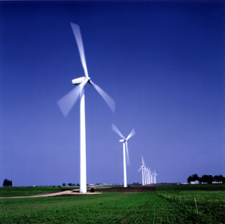
4. Wind energy
More wind turbines are contracted every year.
We would need 40 times the number we have now to save a wedge of carbon.
These would cover an area of 1.5 times the size of the UK.
Photo courtesy of DOE
  To save 1 wedge of carbon:
  A land area 1.5 x the size of the UK would have to be covered in wind turbines.
Notes:
Comments & questions for children:
Where is your nearest wind turbine?
How often do you see it working?
What are the advantages? Because windmills are widely spaced, land with windmills can have multiple uses. No carbon is released.
What are the disadvantages? Some people don’t like the look of them when there are a lot together. Problems for birds.
Would you like to see more of them? Why/why not?
Notes for teachers:
Because windmills are widely spaced, land with windmills can have multiple uses.

Slide 16

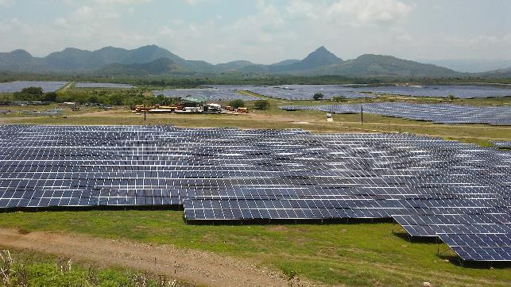
5. Solar Power
Solar panels can be put on roofs or in larger numbers in fields.
  To save 1 wedge of carbon:
  A land area the size of Wales would have to be covered in photovoltaic panels.
Notes:
Comments & questions for children
Where is your nearest solar panel?
What are the advantages? No carbon is released.
What are the disadvantages? Some people don’t like the look of them when there are a lot together. Expensive to install.
Is it acceptable to use farmland which would otherwise be used to grow food for humans or livestock?

Slide 17
What can I do to help reduce atmospheric pollution?
Do I turn lights off when they are not wanted?
Do I travel by car or bus when I could walk?
Do I buy goods with lots of wrapping that costs fuel to transport and fuel to make?
Do I turn off water taps (hot or cold) when not needed?
Do I turn up the heating instead of putting on an extra layer of clothes?
Do I always buy new instead of reusing old?
Do I shut doors to avoid drafts?
Could I plant some trees?
Do I recycle effectively?
Can I tell someone outside school what I know about reducing carbon emissions?
If each person makes a little difference, the 7,500,000,000 (7.5 billion) people in the world would have a big effect!
Notes:
Comments & Questions for children:
Will your children each pledge to do 3 of these actions each?
Can you make a poster to encourage others to adopt one of these commitments?

Slide 18
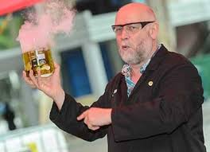
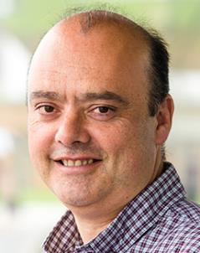
PowerPoint created by
Tim Harrison (Bristol ChemLabs),
Professor Dudley Shallcross (University of Bristol),
& Dr. Alison Trew (Primary Science Teaching Trust)

