Slide 1
Using the UK Air Data Archive for Your Own Research:
Step-by-step Guidance on Accessing Data
Tim Harrison^{1,2}, Prof. Dudley Shallcross^{2,3} and Dr. Alison Trew³
¹Bristol ChemLabS, University of Bristol
²Atmospheric Chemistry Research Group, University of Bristol
³Primary Science Teaching Trust (PSTT)
Please note that the content of this PowerPoint is ©PSTT 2020 but may be freely reproduced by teachers in schools for educational purposes.

Slide 2
Introduction
The data archive is enormous.
That said, NOT all the monitoring sites will monitor:
all the pollutants
during all the periods of interest
the frequency of monitoring desired
in the geographical (British Isles) places you want
in the environments needed
Your first task will be to look to see what data are available.

Slide 3
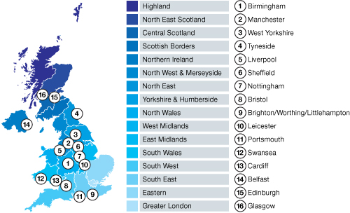
Sites and Zones

Slide 4
Some comments about the UK Air Data site
It contains a vast amount of information.
The buttons that you need to push are not always evident on the bit of the page you are looking at.
You may need to scroll to the top again further down that the page you are looking at.
As with most things in life, the more time/effort you put in the more you get out.
This document will help get you started, after which you will be able to delve a little deeper.

Slide 5
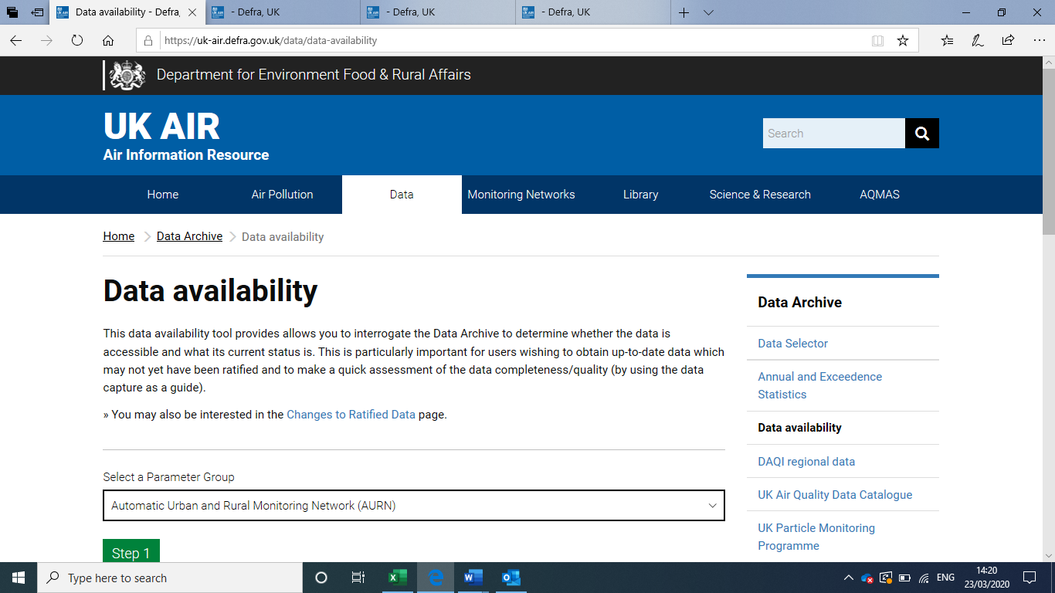
Getting started
Go to https://uk-air.defra.gov.uk/data/
Beneath Data Archive (right hand side menu) select Data Availability (3rd item down).
For this example, we will search for information about the PM₁₀ particulate levels in Bristol.

Slide 6
The dropdown box allows choice of data. You will need to play around with this to see availability of pollutant data.
For this example we will choose the Automatic Urban and Rural Monitoring Network (AURN)’. Click the green Step 1 box to proceed.

Slide 7
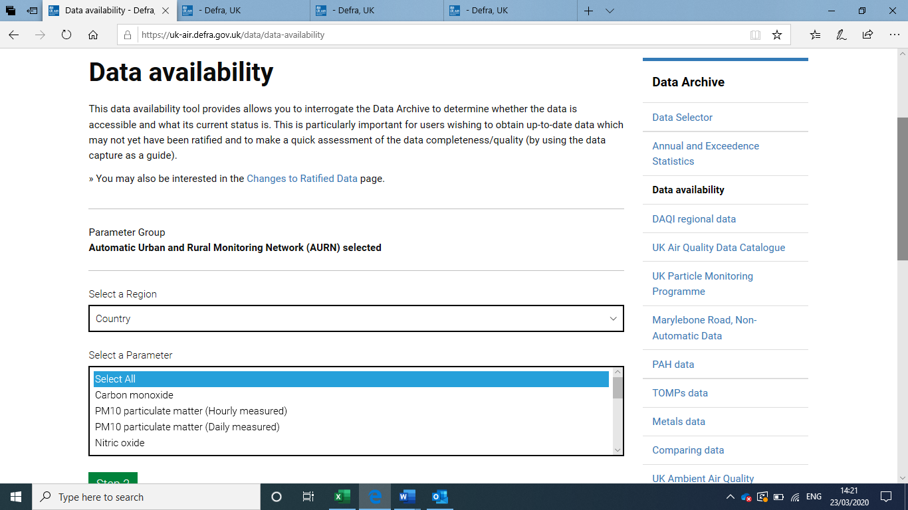
The Select a Region allows you to home in on the place you want via several geographical area types including country, region or local authority.
The Select a Parameter gives you a choice of pollutant.
We are looking for PM₁₀.
Make a choice an click the green Step 2 button.

Slide 8
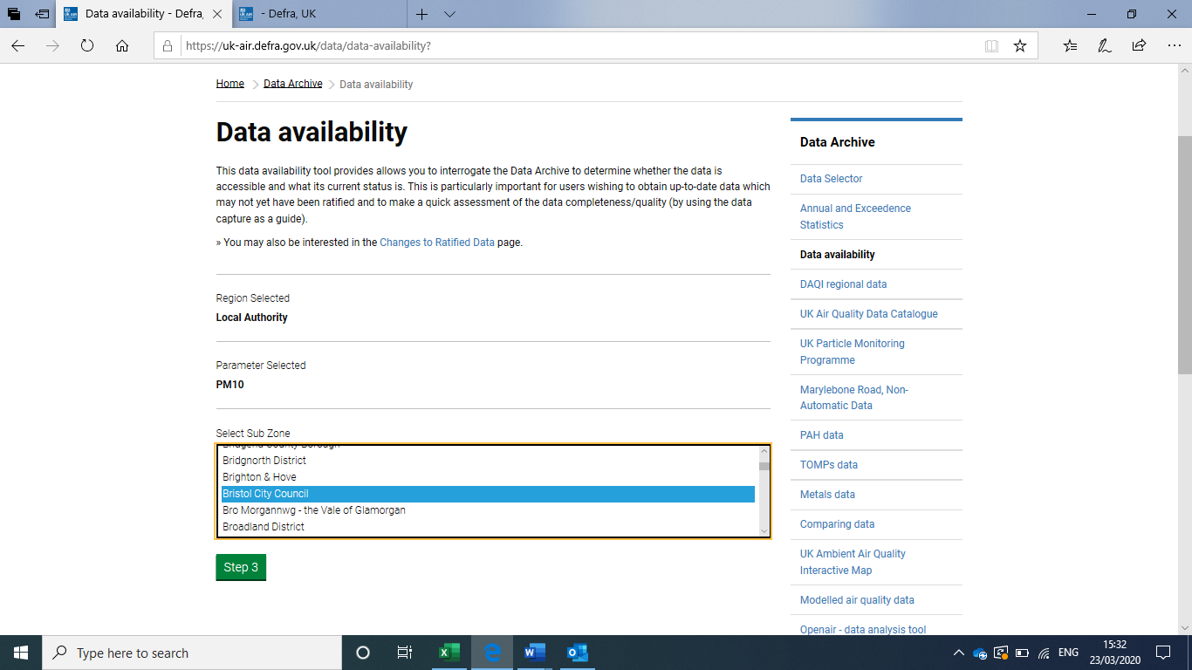
Now you can choose which geographical area you are interested in.
Select the Sub Zone, in this case, Bristol City Council.
Click the green Step 3 button.

Slide 9
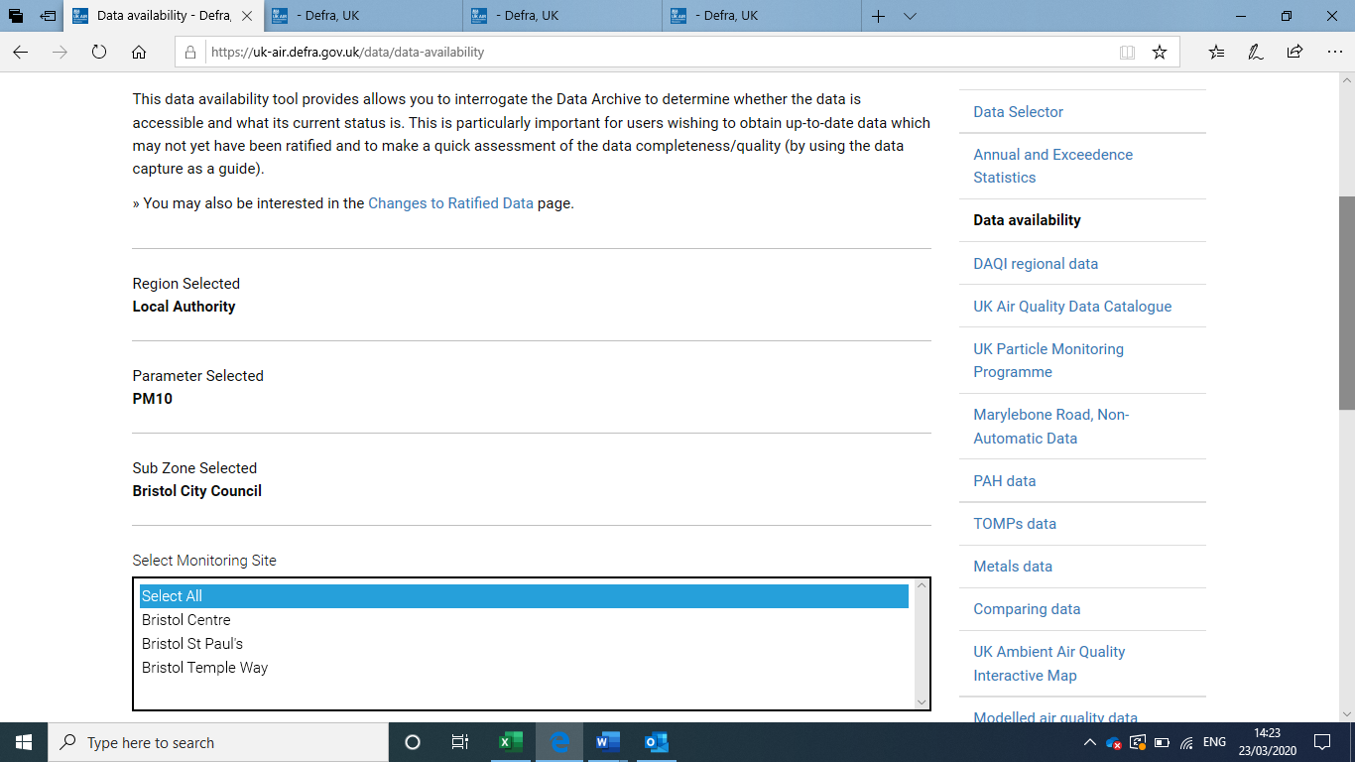
We have a choice of monitoring sites, but at this stage we don’t know which are monitoring or when, so we will select them all.
Click the green Step 4 button.

Slide 10
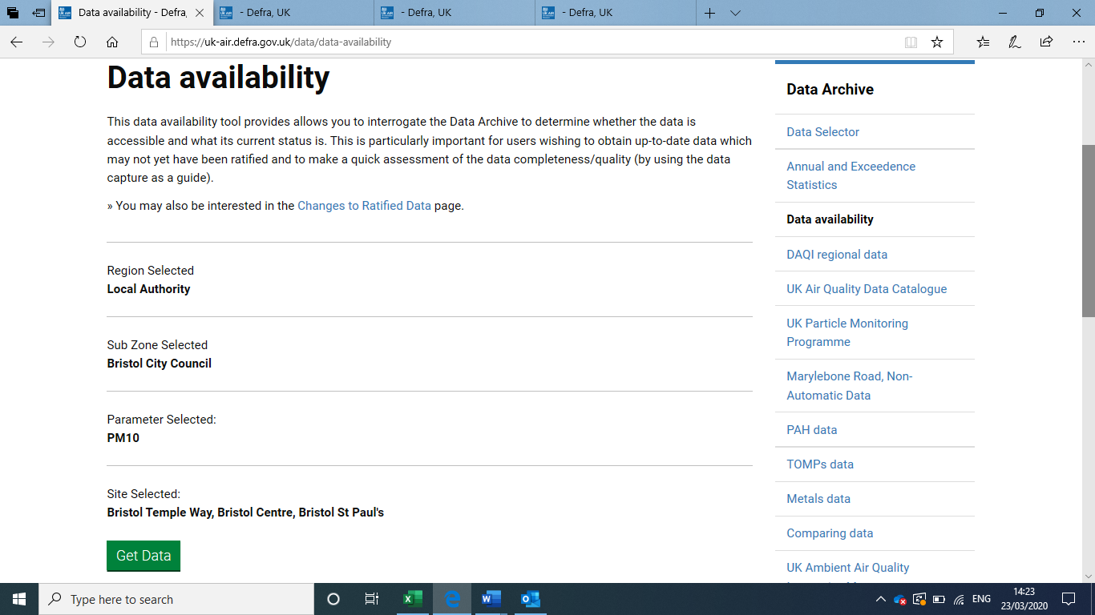
Now we can click Get Data to see what data is available.
If no data is available, you will be told that on the appropriate choice button:
Select Monitoring Site
No data available for this selection

Slide 11
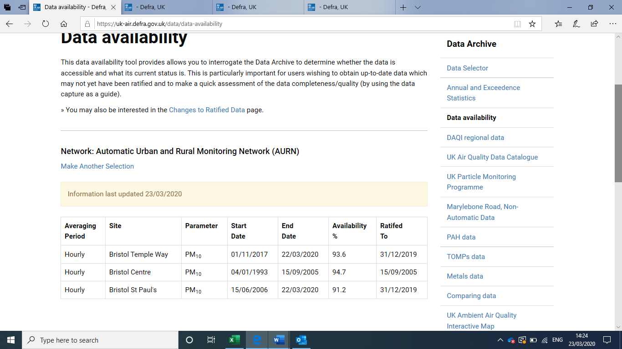
If data is available, you will see a screen like this.
Note: Bristol Centre data ended in 2005.
We want to see recent data (2018) so we will choose Bristol St Paul’s.

Slide 12
Click Data Selector on the RHS menu.
This takes us to https://uk-air.defra.gov.uk/data/data_selector

Slide 13
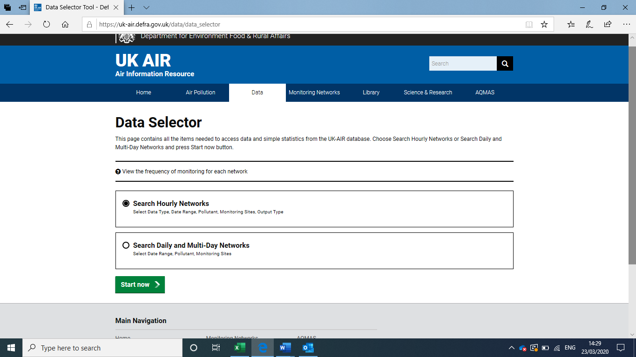
We want hourly data.
Click the green Start Now button.

Slide 14
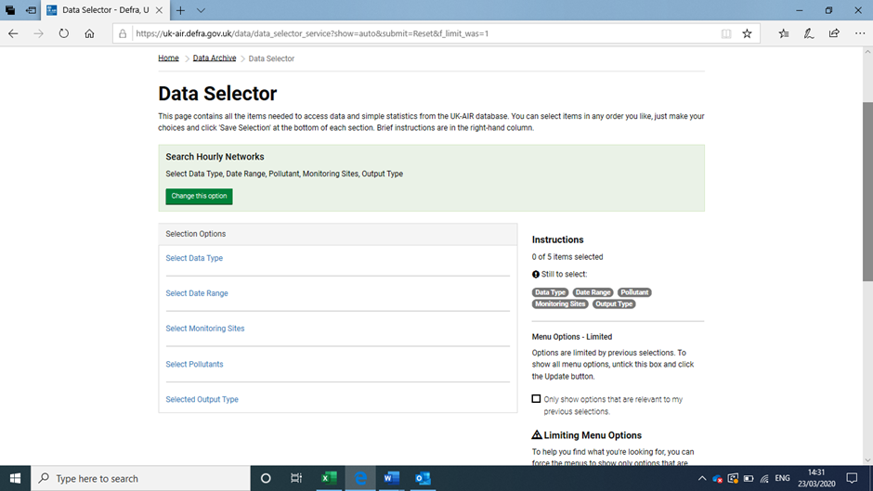
Decision time. You will need to select many options from the list.
Start at the top: Select Data Type.

Slide 15
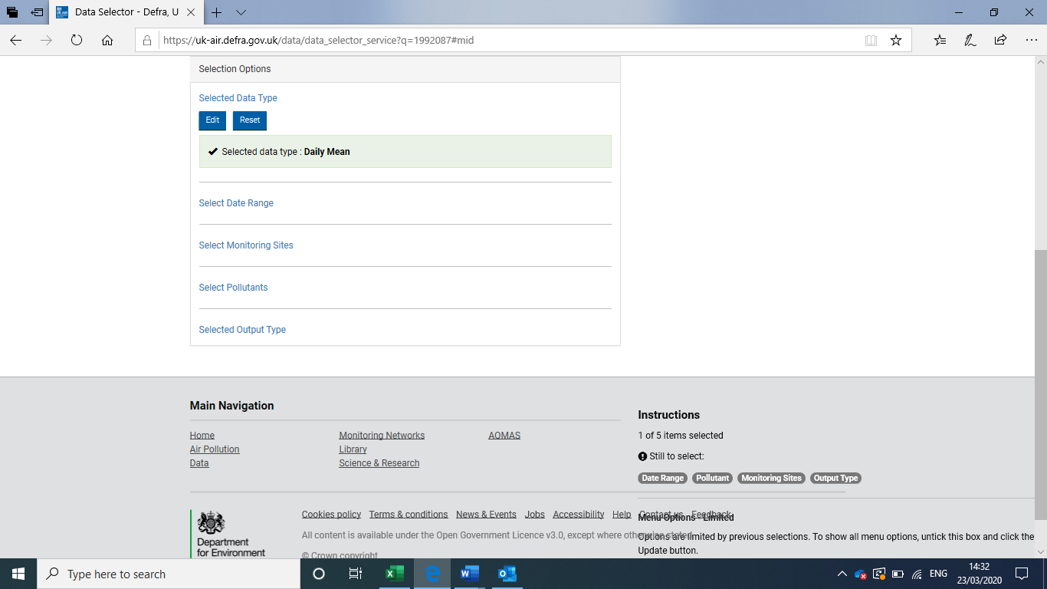
Selected Data Type – we have chosen Daily Mean.
Click the green Save Selection button.

Slide 16
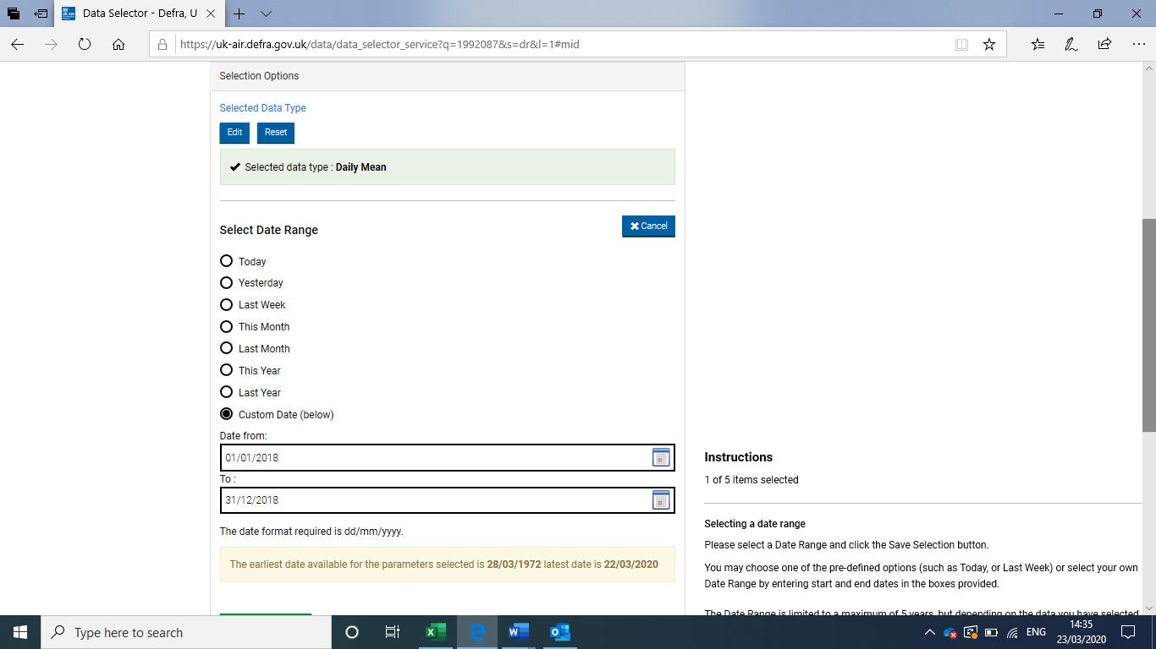
Select Date Range allows you to choose different periods of time.
Here we used the Custom Data option to select start and finish dates, via the calendars provided.
Click the green Save Selection button.

Slide 17
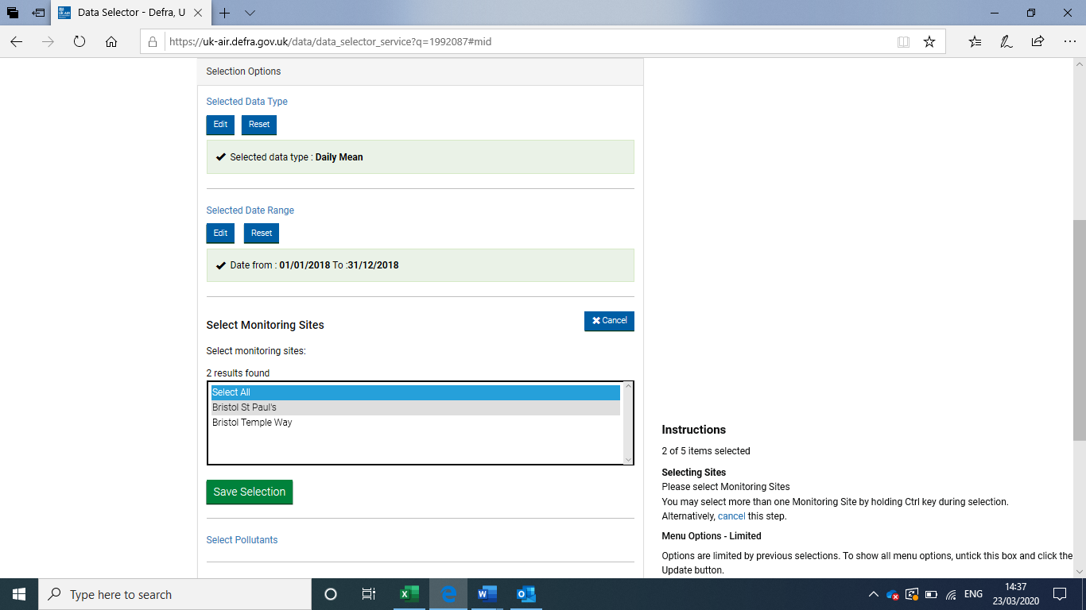
Select Monitoring Sites involves 2 boxes.
We selected the site by first going to Authority (we could have gone via country or region), then in a second box, select St Paul’s.
Click the green Save Selection button.

Slide 18
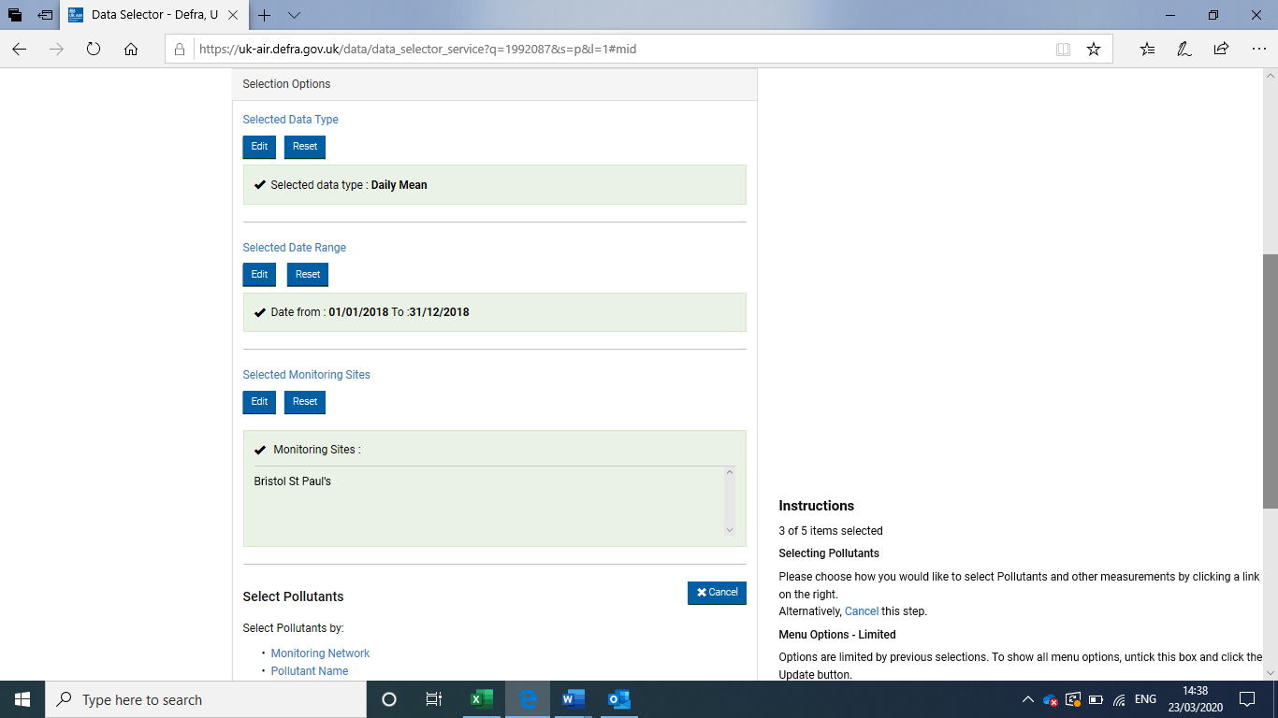
Select Pollutants – by Pollutant Name, in this case PM₁₀

Slide 19
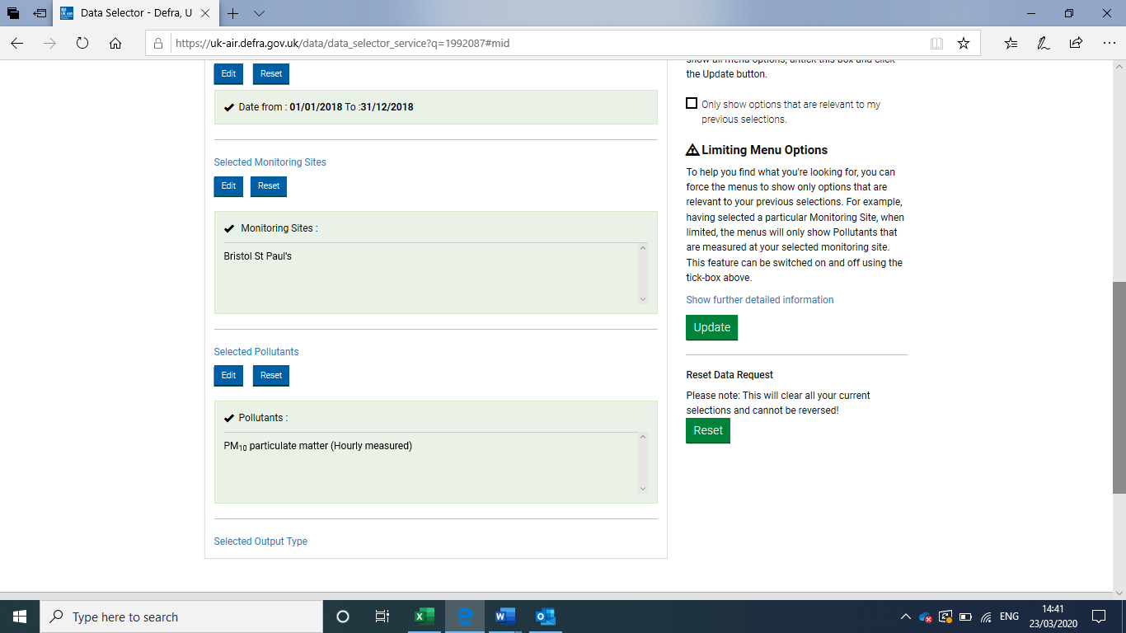
Note: there can be different types of PM₁₀ (particulate matter, non-volatile and volatile).
We are interested in PM₁₀ particulate matter.
Click the green Save Selection button.

Slide 20
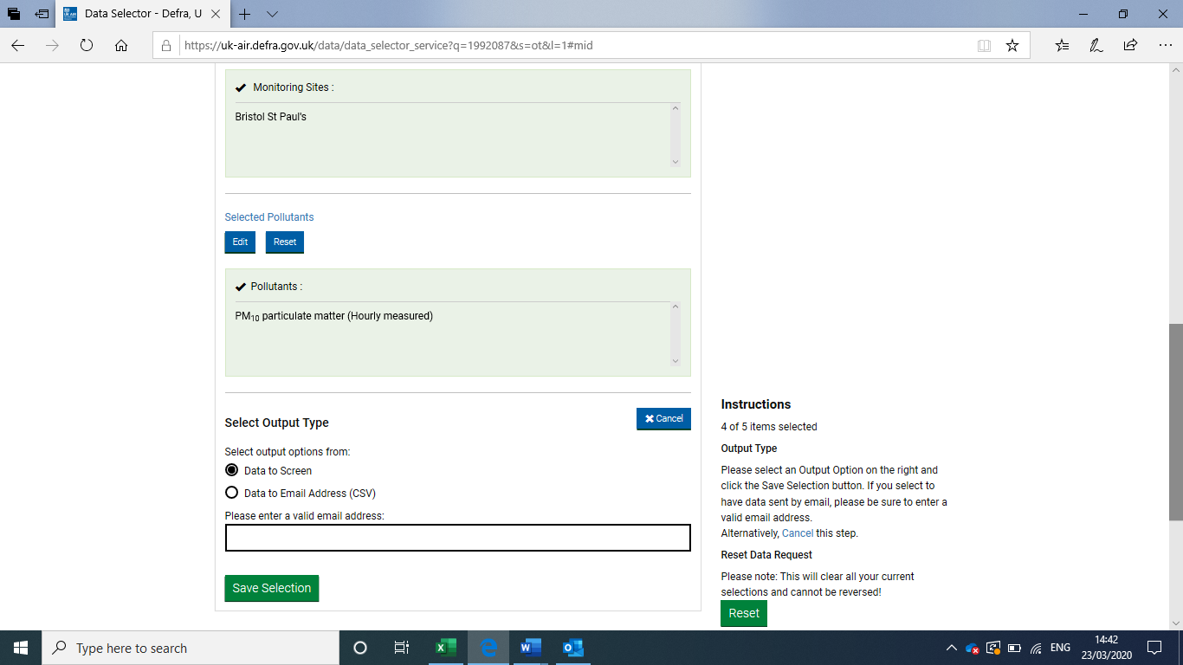
Now chose Output Type.
Not all data allows results to be emailed. We chose Data to Screen.
Some allow a straight download of the data. Data downloads could be used to make more detailed comparisons between different locations or for different pollutants.

Slide 21
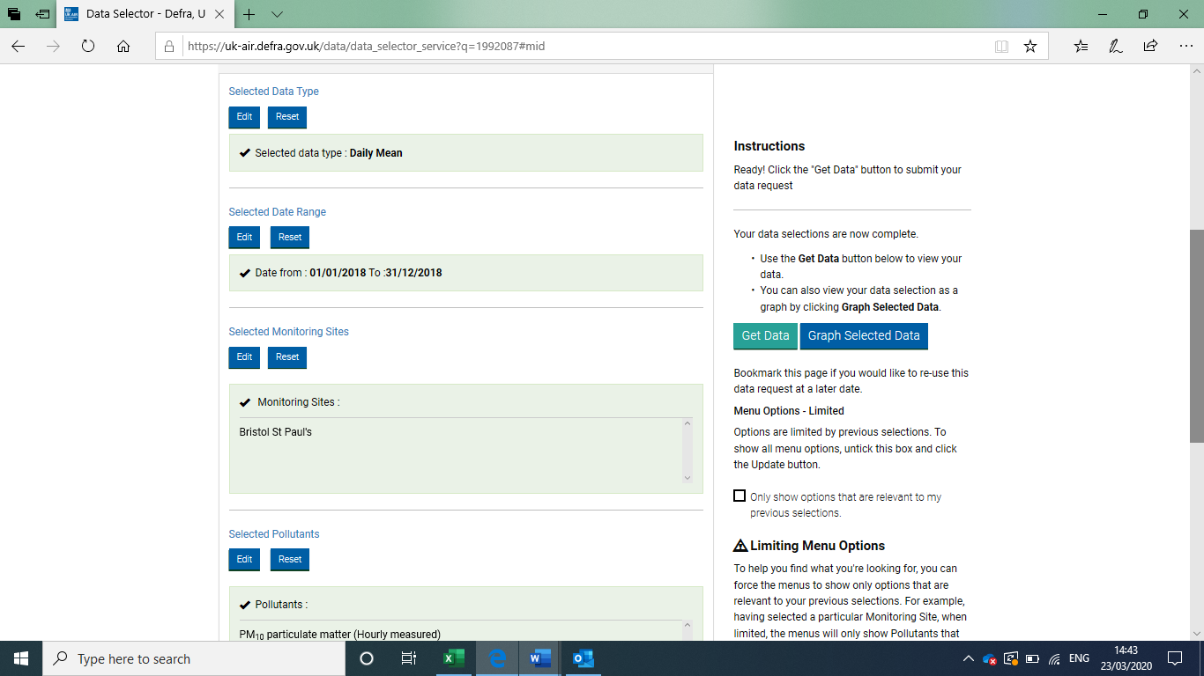
On the right-hand side is now a choice of how you want the data to be presented: a choice of tabulated data or a graphical readout.
Not all data will have a graphical data option.
The tabulated or graphical data will open in a new tab.

Slide 22
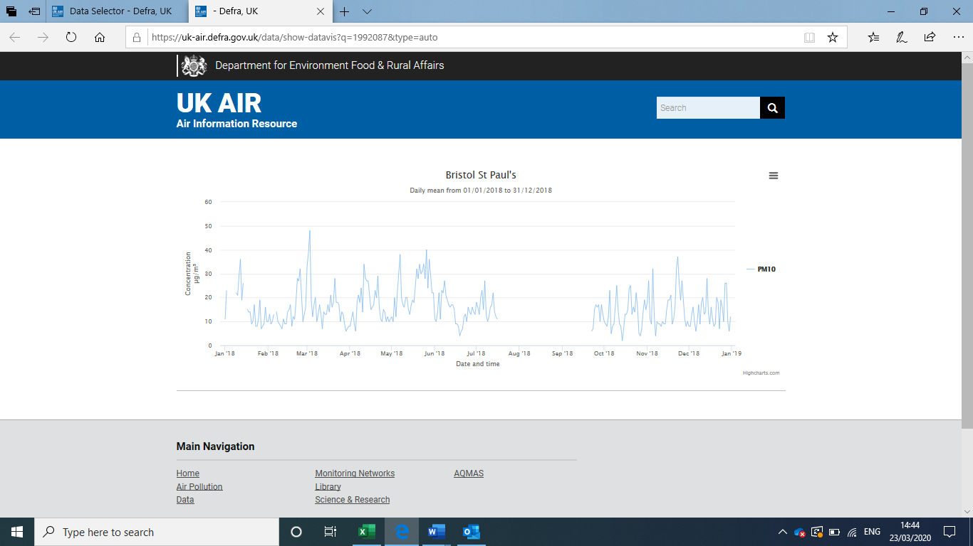
Graphical data
Here is the Graphical Data from one of the sites we selected in Bristol.
The graph can be saved or copied by right clicking on the image.

Slide 23
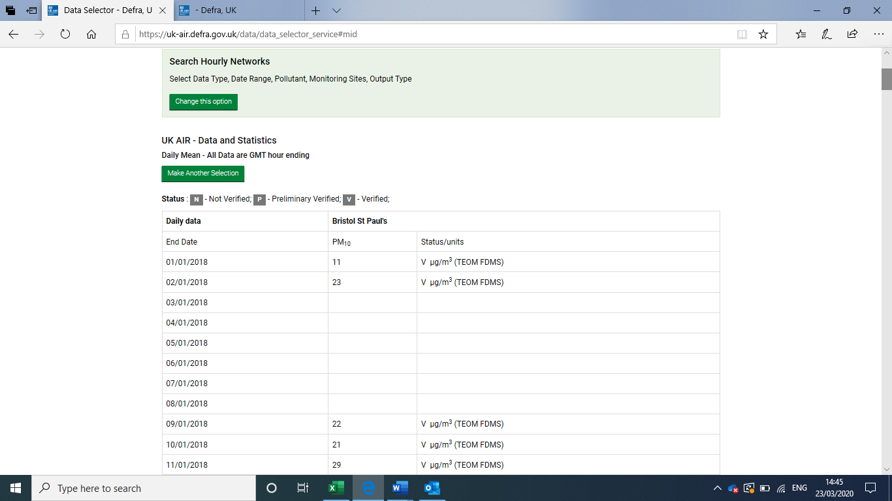
Table of data
If you chose the Get Data option, you will see tabulated data.
A snapshot of a huge tale of data.
Have fun!

Slide 24



For more information on the Primary Science Teaching Trust and access to a large selection of PSTT resources, visit our website:
pstt.org.uk
/primaryscienceteachingtrust @pstt_whyhow
To help you find high quality resources to support your primary science teaching quickly and easily, we provide links to excellent resources for teachers, children and families on our Wow Science website :
                wowscience.co.uk
and we regularly provide further suggestions on how to use these in the classroom through social media platforms:
/wowscience @WowScienceHQ

