Slide 1
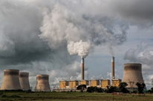
What does BIG data look like?
What data is there?
What does the data look like?
Dr. Alison Trew,¹ Prof. Dudley Shallcross,^{1,2} Tim Harrison² and Dr. Jonny Furze²
1 Primary Science Teaching Trust (PSTT)
2 ACRG School of Chemistry, University of Bristol, UK
Please note that the content of this PowerPoint is ©PSTT 2020 but may be freely reproduced by teachers in schools for educational purposes.
Notes:
PPT2.
This PowerPoint could be used as a classroom presentation and is suitable for primary children (ages 9-11).
To investigate air pollution more fully with children, the following PowerPoints (which can be used as classroom presentations) are available from the Primary Science Teaching Trust (PSTT) Free Teaching Resource - Air Pollution Research:
PPT 1A. What is air?
PPT1B. What is pollution?
PPT 2. What does BIG data look like?
PPT 3. What do levels of air pollutants look like across the UK?
PPT4. What happened to levels of air pollutants during national lockdown in 2020?
PPT5. What can we do?
https://pstt.org.uk/resources/curriculum-materials/citizen-science-air-pollution

Slide 2
Overview for Teachers
Interpreting data
Once children understand what air pollutants are and why it is important to monitor them, show examples of data (graphs). Questions to ask the children are suggested. There are 8 graphs. Children could work in small groups looking at one graph and share their conclusions with the class, or the whole class could work through all of the graphs. We estimate this this could take approx. 1 hour.
Aim/Learning objectives of slides: to interpret line graphs and scatter graphs, to use real scientific data to answer questions and draw conclusions.
Notes on units
Pollutants are measured in µg/m3, i.e. the mass (micrograms) of a substance in a cubic metre of air. You could use metre rulers/canes to show children a cubic metre. To convey an appreciation of the scale of micrograms (µg) compared with milligrams (mg), grams (g) and kilograms (kg), provide 1 g and 1 kg weights for children to hold (one in each hand). Explain that: 1 g = 1/1000th 1 kg. Next, can they imagine 1/1000th of 1 g (=1 mg)? Can they imagine 1/1,000,000th of the 1 g weight (= 1 µg)?
Slides
2-5 Benzene (C₆H₆)
6 Nitrogen oxides (NO and NO₂)
7 Carbon monoxide (CO)
8 Ozone (O₃)
9 Sulfur dioxide (SO₂)
10 Particulates (PM₁₀ and PM_{2.5})
Notes:
This PowerPoint presentation is designed for children who already have some knowledge of the causes and possible effects of air pollution, and different types of air pollutants. The following slides provide real data in the form of graphs from the Air Quality Data Archive. There are notes with each slide which give background information and answers to questions that you might ask the children.

Slide 3
1. Benzene (C₆H₆)
Daily average benzene level (micrograms per cubic metre) measured at Marylebone Road in London from 2000 to 2020.
What does this graph tell you about benzene levels?
Why do you think benzene levels have gone down?
Notes:
Benzene is an example of a hydrocarbon. Hydrocarbons (chemicals that just contain hydrogen and carbon atoms bonded together) are major components of fuel that is burned in combustion engines that propel vehicles. Some unburned hydrocarbon fuel will be released, and this can be measured. Higher levels of hydrocarbon will be found near busy roads and near other sources such as petrol stations, oil refineries, etc. Some hydrocarbons can cause cancer and other illnesses. A European study found that people breathe in 220 μg of benzene every day due to general atmospheric pollution. A smoker smoking 20 cigarettes per day takes in between 1800 and 7900 μg per day of benzene (in addition).
What does this graph tell you about benzene levels?
The level of benzene fell sharply from 2000 to 2010 but has been much the same since then.
Why do you think benzene levels have gone down?
Some possible reasons:
Less cars?
Cleaner cars? (more electric cars?)
Cleaner fuel? (less benzene in unleaded petrol?)

Slide 4
2. Benzene (C₆H₆)
Daily average benzene levels (micrograms per cubic metre) measured at Marylebone Road in London in January in 2000 and in 2020.
January 2020 has much lower levels of benzene than Jan 2000. Why do you think this might be?
There is a lot more variability (change) in January 2000. Why do you think this might be?
Notes:
Benzene is an example of a hydrocarbon. Hydrocarbons (chemicals that just contain hydrogen and carbon atoms bonded together) are major components of fuel that is burned in combustion engines that propel vehicles. Some unburned hydrocarbon fuel will be released, and this can be measured. Higher levels of hydrocarbon will be found near busy roads and near other sources such as petrol stations, oil refineries, etc. Some hydrocarbons can cause cancer and other illnesses. A European study found that people breathe in 220 μg of benzene every day due to general atmospheric pollution. A smoker smoking 20 cigarettes per day takes in between 1800 and 7900 μg per day of benzene (in addition).
January 2020 has much lower levels of benzene than Jan 2000. Why do you think this might be?
Some possible reasons:
Perhaps, the congestion zone coming into force in London on 17th February 2003 (Marylebone Road was on the edge of the zone). A congestion zone is where a charge is made to bring your vehicle into an area hoping the cost will put off people so less vehicles will use the roads.
Were cars in 2000 more polluting than in 2020? If so, why?
Maybe fuel in 2000 contained a lot more benzene than 2020.
There is a lot more variability (change) in January 2000. Why do you think this might be?
Perhaps, weekday and weekend differences in the number of vehicles on the road in 2000.

Slide 5
3. Benzene (C₆H₆)
Daily average benzene level (micrograms per cubic metre) as measured at Marylebone Road in London during the year 2019.
January
The level of benzene goes through a minimum in the summer and a maximum in the winter in 2019. This is seen clearly in more recent years, but it is less clear in 2000.
Why do you think this might this be?
Notes:
Benzene is an example of a hydrocarbon. Hydrocarbons (chemicals that just contain hydrogen and carbon atoms bonded together) are major components of fuel that is burned in combustion engines that propel vehicles. Some unburned hydrocarbon fuel will be released, and this can be measured. Higher levels of hydrocarbon will be found near busy roads and near other sources such as petrol stations, oil refineries, etc. Some hydrocarbons can cause cancer and other illnesses. A European study found that people breathe in 220 μg of benzene every day due to general atmospheric pollution. A smoker smoking 20 cigarettes per day takes in between 1800 and 7900 μg per day of benzene (in addition).
In this graph, we see that the level of benzene goes through a minimum in the summer and a maximum in the winter in 2019. Why do you think this might this be?
Some possible reasons:
Fewer cars in the summer? People walking and cycling more?
Hotter in the summer, perhaps this is a reason somehow?
More sunlight in the summer? This might remove the benzene directly or help to remove it?

Slide 6
4. Nitrogen Oxides
Nitric oxide (NO), nitrogen dioxide (NO₂) and sulphur dioxide (SO₂) concentrations measured at Marylebone Road, London for one day on 11th February 2020.
6am
12 noon
6pm
Why do you think that the peak in the morning is larger than the peak in the evening?
Would this pattern be different on the weekend?
Would this pattern be similar in other places in the U.K.?
Notes:
Nitrogen Oxides (nitric oxide and nitrogen dioxide) are produced inside a combustion engine. Air (which is mainly nitrogen and oxygen) is needed in the engine so the oxygen can be used to burn the fuel (petrol/diesel). Some of the nitrogen and oxygen reacts together producing nitrogen oxides because there is a lot of heat and pressure (in normal air conditions they don’t react).
Nitric oxide (NO) is not considered to be hazardous to health at typical ambient concentrations. Nitrogen dioxide (NO₂) is a poisonous gas which at high concentrations causes inflammation of the airways in animals including humans. Nitrogen dioxide gas is also acidic. When it dissolves in water it causes corrosive damage to materials and animals.
Why do you think that the peak in the morning is larger than the peak in the evening?
This graph shows that the levels of nitric oxide and nitrogen dioxide measured at the kerbside site of the Marylebone Road are highest in the morning when people are travelling to school and work. The levels are also high again in the afternoon, when many people travel home. This suggests that the levels of pollutants are heavily influenced by traffic.
The morning rush hour is short – a lot of people (including children) travel between 7:30am – 9am to get to schools and workplaces. The afternoon rush hour is longer because schools finish earlier (3:30-4pm) than most workplaces (5-6pm). Probably, the same number of people travel in the morning and the afternoon, and the same amount of pollutants is produced. However, the afternoon peak is lower because the amount of pollutants released is spread over a longer period. This may change post COVID-19.
Would this pattern be different on the weekend?
Fewer people work at weekends and schools are closed so the morning and afternoon peaks would be much less.
Would this pattern be similar in other places in the U.K.?
People still travel to work and schools at the same times so there would be a similar rise in pollutants in the mornings and afternoons. In the countryside, there are fewer people driving vehicles so the peaks might be lower than in cities.

Slide 7
5. Carbon Monoxide (CO)
Carbon monoxide maximum concentrations in Marylebone, London, in August 2000.
Can you work out when the minimum concentration of carbon monoxide was?
Can you find out what dates were weekends (Saturdays and Sundays)?
Do the weekend concentrations differ to weekday concentrations?
Suggest how might this data look different to that of a winter month such as November 2000?
Notes:
Carbon monoxide (CO) - The two major sources of carbon monoxide are the incomplete combustion of fossil fuels (burning with not enough oxygen present) and biomass (trees, bushes and grass) burning. Some carbon monoxide is emitted from the oceans and vegetation. The incomplete combustion of fossil fuels produces 23% of global carbon monoxide. This is a poisonous gas and can replace oxygen in blood. At concentrations above 1000ppm it is considered immediately dangerous.
Can you work out when the minimum concentration of carbon monoxide was?
7th August
Can you find out what dates were weekends (Saturdays and Sundays)?
Children could use Google calendar to determine weekends in August 2000.
Weekends in August 2000: 5th/6th, 12th/13th, 19th/20th, 26th/27th August
Do the weekend concentrations differ to weekday concentrations?
Levels of carbon monoxide are lower at weekends.
Suggest how might this data look different to that of a winter month such as November 2000?
In November, few people take holidays so levels of carbon monoxide in a city could be higher Mon-Fri. Weekend levels could be lower. Note: it is bonfire night on 5th November so levels of many pollutants could be higher on or near this day.

Slide 8
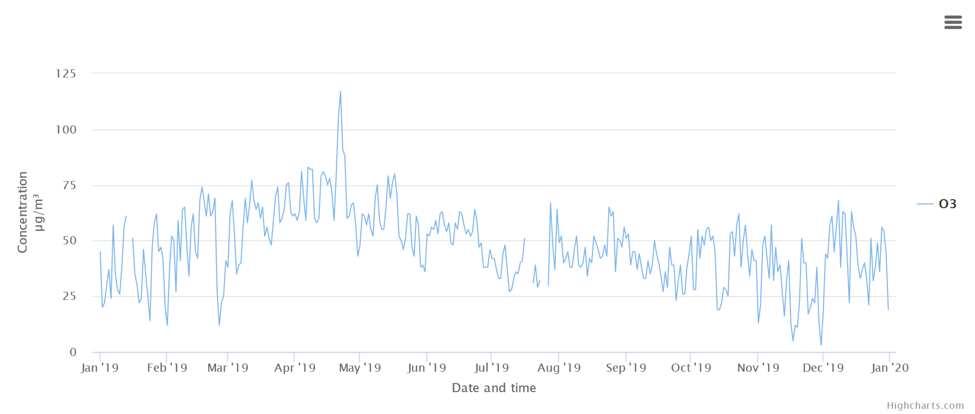
6. Ozone (O₃)
Ozone concentrations from a road in Edinburgh during 2019.
Can you work out what the highest and lowest concentration of ozone was in 2019?
Can you suggest reasons for the highest level and the lowest level?
Notes:
Ozone (O₃) is a poisonous form of oxygen. The oxygen we breathe is O₂. Ozone is present in the atmosphere in tiny amounts, but it is important and is involved in the breakdown of other atmospheric pollutants. Breathing ozone can trigger a variety of health problems including chest pain, coughing, throat irritation, and airway inflammation. It also can reduce lung function and harm lung tissue. Ozone can worsen bronchitis, emphysema, and asthma, leading to increased medical care.
Can you work out what the highest and lowest concentration of ozone was in 2019?
Highest = 120 microgram / cubic metre in April.
Lowest = 5 microgram/cubic metre at the start of December.
Can you suggest reasons for the highest level and the lowest level?
Perhaps, levels were high in April because it was Easter Bank holiday weekend, or it was the first sunny weekend of the year. This could mean there was more traffic than usual because people were visiting families or having a day out. Perhaps, levels were low at the start of December because roads closed in the city centre due to switching on Christmas lights.

Slide 9
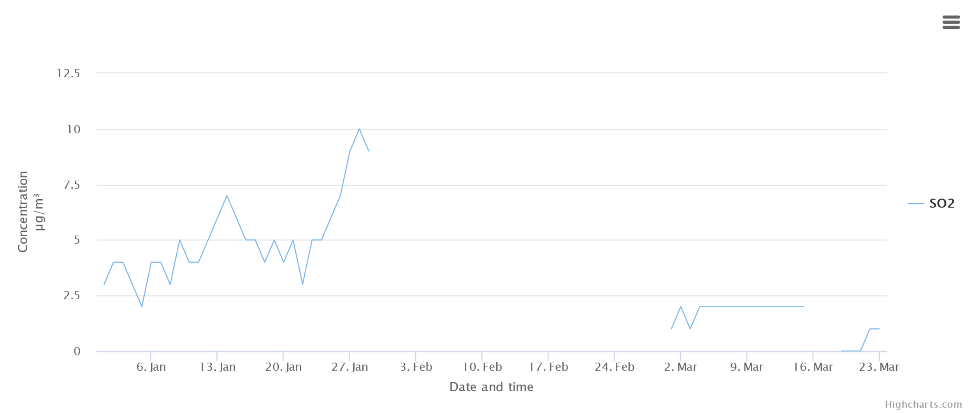
7. Sulfur dioxide (SO₂)
Sulfur dioxide measurements for the year so far (2020) in Birmingham.
What do you think happened from the end of January to the beginning of March 2020?
Notes:
Sulfur dioxide (SO₂) gas has may sources, some from nature and some from the things we do and make. Volcanoes can produce SO₂. Much of the SO₂ in the atmosphere comes from burning sulfur containing compounds such as fossil fuels. It is also produced when some metals are extracted from their ores. SO₂ has many uses including for the manufacture of sulfuric acid. It also has harmful effects: it dissolves in water making acid which corrodes some stonework, poisons lakes and rivers, and kills trees from the top down; it affects the respiratory system, particularly lung function, and can irritate the eyes and aggravates conditions such as asthma.
Note: In world of science it is normal to use ‘sulfur’ rather than ‘sulphur’.
What do you think happened from the end of January to the beginning of March 2020?
Possible reasons:
• The instrument used to measure sulfur dioxide at the Birmingham site was broken.
• The scientists collecting data were on holiday or ill.

Slide 10
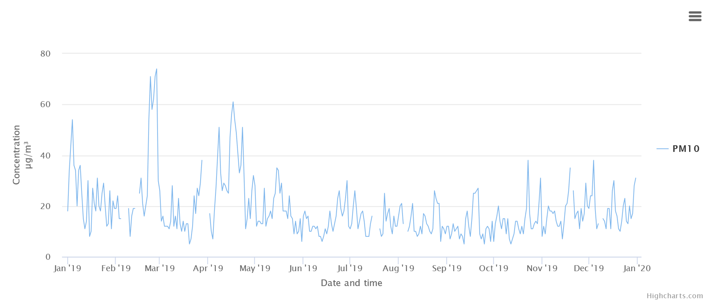
8. Particulates: PM₁₀ / PM_{2.5}
The PM₁₀ data from a busy road (Newport Road) going into Cardiff during 2019.
Can you suggest why are the PM₁₀ particulates much higher in the period March to May, than in July-December?
Notes:
Particulates: PM10 / PM2.5
Particulates are tiny pieces of solid (dust) in the air. They come in many sizes. PM₁₀ is bigger than PM_{2.5}. The number is the size in micrometres (µm). A micrometre is a millionth of a metre. Put another way a micrometre is a thousandth of a millimetre (mm). A thick human hair is a tenth of a millimetre (0.1 mm). Particulate matter (PM_{2.5} and PM₁₀) can hang in the air for a long time and are so tiny that they can enter deep into the lungs and damage lung tissue.
Can you suggest why are the PM10 particulates much higher in the period March to May, than in July-December?
One possibility is garden bonfires as gardeners tidy debris in the spring.

Slide 11
This resource is based on work by
Prof. Dudley Shallcross, Dr. Anwar Khan, Dr. James Matthews, Rayne Holland,
of the Atmospheric Chemistry Research Group (ACRG), University of Bristol.
Data sets extraction and graphs generated by
Tim Harrison & Dr. Jonathan Furze,
Bristol ChemLabS University of Bristol.
PowerPoint created by
Dr. Alison Trew,
Primary Science Teaching Trust

Slide 12



For more information on the Primary Science Teaching Trust and access to a large selection of PSTT resources, visit our website:
pstt.org.uk
/primaryscienceteachingtrust @pstt_whyhow
To help you find high quality resources to support your primary science teaching quickly and easily, we provide links to excellent resources for teachers, children and families on our Wow Science website :
                wowscience.co.uk
and we regularly provide further suggestions on how to use these in the classroom through social media platforms:
/wowscience @WowScienceHQ

