Slide 1
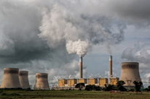
Introducing Atmospheric Pollutants & Air Quality to Primary Children
What is pollution?
What are air pollutants?
Why do scientists measure air pollutants?
Dr. Alison Trew, Primary Science Teaching Trust (PSTT)
Please note that the content of this PowerPoint is ©PSTT 2020 but may be freely reproduced by teachers in schools for educational purposes.
Notes:
PPT1B
This PowerPoint could be used as a classroom presentation and is suitable for primary children (ages 9-11).
To investigate air pollution more fully with children, the following PowerPoints (which can be used as classroom presentations) are available from the Primary Science Teaching Trust (PSTT) Free Teaching Resource - Air Pollution Research:
PPT 1A. What is air?
PPT1B. What is pollution?
PPT 2. What does BIG data look like?
PPT 3. What do levels of air pollutants look like across the UK?
PPT4. What happened to levels of air pollutants during national lockdown in 2020?
PPT5. What can we do?
https://pstt.org.uk/resources/curriculum-materials/citizen-science-air-pollution

Slide 2
Overview for Teachers
What is pollution? (slides 3-5) approx. 15-20 minutes
To introduce the topic of pollution to children, we look at images of plastic, oil and air pollution and suggest the following questions are discussed with the children:
What is pollution?
What does it look like?
What impact might it have?
What causes air pollution? (slides 6-7) approx. 15 minutes
Natural sources of air pollutants
Anthropogenic (human) causes of air pollutants
How do air pollutants affect humans and the environment? (slides 8) approx. 10 minutes
Why do scientists measure air pollutants? (slide 9) approx. 5 minutes
Notes:
This PowerPoint has 4 sections. We suggest that you introduce children to air quality and atmospheric pollutants by exploring the questions on this slide in this order.
Depending on the children’s prior knowledge and understanding, you may decide to omit some sections.
There are notes with each slide which give background information and answers to questions that you may ask the children.

Slide 3
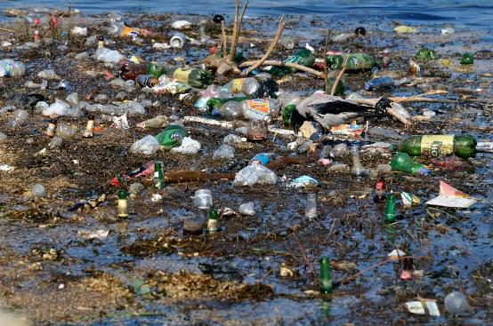
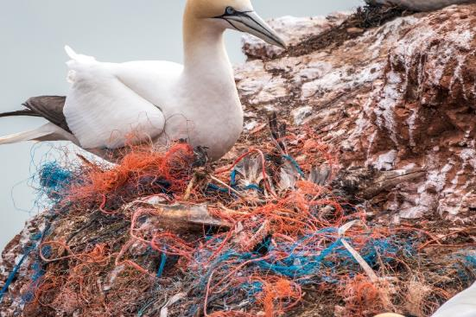
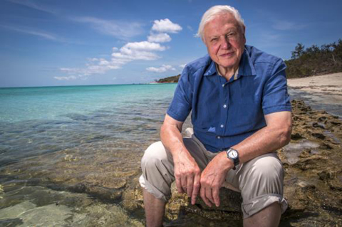
What is pollution?
What do you think is happening here? Why?
Does it matter?
Look carefully – can you see 2 birds in this picture?
David Attenborough has an important message about plastics.
Notes:
Aim: to explain plastic pollution and consider its impact on the environment
Small groups/pairs: ask children what they think has happened in the pictures.
Plastic is a synthetic material made from a wide range of natural organic materials such as cellulose, coal, natural gas and crude oil. There are thousands of different plastics which make modern life possible. Plastics are termed polymers by scientists.
Much of the plastic that does not end up in landfill or go through other waste management pathways (such as recycling or incineration) is thought to end up in the ocean. Most plastics are low density, so they float on seawater.
8 million tonnes of plastic enter the ocean each year, according to figures published by National Geographic in 2019. Plastic can enter the ocean as large, identifiable items (as above), or as microplastics (pieces under five millimetres in length), and some are microscopic (so small as to be visible only with a microscope). All pose a threat to marine life. Microplastics have been found in more than 100 aquatic species such as fish which are eaten by humans.
Note: Sir David Attenborough’s plastic message (BBC) is suitable for primary children to watch and includes primary school children in the film.
Click on the link to view the film clip (<3 minutes).

Slide 4
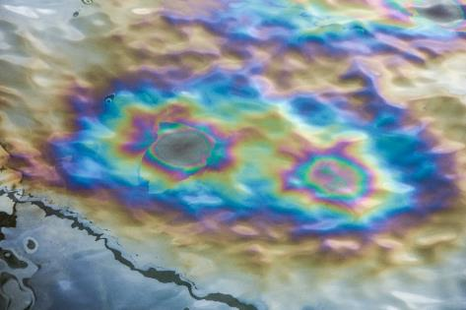
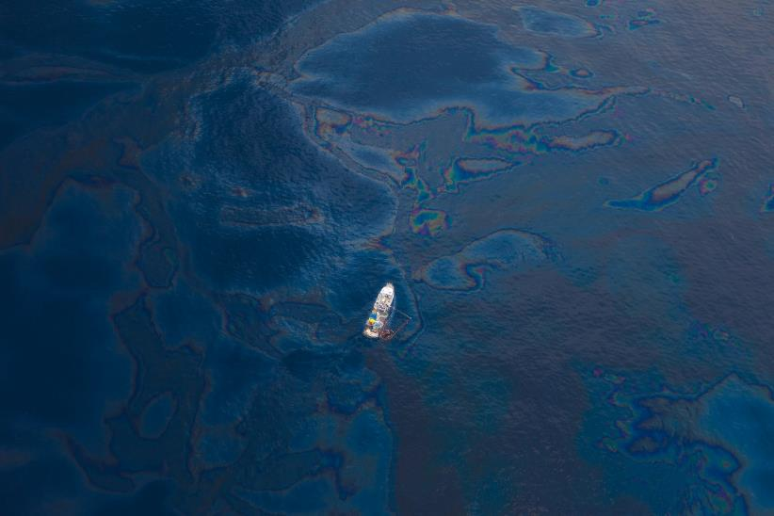
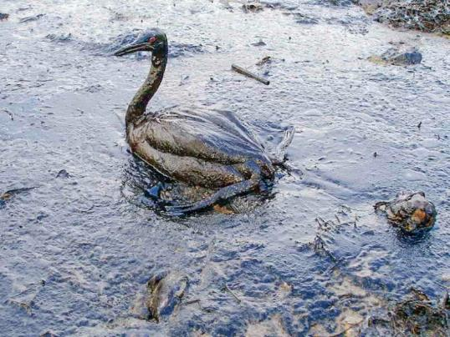
What is pollution?
What do you think has happened in these pictures?
Why?
Does it matter?
Notes:
Aim: to explain oil pollution and consider its impact on the environment
Small groups/pairs: ask children what they think has happened in the pictures.
A ship floats amongst a sea of spilled oil in the Gulf of Mexico after the BP Deepwater Horizon oil spill disaster (April 2010).
Crude oil is a liquid found in the Earth’s crust. It is the remains of organisms that lived and died millions of years ago. Across the world, humans use enormous quantities of crude oil to make fuels (petrol and diesel) and other products such as plastics. Most of that crude oil reaches its destination by sea. Unfortunately, there are occasional oil spills from super tankers, underwater pipelines, offshore oil rigs, coastal storage facilities and oil refineries. When an oil spill occurs, the oil forms a millimetre-thick slick that floats on the water (because oil and water do not mix). The oil spreads out over many square kilometres, until it becomes a widespread sheen on the water surface. Oil spills are generally very messy and environmentally threatening. Spills may reach shorelines and affect wildlife. This bird is covered in oil from the Black Sea oil spill 2014. A leak on a Russian oil pipeline caused the oil spill in the Black Sea near the port of Tuapse, Russia. More information about oil spills and cleaning them up can be found here https://science.howstuffworks.com/environmental/green-science/cleaning-oil-spill.htm

Slide 5
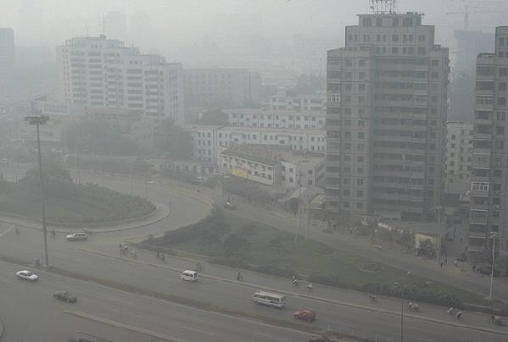
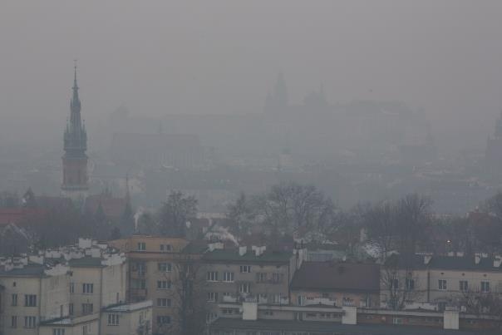
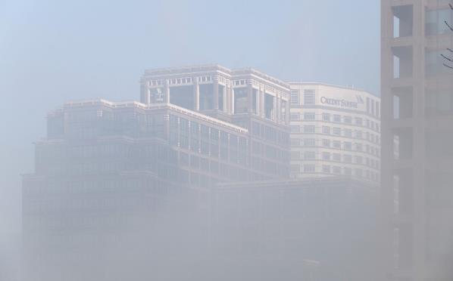
What is pollution?
Beijing, China (2012)
Kraków, Poland (2017)
Why is it difficult to see the buildings in these cities?
What would it be like to live here?
Canary Wharf, London, UK (2014)
Notes:
Aim: to explain air pollution and consider its impact on us
Small groups/pairs: ask children what they think has happened in the pictures.
Children may talk about fog, mist, smoke, smog, fires.
Fog occurs when water vapour (which is invisible) in the air condenses to make tiny water droplets that hang in the air. It is like a cloud that touches the ground. Fog will prevent you seeing objects 1km further away from where you are standing.
Mist is less dense than fog. Mist can reduce visibility to 1-2 km.
The term smog was first used in the early 1900s to describe a mixture of fog and smoke (a suspension of carbon and other particles in the air). The smoke usually came from burning coal and was common in industrial areas and cities. Today, the smog we see is photochemical smog which is produced when sunlight reacts with gases in the atmosphere. Smog can be harmful to humans because some of the pollutants in the air can damage lung tissue making it hard to breathe. If you lived in a city which had frequent smogs, you might need to wear a mask when you went outside or even stay inside to avoid getting ill.

Slide 6
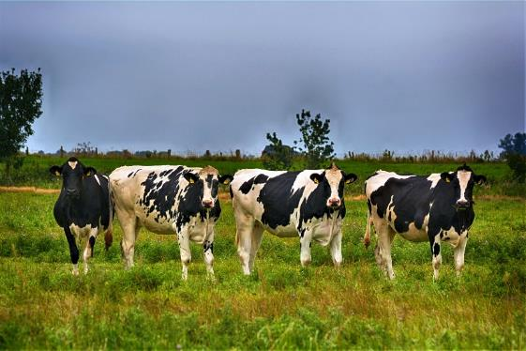
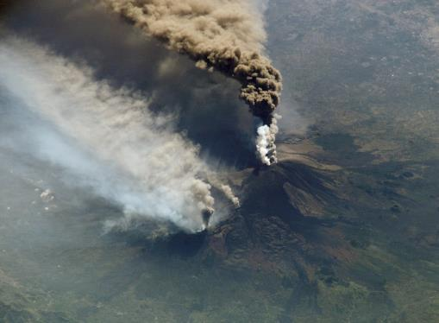
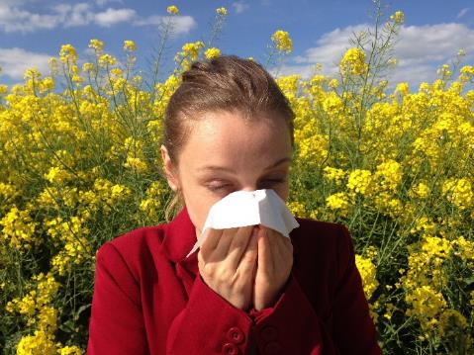
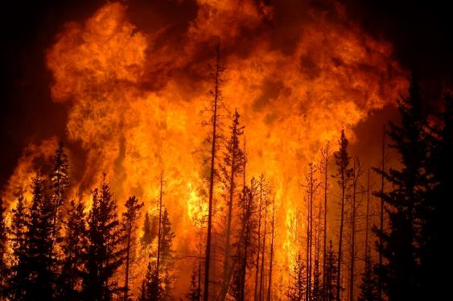
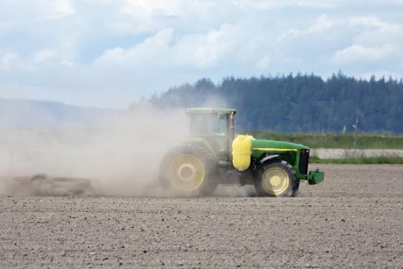
Natural sources of air pollution
4
1
3
2
5
Notes:
Aim: to know what air pollution is and what causes it (1st of 2 slides)
Small groups/pairs - ask children:
What is happening in each picture?
How do they think these processes would contribute to the quality of the air they breathe?
Air pollution is the contamination of the air by a mix of particles and gases that can be harmful to human health and the environment. Air pollutants are not always visible to humans.
Some pollutants come from natural sources:
volcanic eruptions produce sulfur gases (e.g. sulfur dioxide), chlorine and ash (the solid powdery substance left over when something is completely burned. The chemical composition of ash depends on that of the substance burned but is mainly carbon with varying amounts of metals and phosphorous)
wild fires produce smoke (a visible suspension of carbon and other particles in the air) and carbon monoxide (an invisible gas)
allergens (pollen) can cause an allergic reaction in some people
animals (e.g. cattle) produce methane (an invisible gas) when they digest their food
dust (particulate matter) is produced from large areas of land with little vegetation)

Slide 7

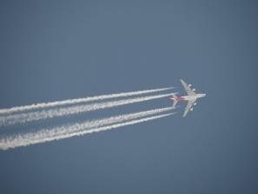
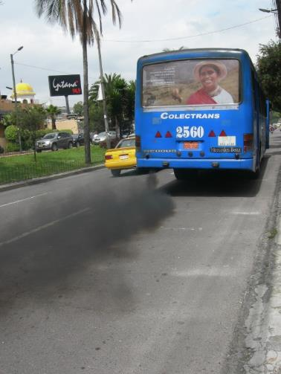
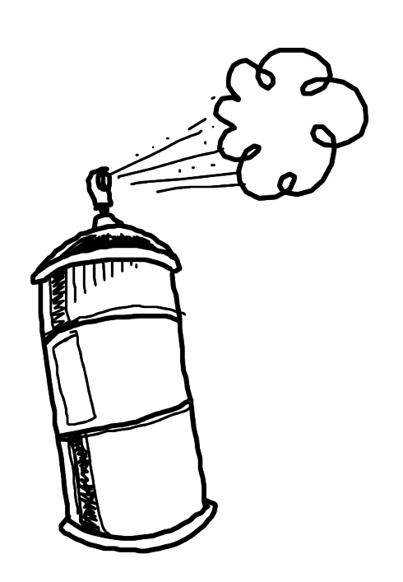
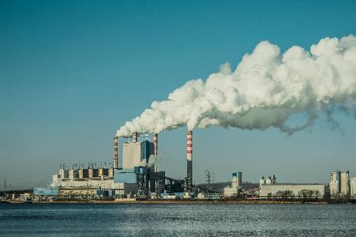
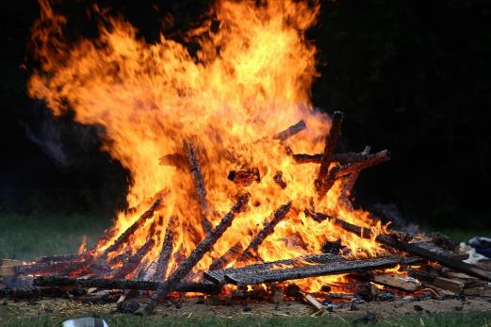
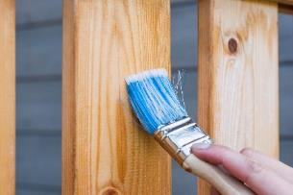
Human causes of air pollution
1
2
3
4
5
7
6
Notes:
Aim: to know what air pollution is and what causes it (2nd of 2 slides)
Small groups/pairs - ask children:
What they think is happening in each image?
How do they think these processes would contribute to the quality of the air they breathe?
Most pollutants come from human activities:
1, 2, 3 & 4 - Burning fossil fuels (in vehicles, aeroplanes, power stations & factories) produces carbon dioxide (CO₂), nitric oxide (NO) nitrogen dioxide (NO₂), sulfur dioxide (SO₂) and hydrocarbons (chemicals that contain just hydrogen and carbon, e.g. benzene (C₆H₆))
5 & 6 - Fumes from petrol, paints, varnish, cleaning solvents, aerosol sprays (e.g. hair spray) contain volatile organic compounds (VOCs). VOCs are carbon containing molecules that vapourise easily. Petrol and alcohol are common examples. The smells from plants and animal such as rose, vanilla civet are VOCs.
7 - Controlled burning in farming and forest management produces small airborne particulate matter (PM). Particulates are tiny pieces of solid (dust) and come in many sizes. PM₁₀ is bigger than PM_{2.5}. The number is the size of the particle in micrometres (µm). Particles with diameters equal or smaller than 10 µm are called PM₁₀. Particles with diameters equal or smaller than 2.5 µm are called PM_{2.5}.
Note on PM units:
A micrometre (µm) is a thousandth of a millimetre (mm).
A thick human hair is a tenth of a millimetre (0.1 mm).
This means PM₁₀ (diameter =10 µm =0.01 mm) is a tenth of the diameter of a human hair.

Slide 8
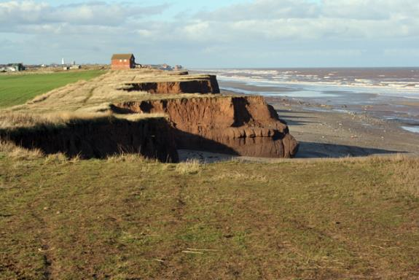
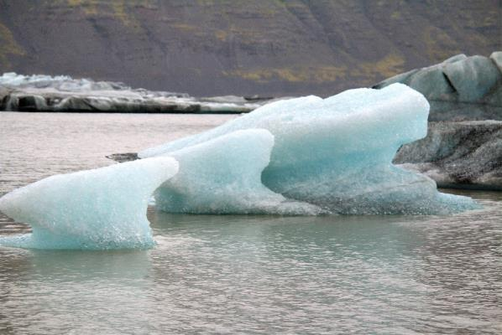
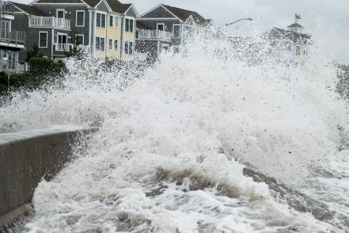
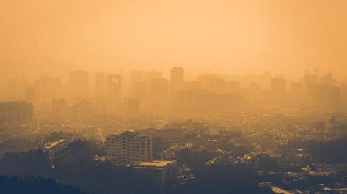
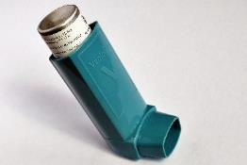
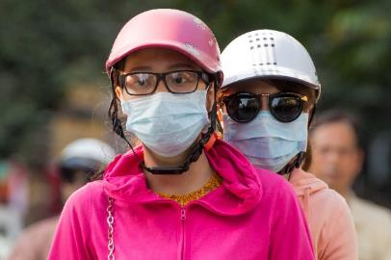
2
Impacts of air pollution
1
3
5
4
6
Notes:
Aim: to understand the possible impacts of air pollution
Note: be aware that some children or members of their families may suffer from breathing difficulties.
Using the pictures as prompts, ask the children to help you make a list of possible effects of air pollution:
Ice melting in polar regions
Coastal erosion
Extreme weather
Smog in cities
Inhalers
Wearing facemasks to avoid breathing particulate matter
Global warming & climate change
Some air pollution cannot be seen. Greenhouse gases (e.g. carbon dioxide and methane) are colourless. They trap heat from the Sun in the Earth’s atmosphere causing the temperature of the Earth to rise. This contributes to global warming and climate change (melting ice at the poles, rising sea levels, coastal erosion, extreme weather such as hurricanes and typhoons, floods, habitat change, possible species extinction).
Poor health
Some air pollution can be seen. Smog creates a haze (often brown or grey) which reduces visibility. Sulfurous smog is caused by sulfur dioxide in the air and photochemical smog is produced when nitrogen oxides and VOCs in the atmosphere react with sunlight to produce ground-level ozone. Both types of smog are harmful to plants and animals. Particulate Matter (PM_{2.5} and PM₁₀ ) can hang in the air for a long time and are so tiny that they can enter deep into the lungs. In humans, poor air quality can cause headaches, sore throats, coughs, tiredness, eye irritation, and damaged lung tissue, so it is especially dangerous to people with illnesses like asthma. Children are more vulnerable to the harmful effects of pollution because they breathe a higher amount of the pollutants per kg of their body weight and they probably spend more time outside and are more exposed to it.

Slide 9

Why do scientists measure air pollution?
Notes:
Aim: to understand why & how scientists measure levels of air pollutants
Small groups/pairs - ask children why do you think that scientists measure levels of air pollutants?
Some chemicals that are in the air have limits imposed by governments. Above these levels the chemicals may be harmful to the health of people, other animals or plants. These atmospheric chemicals need to be monitored accurately to see whether levels of pollutants are kept below the limits set. Scientists also look for relationships between levels of pollutants and illnesses.
Small groups/pairs - ask children when & where do scientists take their measurements?
It is no use in just measuring in one place in the UK on one day per year:
Different areas, towns, cities, countryside may have different concentrations of pollutants.
An industry or natural process may only produce pollutants at certain times, e.g. during the evening in the summer.
The wind conditions (strength and direction) may move that pollutant to different places each year (or may not move it at all).
Scientists measure many types of air pollutants at sites around the UK. Running an air quality network (https://uk-air.defra.gov.uk/) is expensive and so there are a limited number of sites around the UK that The UK Department for Environment, Food and Rural Affairs (Defra) can site science instruments to measure the levels of pollutants in the air.
The UK Air Quality Network focuses on primary pollutants that are produced from human activity:
Hydrocarbons (for example, benzene)
Nitrogen oxides - nitric oxide (NO) and nitrogen dioxide (NO₂)
Carbon monoxide (CO)
Ozone (O₃)
Sulfur dioxide (SO₂)
Particulates i.e. PM_{2.5} and PM₁₀

Slide 10



For more information on the Primary Science Teaching Trust and access to a large selection of PSTT resources, visit our website:
pstt.org.uk
/primaryscienceteachingtrust @pstt_whyhow
To help you find high quality resources to support your primary science teaching quickly and easily, we provide links to excellent resources for teachers, children and families on our Wow Science website :
                wowscience.co.uk
and we regularly provide further suggestions on how to use these in the classroom through social media platforms:
/wowscience @WowScienceHQ

