Slide 1
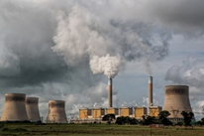
What is air?
Dr. Alison Trew, Primary Science Teaching Trust (PSTT)
Please note that the content of this PowerPoint is ©PSTT 2020 but may be freely reproduced by teachers in schools for educational purposes.
Notes:
PPT1A
This PowerPoint could be used as a classroom presentation and is suitable for primary children (ages 9-11).
To investigate air pollution more fully with children, the following PowerPoints (which can be used as classroom presentations) are available from the Primary Science Teaching Trust (PSTT) Free Teaching Resource - Air Pollution Research:
PPT 1A. What is air?
PPT1B. What is pollution?
PPT 2. What does BIG data look like?
PPT 3. What do levels of air pollutants look like across the UK?
PPT4. What happened to levels of air pollutants during national lockdown in 2020?
PPT5. What can we do?
https://pstt.org.uk/resources/curriculum-materials/citizen-science-air-pollution

Slide 2
Overview for Teachers
What is a chemical? (Slide 3)
Think about everyday materials
Understand the difference between a chemical and a phenomenon
What is a gas? (slide 4)
Talk about the difference between a solid, a liquid & a gas.
Name some familiar gases
What is air?(slides 5-7) Activities to explain what air is comprised of:
Rocket mice (1-2 hours)
Burning candle (20 minutes)
Sooty tile (10 minutes)
Note: for more information about gases, see Gases in the Air, a 48 minute film for primary children, produced by Bristol ChemLabS. This is available on the Air Pollution Research webpage.
Notes:
This PowerPoint has 3 sections. We suggest that you introduce children to air by exploring the questions on this slide in this order.
Depending on the children’s prior knowledge and understanding, you may decide to omit some sections.
There are notes with each slide that give background information and answers to questions that you may ask the children.

Slide 3
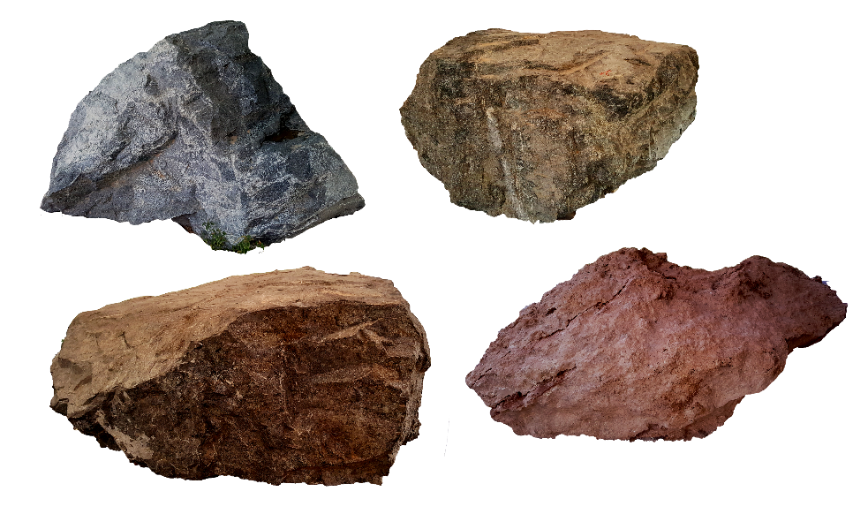
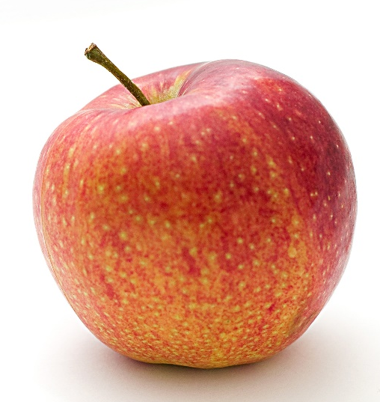


What is a chemical?
Notes:
What is a chemical?
A chemical is any substance made of matter. This includes any solid, liquid or gas.
The chemical may be a pure substance (an element) or a combination of substances chemically bonded together (a compound).
Note: it is not expected that children will understand the difference between an element and a compound at this stage.
Where are chemicals in our lives?
Examples – can children think of any more?
Rocks are made up of chemicals. Some, such as copper, zinc are made entirely from one element. Granite is a rock made of multiple compounds.
Water consists of a chemical combination of 2 elements, oxygen and hydrogen.
Apples (like all our food) are made up of many compounds.
People are made up of lots of chemicals – our hair is made of a tough protein (proteins are made of elements carbon, hydrogen, nitrogen and oxygen, chemically bonded in different ways to make different compounds); our bones are made of proteins and calcium phosphate.
What is not a chemical?
Because things are made of matter, they are all chemicals. Some things (situations) that we observe or effects that we see are not made of matter – they are not chemicals - for example, light, sound, heat (all forms of energy) and forces.

Slide 4

What is a gas?
How many gases can you think of?
Notes:
What is a gas?
The properties of gases include:
Gases are often (‘though not always) invisible.
Gases do not have a fixed shape. They spread out and change their shape and volume to fill up whatever container they are in.
Gases can be squashed (compressed).
How many gases can you think of?
Examples which children might have heard of:
Oxygen (we need oxygen for respiration, we inhale more than we exhale)
Carbon dioxide (a waste product of our respiration, we exhale more than we inhale)
Helium (balloons)
Water vapour (invisible gaseous form of water)
Steam (N.B. steam can be the same as water vapour in some contexts but can refer to a mixture of water vapour and aerosol liquid droplets of water suspended in the vapour – this is what we see when a kettle is boiling)
Carbon monoxide (vehicle exhaust fumes, detectors in the home to measure CO from gas appliances)
Air is a mixture of gases.
For more information on gases, BBC Bitesize website (KS2 science) has learner guides and class clips which may be useful:
Does gas weigh anything?
Gases in daily life
Solids, liquids and gases
Testing for oxygen

Slide 5
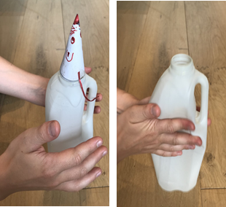
What is air?
How do we know that air exists when we can’t see it?
Try the ‘Rocket Mice’ activity.
Why does the mouse fly?
How does the size of the milk bottle affect the height of the rocket mice?
Resources
plastic bottles of various sizes, ‘rocket’ mice, metre sticks, sticky notes,
iPads to photograph heights
Notes:
Aim: to demonstrate that air is made up of particles/molecules that we cannot see
Rocket Mice Activity suitable for ages 5-11 (1-2 hours)
Click on the link for details of the Rocket Mice Investigation (publ. National Science Museum).
Why does the mouse fly?
Although air is often invisible, it is a substance. When we squash the bottle, the air inside comes out of the top of the bottle and pushes the rocket mouse upwards.
Wind is the movement of air.

Slide 6
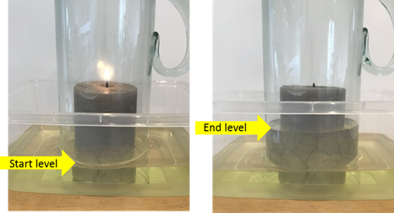
Activity (optional) to show what air is made of
What is in air?
Why does the water rise?
Why does the candle go out?
Resources
large candle, water trough, food colouring and straight glass jug
Notes:
Aim: to demonstrate that air contains oxygen gas that we cannot see
Note: Safety guidance for using candles in the classroom is available from CLEAPSS and SSERC websites.
Demonstrate the presence of oxygen in air by burning a candle (20 minutes)
If you limit the amount of air available, the candle's flame eventually goes out when there is insufficient oxygen to sustain it. The oxygen may not be completely used up when the candle goes out - just at low levels.
Tip: To illustrate % oxygen in air, if air was one hand: four fingers would be nitrogen; the thumb oxygen and half the nail of their forefinger other substances.
Air is roughly 4/5 nitrogen (78%) and 1/5 oxygen (21%). Argon makes up most (0.93%) of the last 1 % with carbon dioxide being 0.04%. All other gases are trace gases.

Slide 7
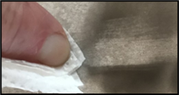
Demonstration (optional) to show what else is in air
What else is in the air?
What happens when you pass a ceramic tile over the yellow part of a flame?
Has the tile been burnt or can the soot wipe away?
Where has it come from?
Resources
Fantastic Flicker film clip (Explorify),
Carbon from a candle demonstration video (RSC)
For your own demonstration – a ceramic tile/plate, candle flame, tissue
Notes:
Aim: to demonstrate that there are solids in air that we cannot see
Note: Safety guidance for using candles in the classroom is available from CLEAPSS and SSERC websites.
1. From Explorify, show Fantastic Flicker or demonstrate this yourself (10 minutes). This shows that candle smoke is made up of soot and vapourised wax, which can cause the flame to ‘jump’ and reignite the candle without touching it. Note: Flame colours for incomplete combustion are referred to as yellow and not orange.
2. Sooty Tile (10 minutes). There are invisible solids in the air too. Hold a tile just above a burning flame for a few seconds and show the children black soot marks. Wipe them away to show that the tile has not been burnt. The tile collects the tiny unburnt soot that is produced when most things burn. (10 minutes)
3. The Royal Society of Chemistry provides a film clip demonstrating how to collect carbon from a candle. https://youtu.be/RU_Nobzk60o

Slide 8
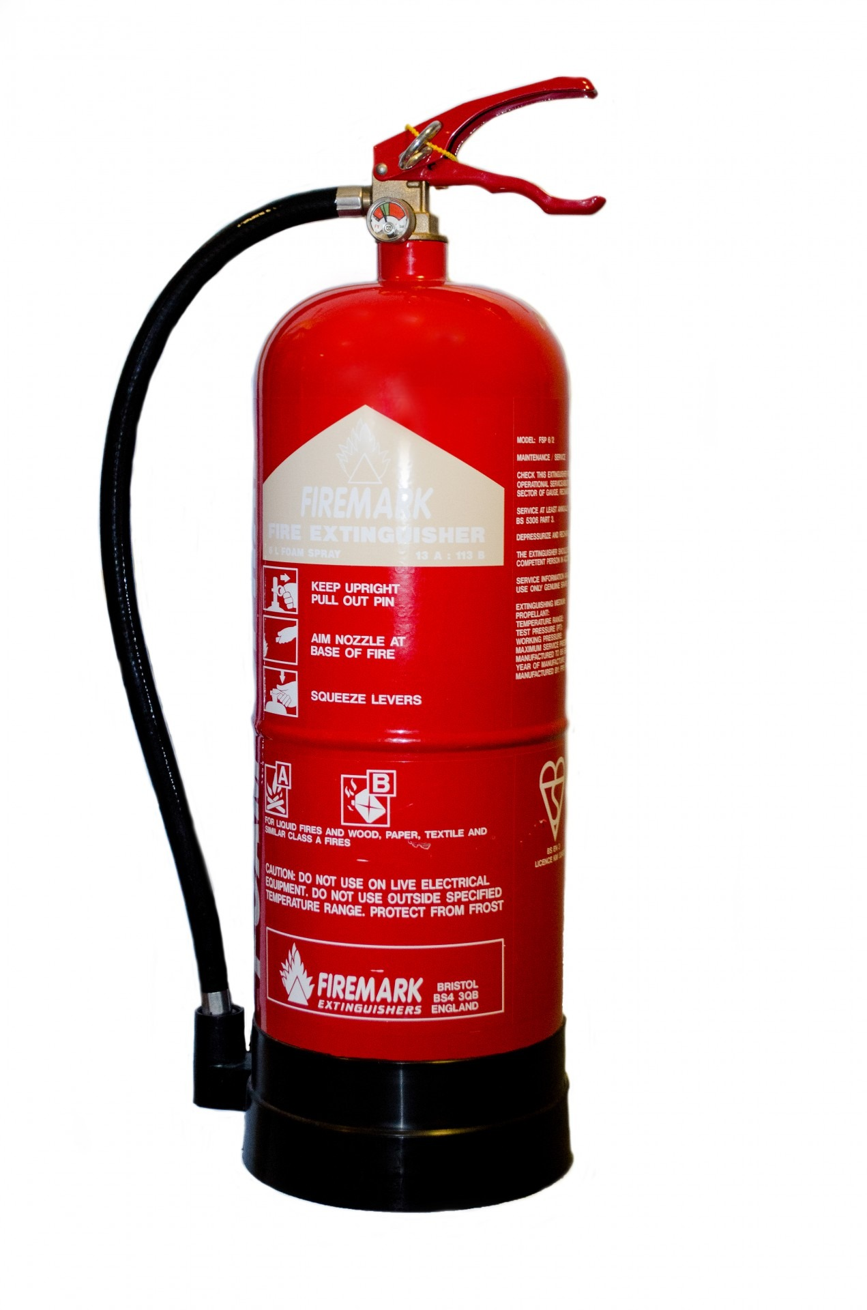
Primary science demonstration videos
Notes:
The Royal Society of Chemistry provides several videos to demonstrate the properties of gases to primary children, which can be accessed here.
https://edu.rsc.org/resources/gases/916.article
You may find these videos useful:
Put out a fire with a jug of carbon dioxide to demonstrate changing materials, irreversible reactions, and gases to primary students.
Investigate gases and atmospheric pressure with the Leaky Bottle experiment.
Make a freaky inflatable hand to demonstrate irreversible reactions to primary students.
Demonstrate the power of atmospheric pressure to make an anti-gravity bottle with primary students.
Demonstrate the expansion and contraction of gases and make a pair of cups stick together.

Slide 9



For more information on the Primary Science Teaching Trust and access to a large selection of PSTT resources, visit our website:
pstt.org.uk
/primaryscienceteachingtrust @pstt_whyhow
To help you find high quality resources to support your primary science teaching quickly and easily, we provide links to excellent resources for teachers, children and families on our Wow Science website :
                wowscience.co.uk
and we regularly provide further suggestions on how to use these in the classroom through social media platforms:
/wowscience @WowScienceHQ

