Slide 1


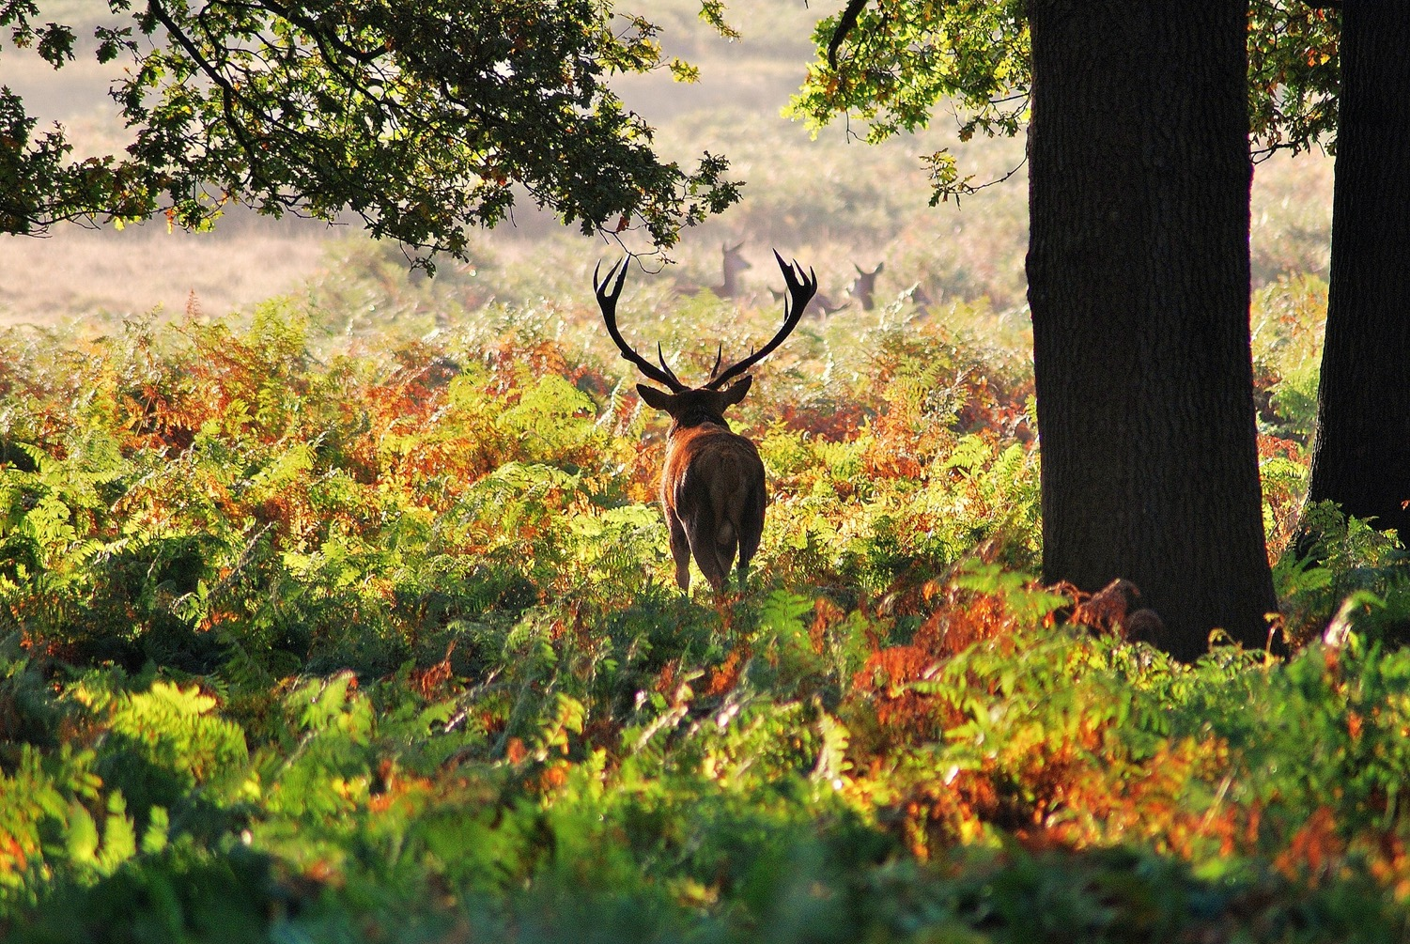
British Wildlife: Who am I?
Notes:
Red deer
In woods, moors and grassland

Slide 2
British Wildlife: Who am I?
Created by the Primary Science Teaching Trust (PSTT) and The Nature Collection
All images taken by and © Susanna Ramsey.
Resource © Primary Science Teaching Trust, 2021.
These materials may be freely reproduced by teachers in schools for educational purposes, subject to the source being credited. Materials may not be used for promotional or commercial purposes without the express permission of the PSTT. On no account may copies be offered for sale.
The Nature Collection is an extraordinary collection of animal bones, skeletons, feathers, antlers, skins and photographs and was created by Susanna Ramsey.

Slide 3
Guidance for using British Wildlife: Who am I?
This resource is designed to engage young children with nature and the animals and plants that they could find living their local environment. The hidden images encourage children to observe closely and to stimulate talk about the features of animals and their habitats.
There are 18 animals in this slideshow. Some are vertebrates (birds, mammals, reptiles and amphibians) and some are invertebrates (insects). All are commonly seen in the UK.
How to use the slides:
On each slide, there are 3 shapes partly covering the animal.
Ask – Who am I? Listen to children’s suggestions.
Ask - Why do you think this? Encourage children to notice where the animal is hiding: What can you see? Who might live here?
Remove one shape.
Ask again – Who am I? Listen to the children’s ideas.
Ask again - Why do you think this? Encourage the children to look closely at special features of the animal such as feathers, fur or scales which might help them to identify the type of animal.
Remove the 2nd shape, repeat the questions and encourage science talk.
Remove the 3rd shape to reveal who is hiding,
Note: This resource could be used with children in Early Years (3-5 years) or Key Stage 1 (5-7 years). The slide notes below each slide give the name of the animal that is hiding and where it likes to live. This is intended to support teachers’ subject knowledge. We are not suggesting that all children should be taught all these facts. The discussions with the children should be appropriate to the age and ability of the children.

Slide 4
British Wildlife: Who am I?
Slide Index
Slides Animals
1 red deer
Canada goose
fox
rabbit
stag beetle
hedgehog
blue butterfly
swan
frog
harvest mouse
dragonfly
lizard
badger
bumble bee
squirrel
adder
mallard duck
fallow deer
tawny owl

Slide 5
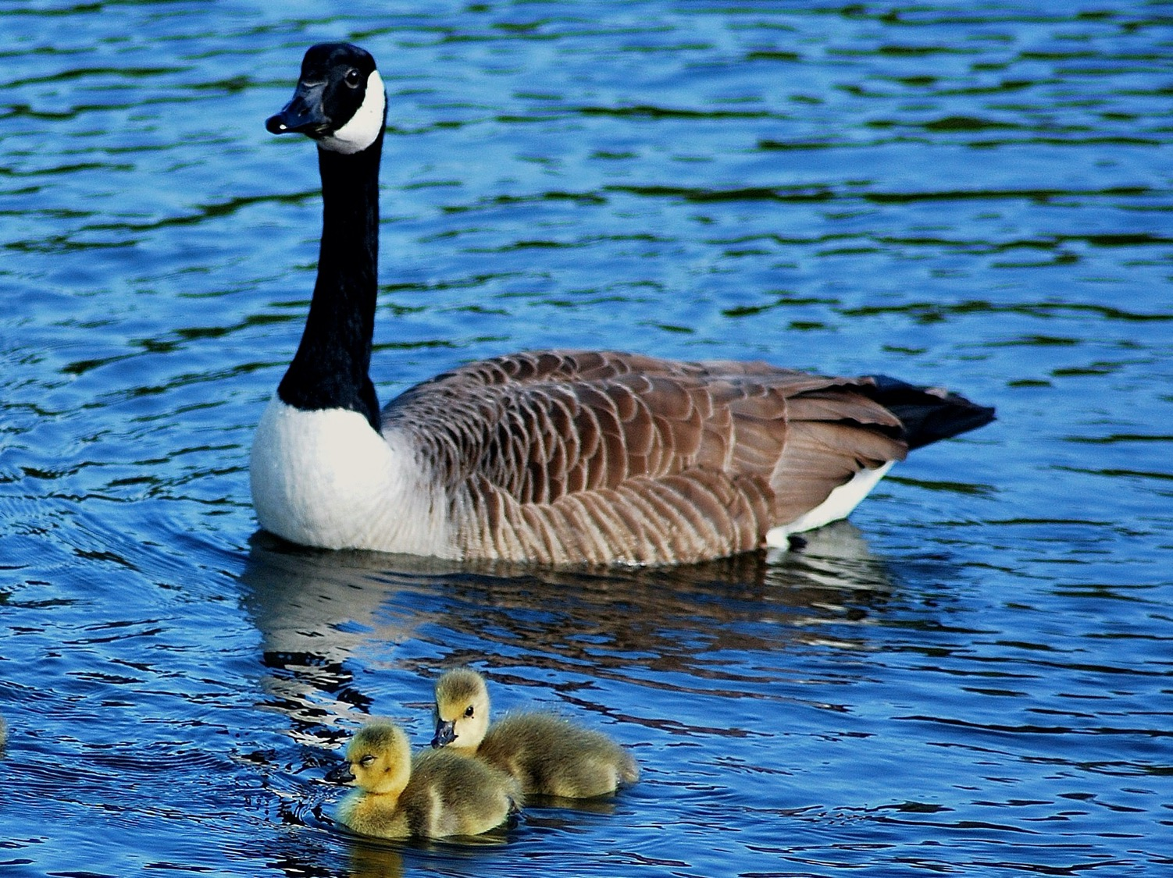
Notes:
Canada goose
Adult with 2 goslings
On ponds and lakes

Slide 6
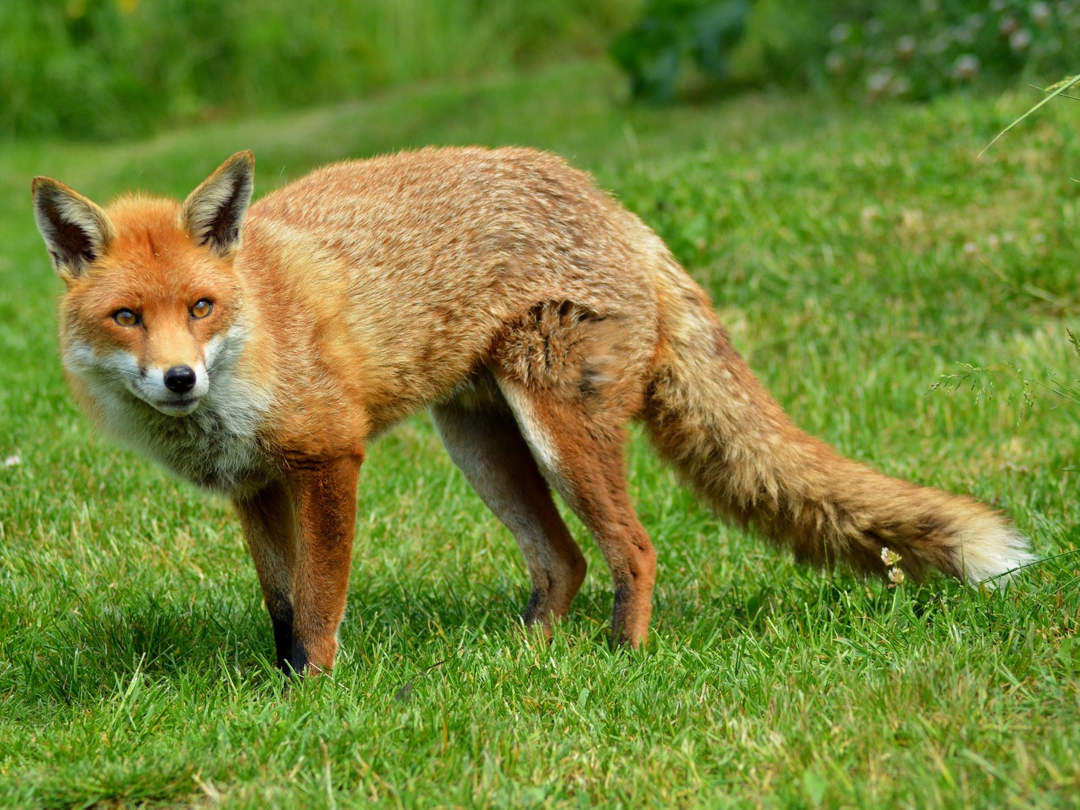
Notes:
Fox
In towns and cities, woods and farmland

Slide 7
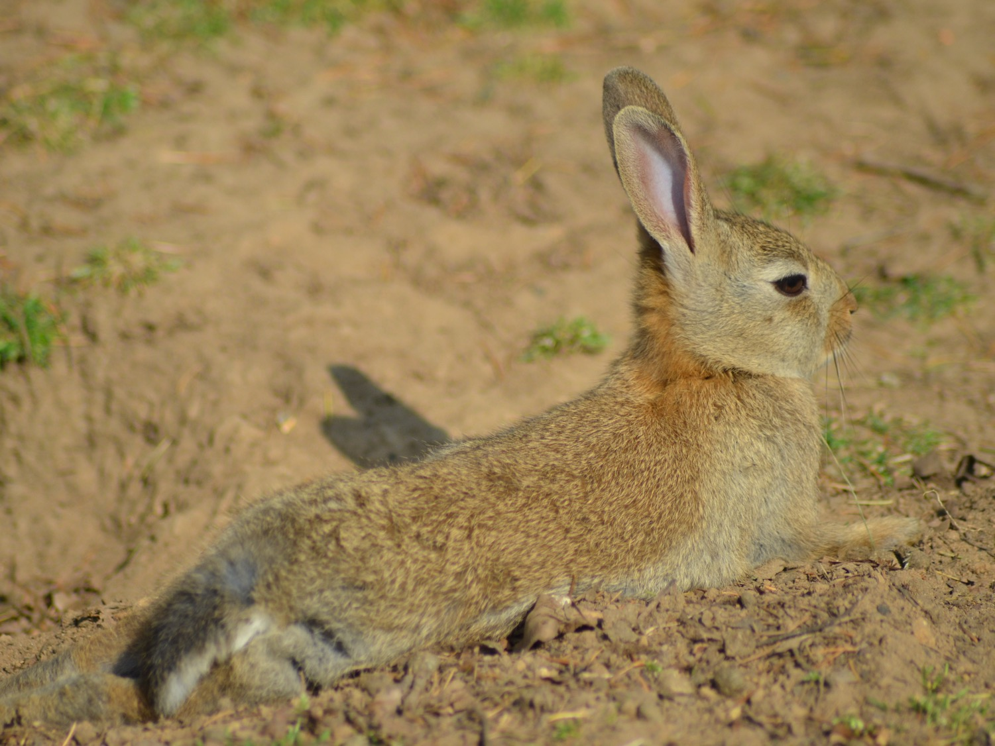
Notes:
Rabbit
In grassland and farmland

Slide 8
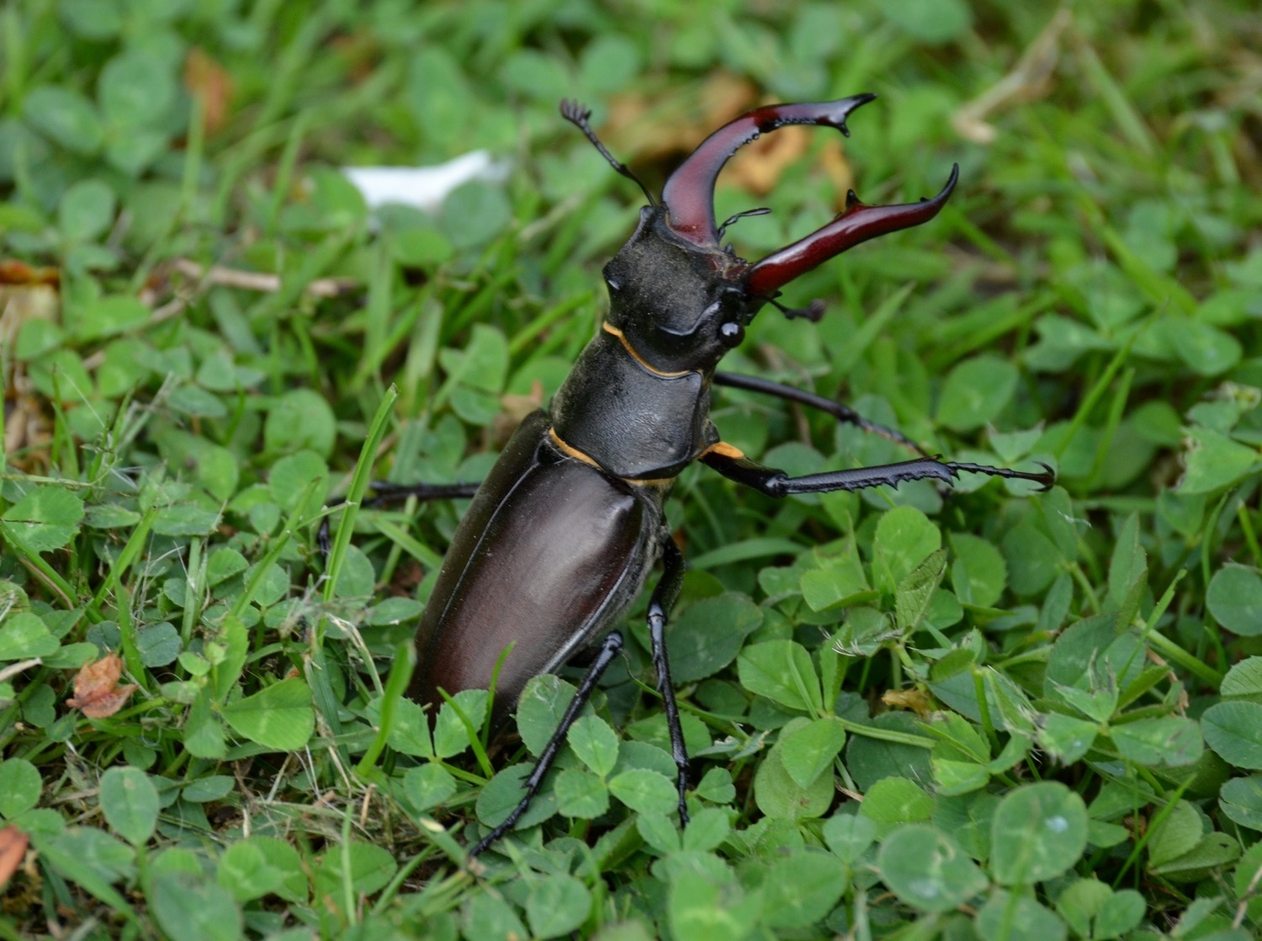
Notes:
Stag beetle
In woods and gardens

Slide 9
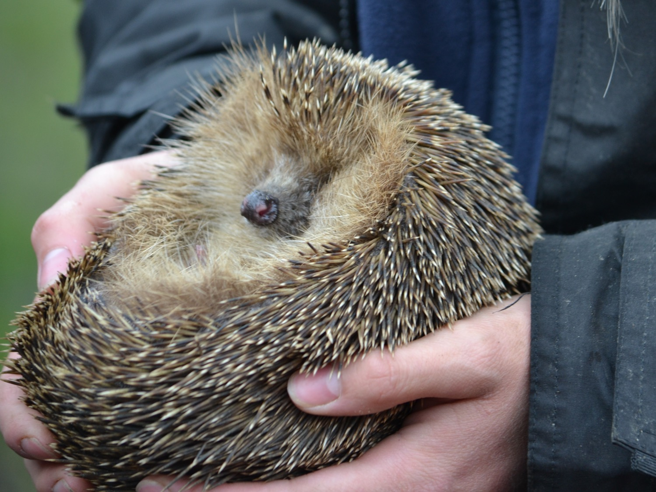
Notes:
Hedgehog
In gardens, parks, woods and hedges

Slide 10
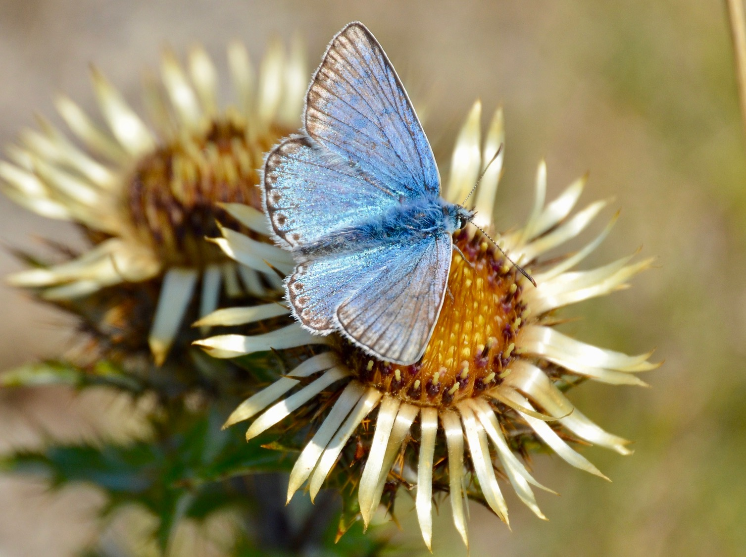
Notes:
Blue butterfly
On flowers

Slide 11
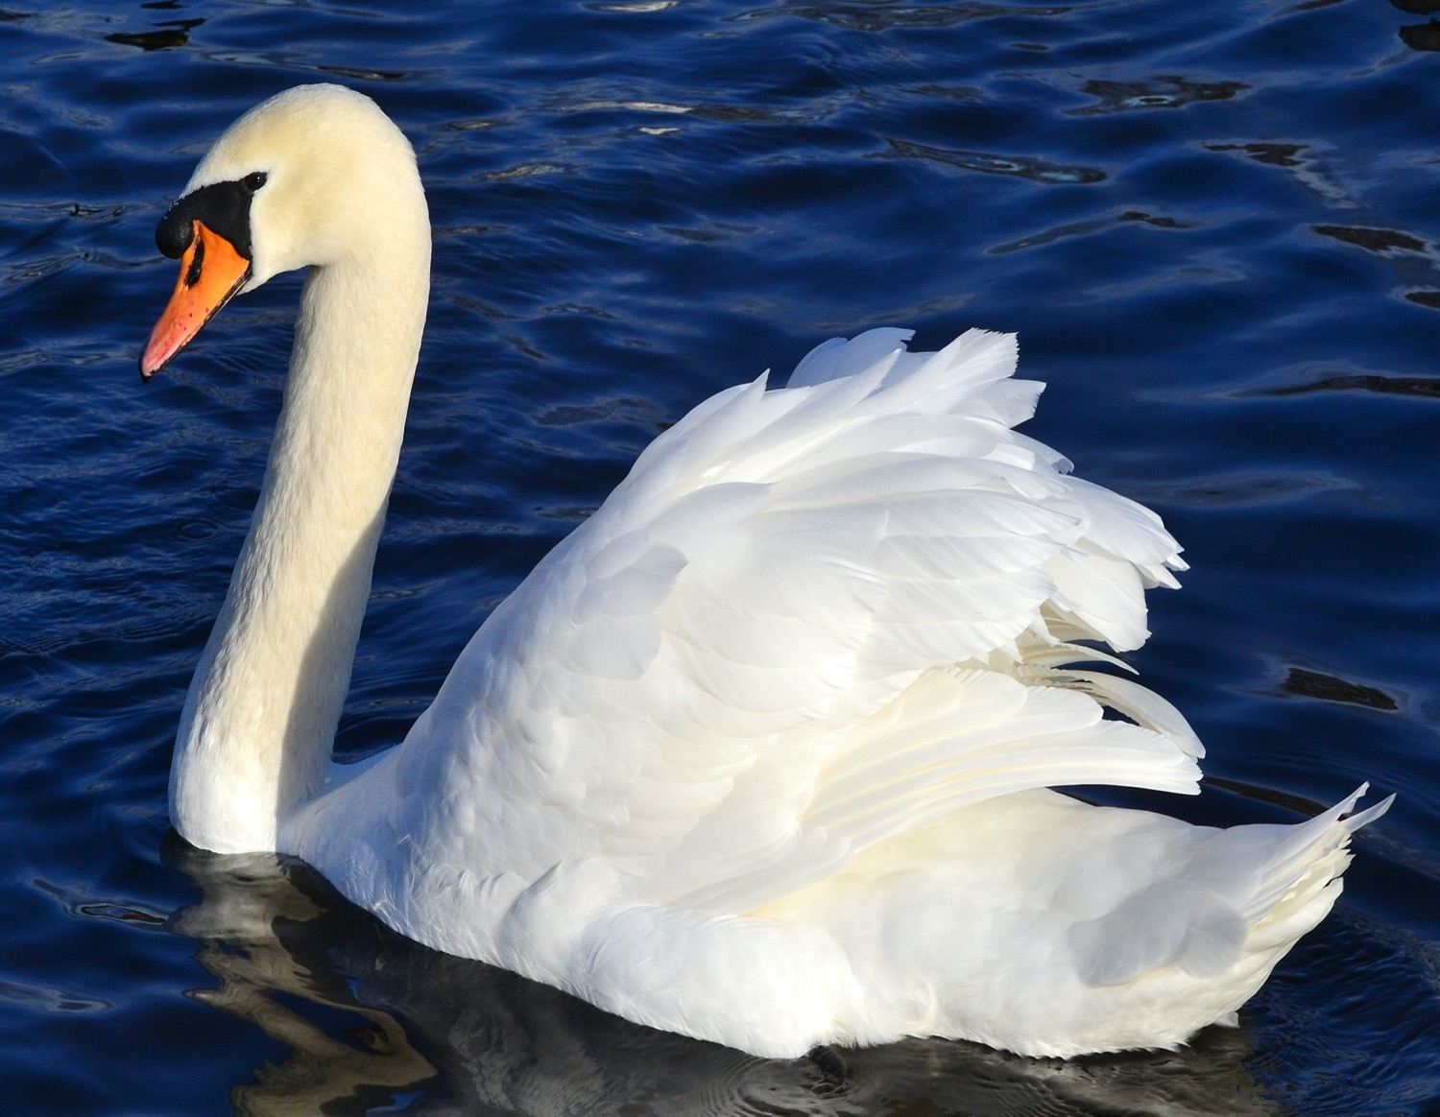
Notes:
Swan
On rivers, lakes, ponds and canals

Slide 12
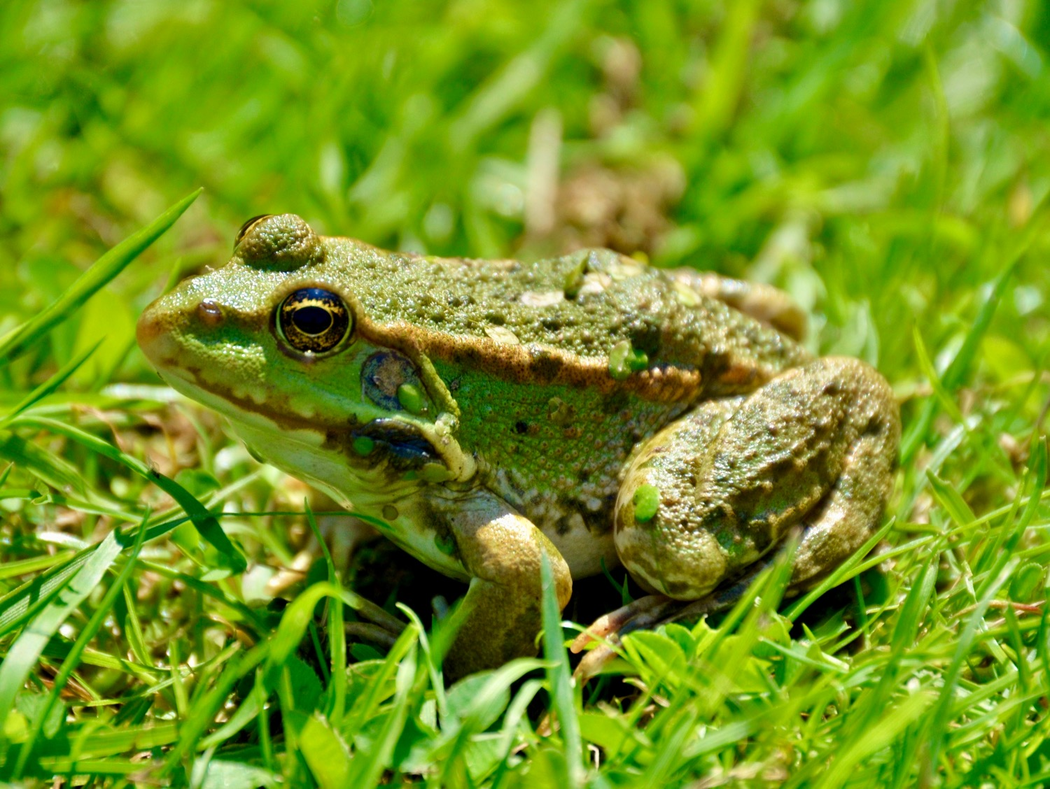
Notes:
Frog
By ponds and lakes

Slide 13
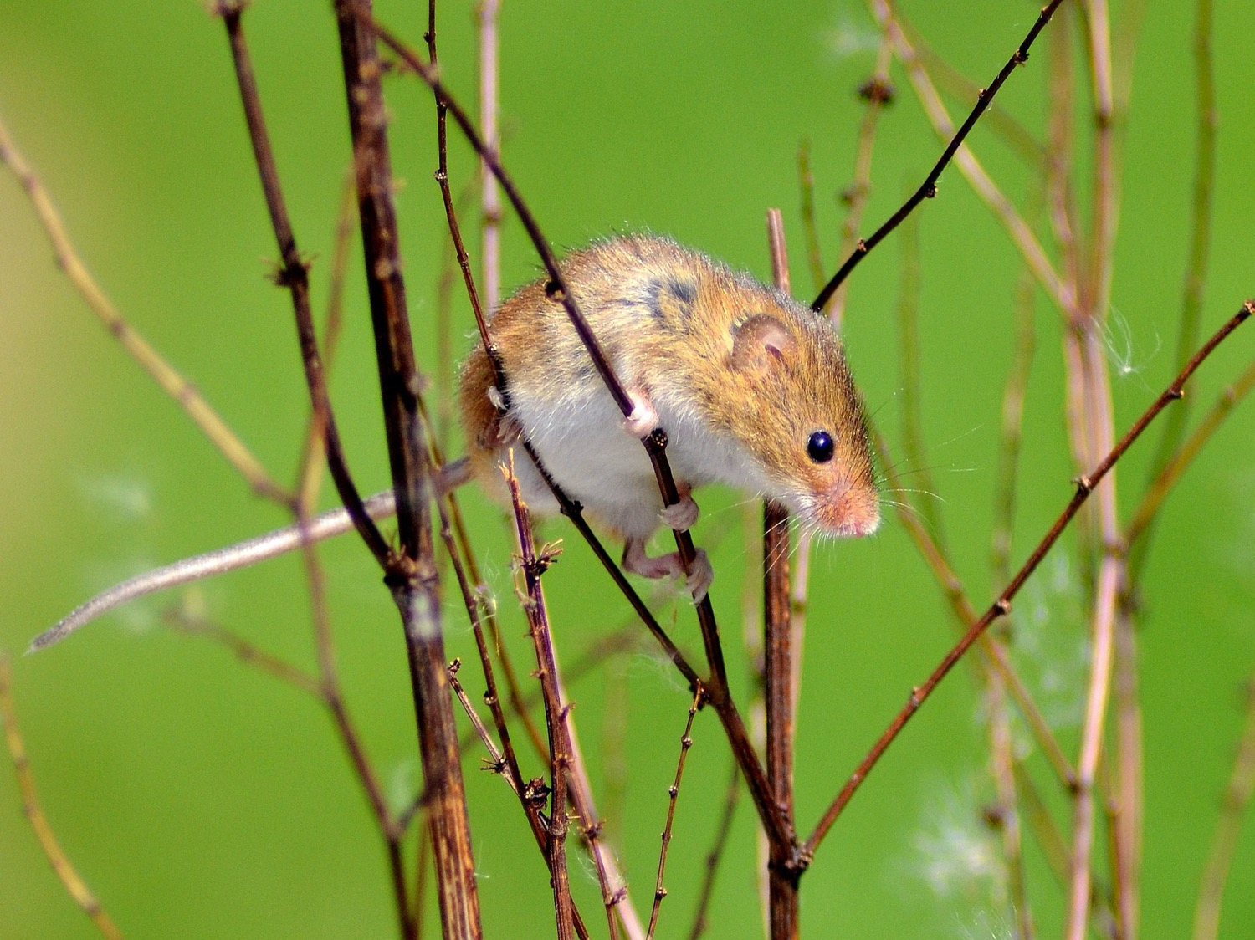
Notes:
Harvest mouse
In meadows, farmland, hedges and reedbeds

Slide 14
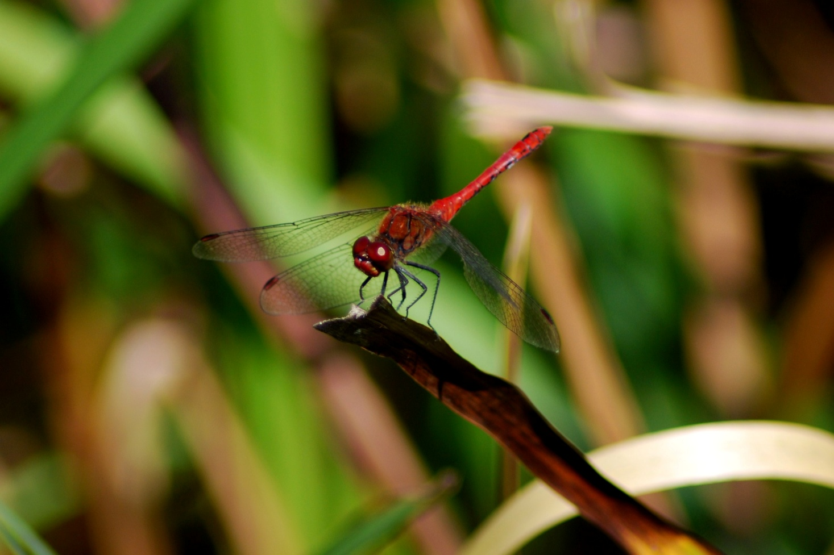
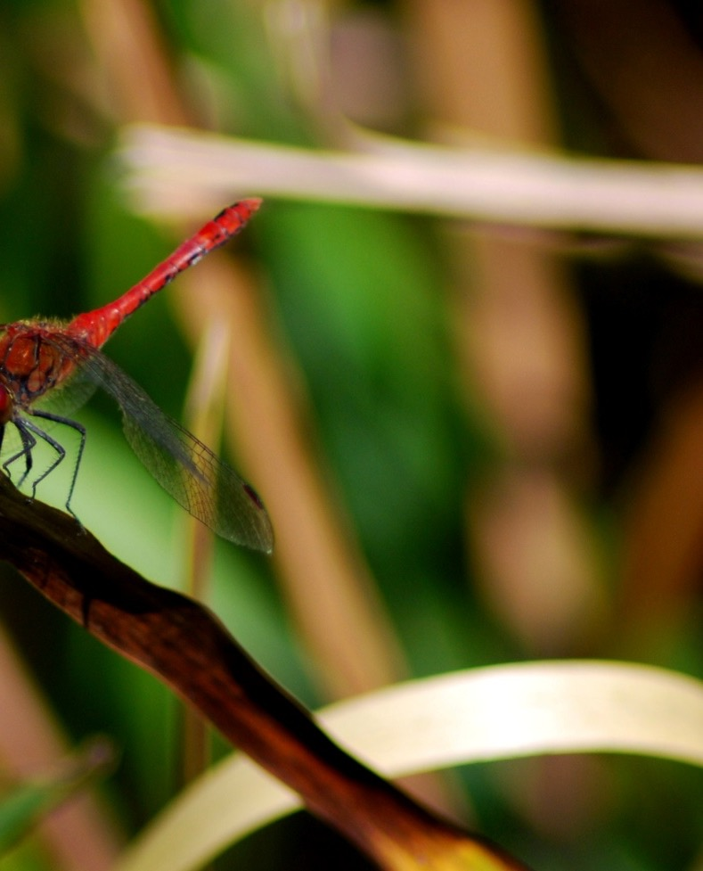
Notes:
Dragonfly
By ponds, streams, ditches and rivers

Slide 15
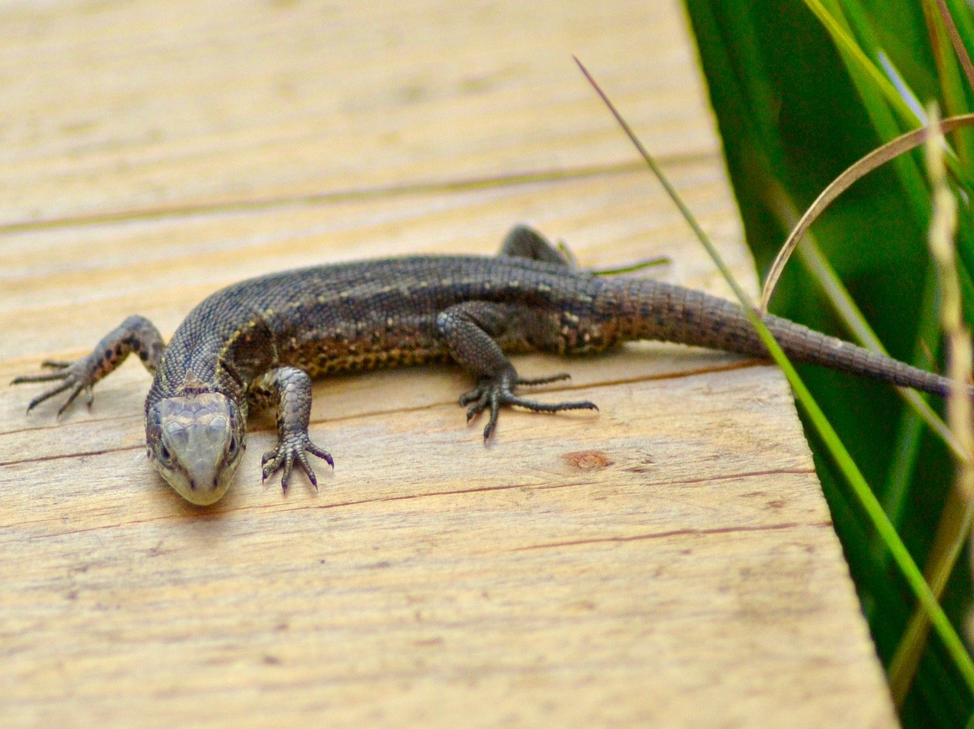
Notes:
Lizard
On heaths, moors and open grassland

Slide 16
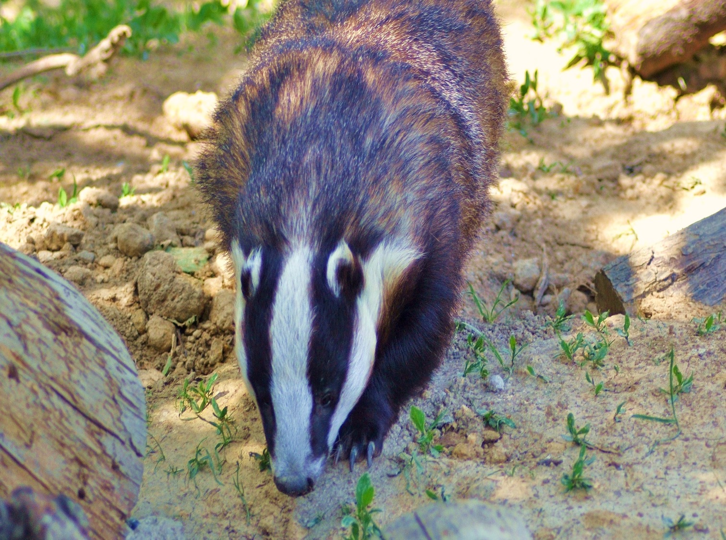
Notes:
Badger
In farmland, meadows and woods

Slide 17
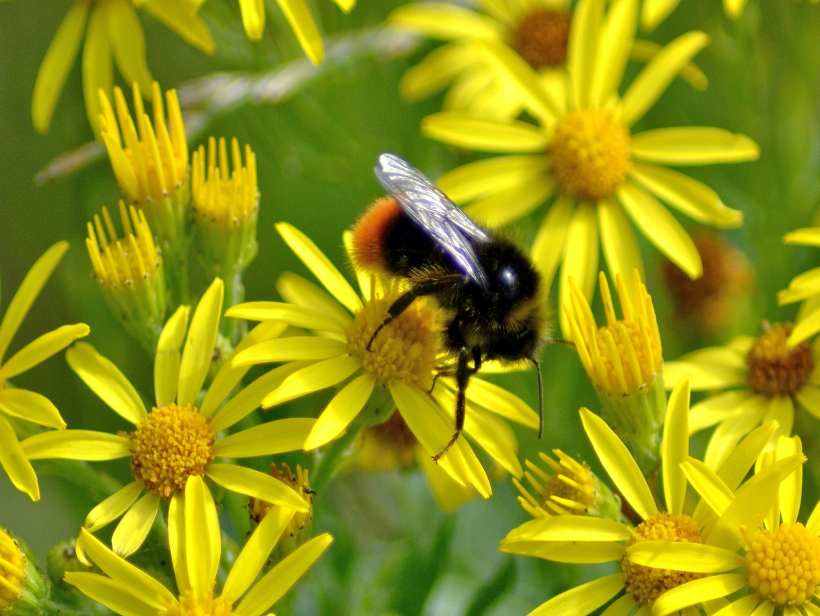
Notes:
Bumble bee
On flowers

Slide 18
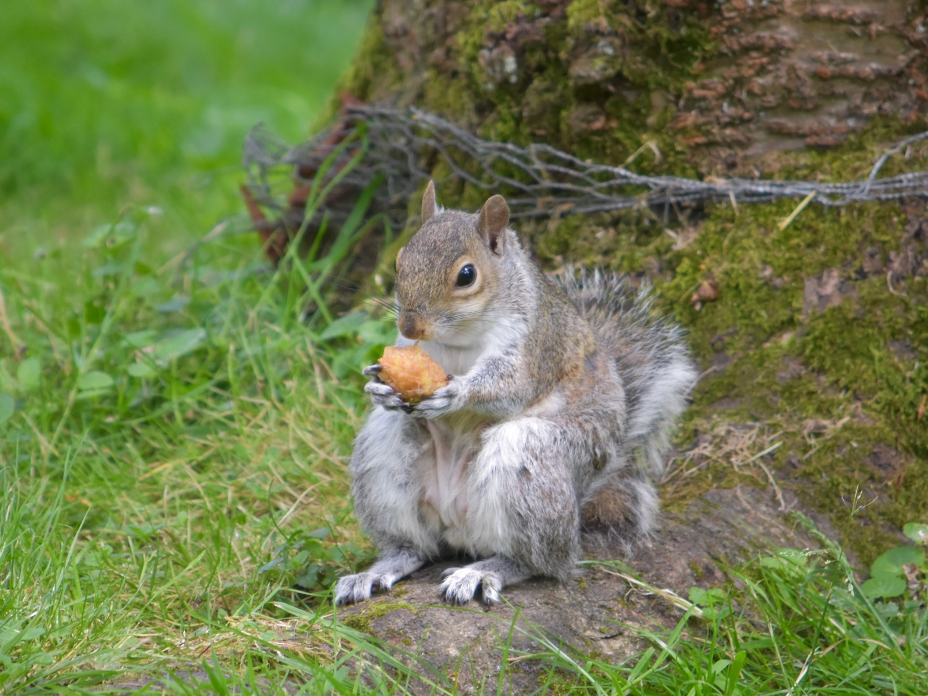
Notes:
Grey squirrel
In trees in parks, gardens and woods

Slide 19
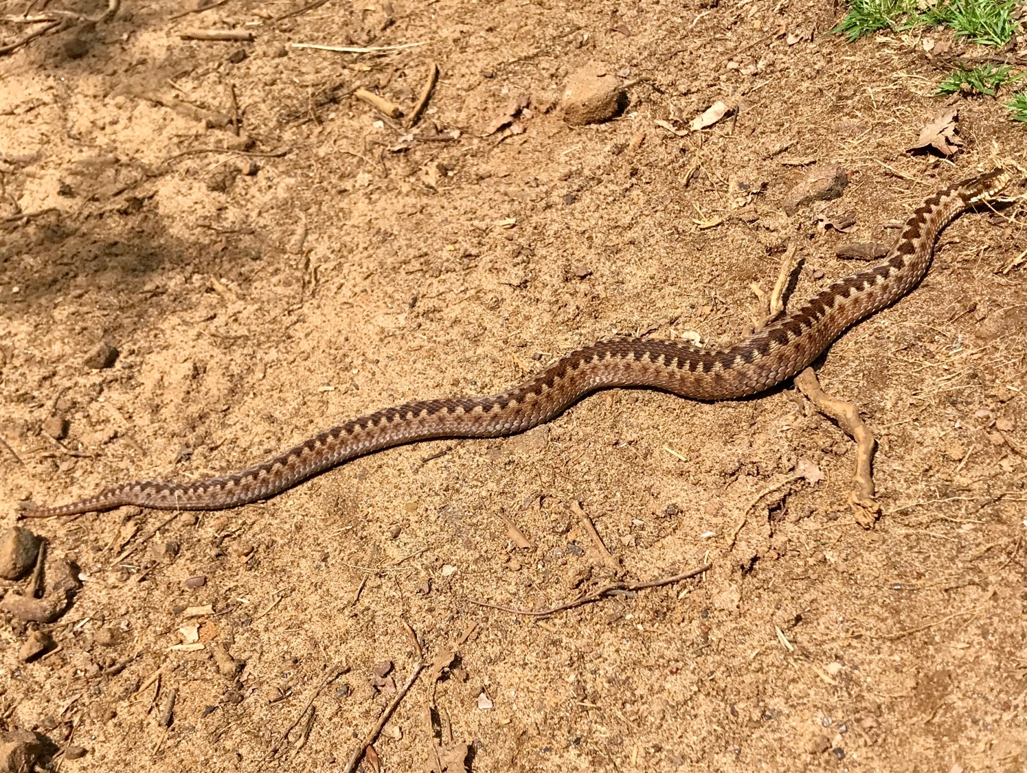
Notes:
Adder
On heaths, moors, rough grassland and sand dunes

Slide 20
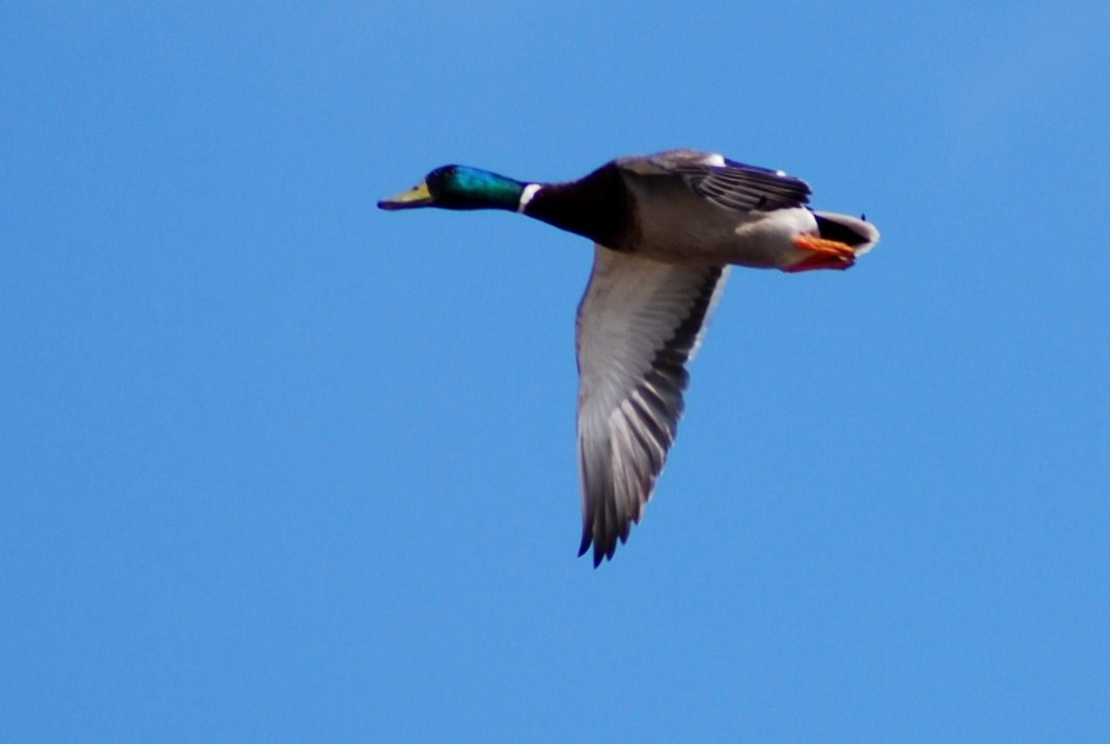
Notes:
Mallard duck
On ponds, lakes, rivers and marshes

Slide 21
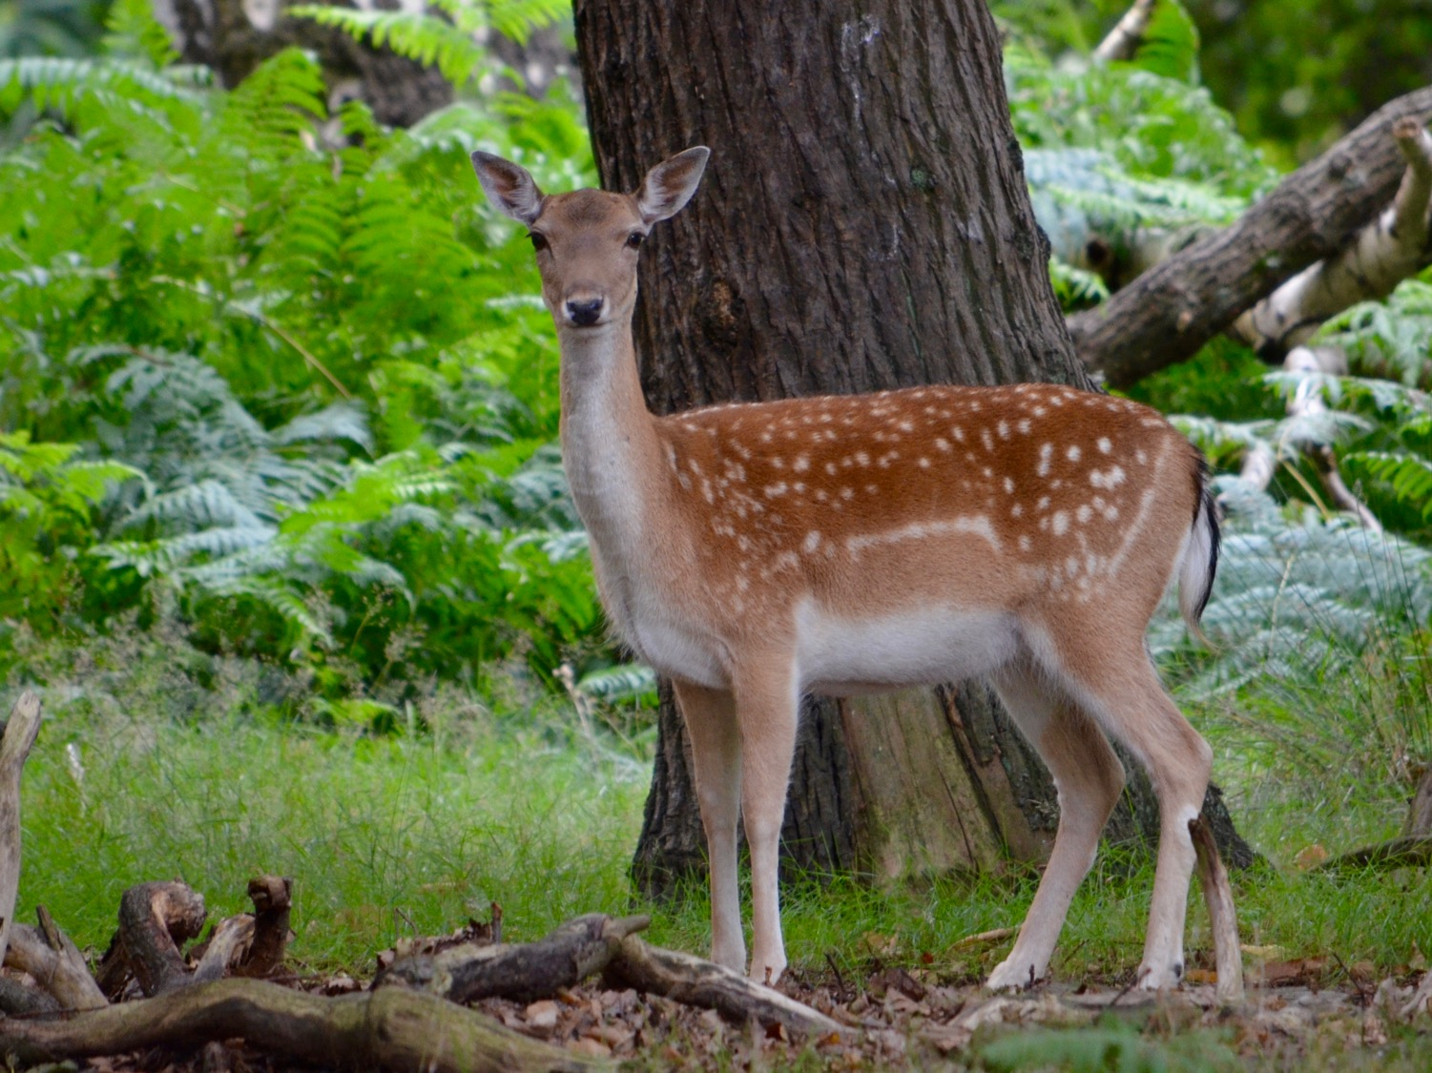
Notes:
Fallow deer
In woods, parks and farmland

Slide 22
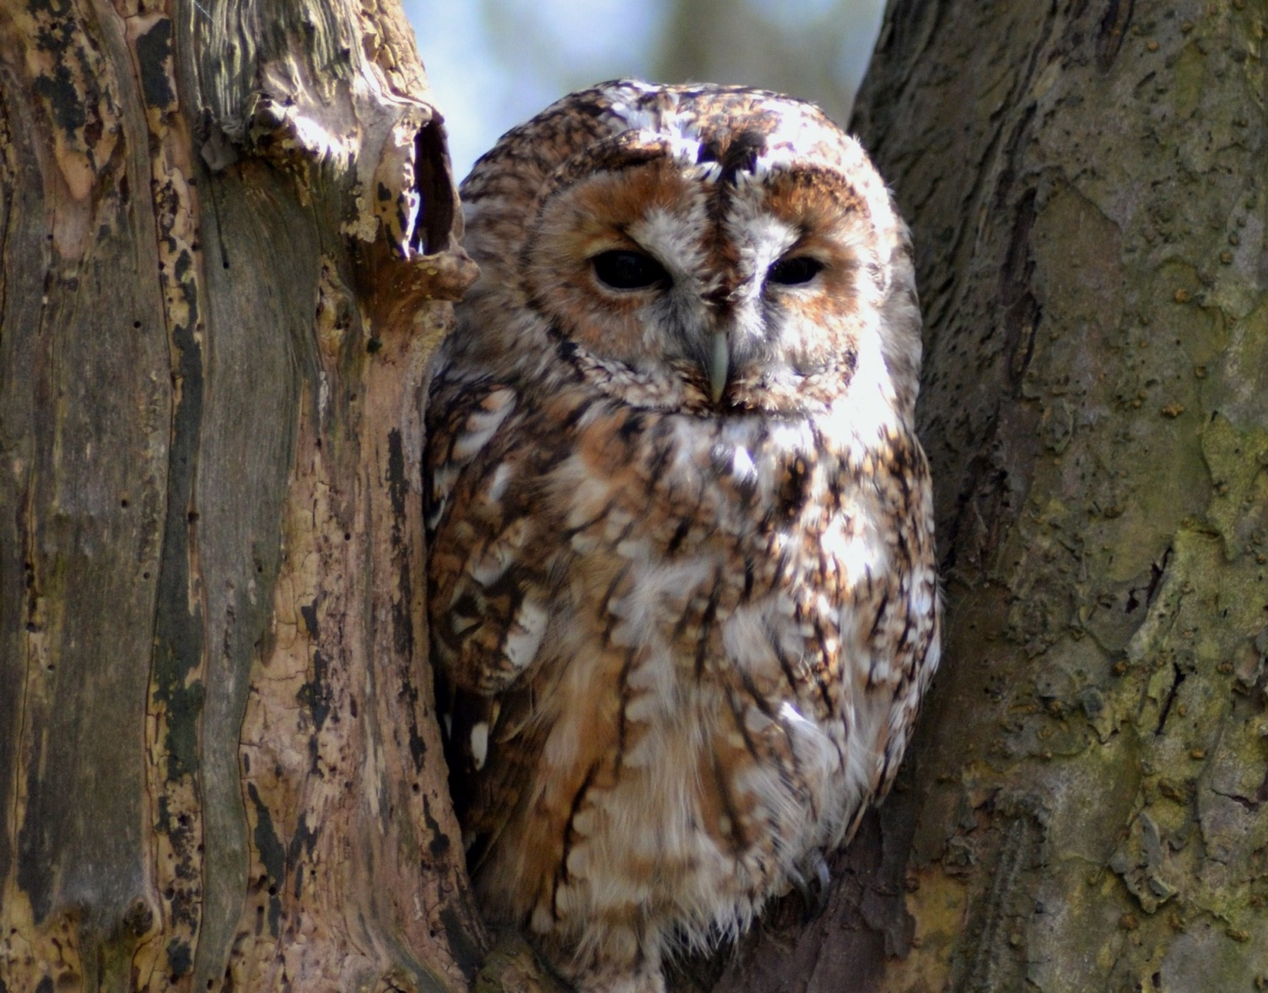
Notes:
Tawny owl
In woods and parks

