Slide 1





Slide 2
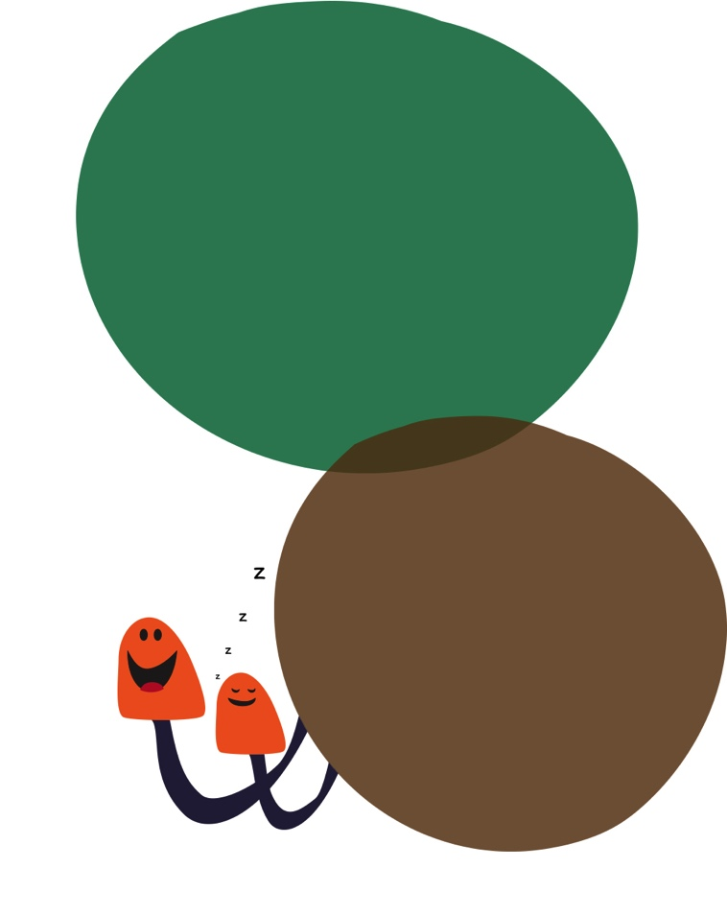
This and the associated resources have been created to inspire and engage school communities in finding and enhancing wildlife in their local area.
You have the ability to amend these resources. Please accredit the original source ‘University of Manchester’.
Contact:
w: http://www.fascinate.manchester.ac.uk/
e: Toby.Tyler@manchester.ac.uk
Twitter: @UoMSEERIH
@StockportSLIC
#GardenScience
Created by Toby Tyler, PSTT Fellow
Great Moor Community Infant School
& Infant Champion at the Science & Engineering
Education fascinate Hub
Garden
Watch
Assembly
Intro
PowerPoint

Slide 3
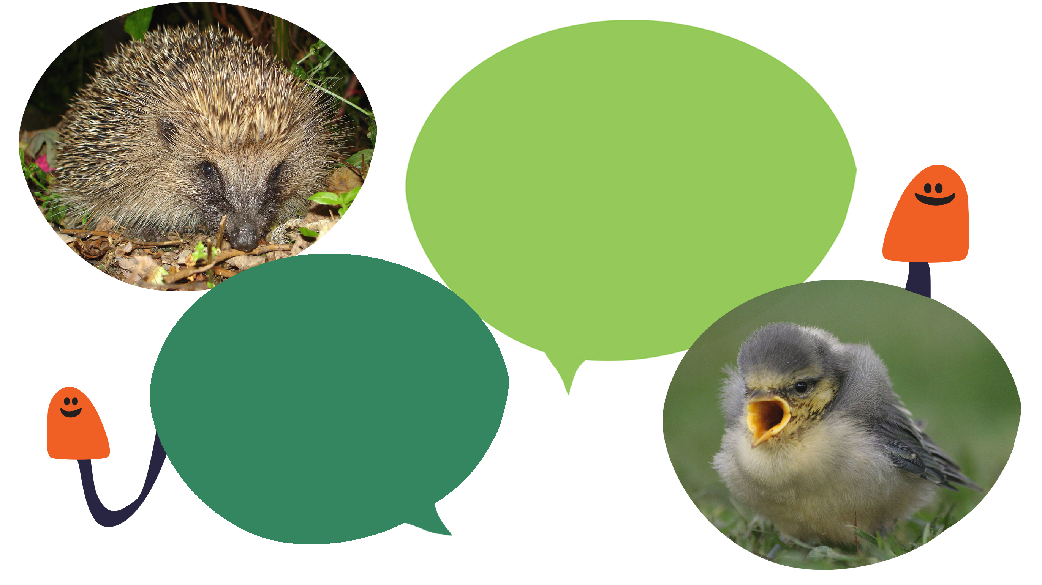
Nature is struggling,
but if we all pull together and do small actions for wildlife in our garden and outdoor spaces, we can make a real difference.
After all, if there's no home for nature, there will be no nature.
(RSPB – Give nature a home)

Slide 4


Our Gardens!
Our
Wildlife!

Slide 5


What is in our gardens?
Add your name.
Add a drawing or photo of your outdoor space.

Slide 6

This
Saturday
List the animals you find or see, e.g. pigeons, spiders, lady birds etc.

Slide 7

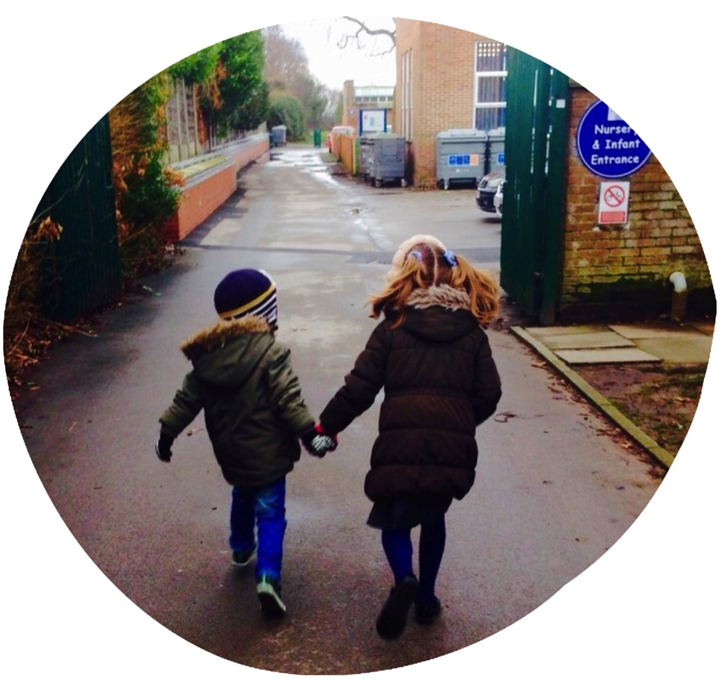
Bring it back to school.

Slide 8
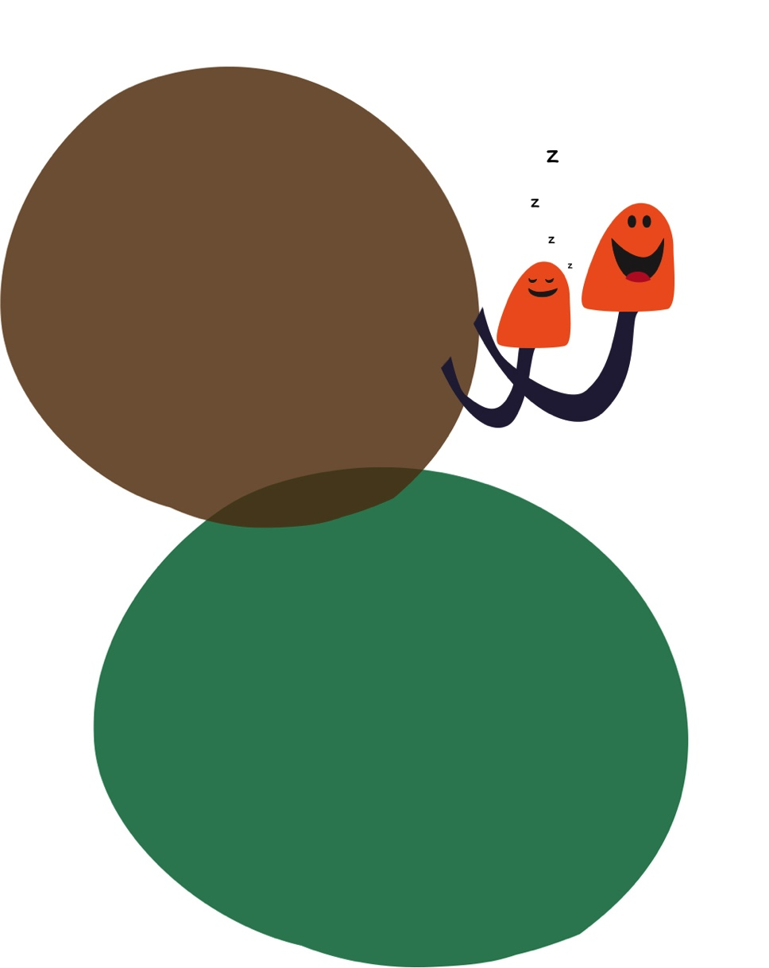
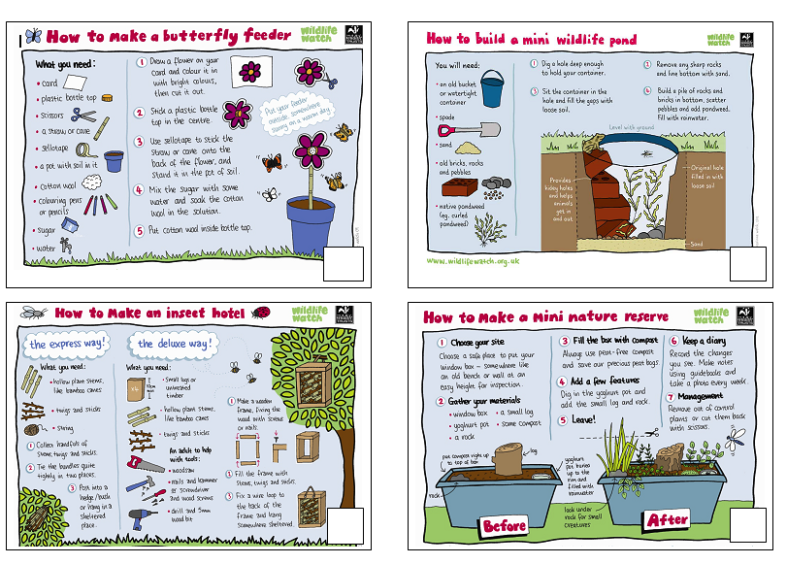
Get busy
With thanks to www.wildlifewatch.org.uk

Slide 9
Draw, write or paste a picture showing
what you have done.
Scan these with a mobile phone or an
iPad. Ask a grown up to help.
Enjoy it!

Slide 10
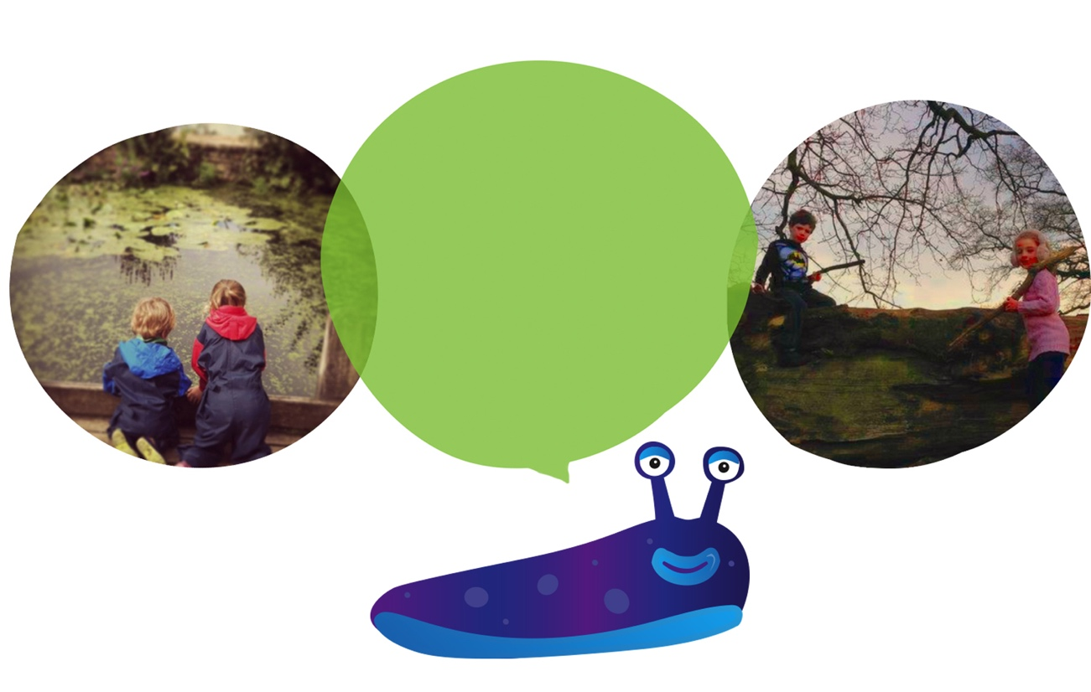
What will you do?

