Slide 1





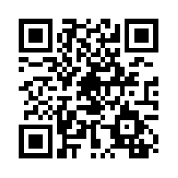

Share your own #GardenScience news activities and pictures!
Share your own #GardenScience news activities and pictures!
Survey 1: Date
Follow our project on Twitter using #GardenScience
for information, ideas, links, activities
and more!
Survey 1: Date
Follow our project on Twitter using #GardenScience
for information, ideas, links, activities
and more!

Slide 2
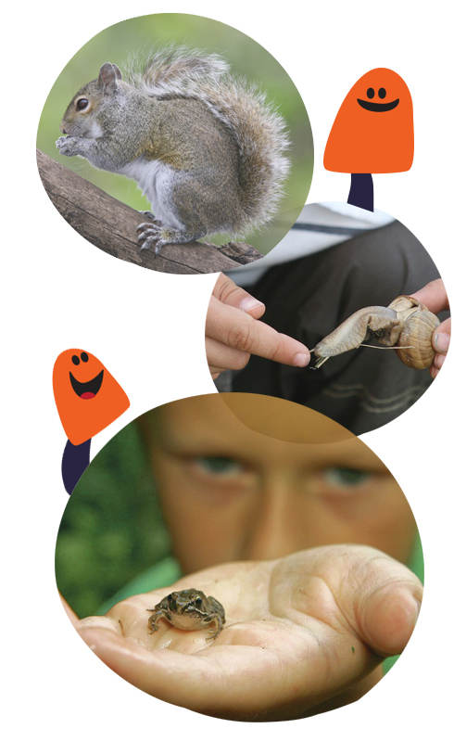
Survey 1 Date
________________
Follow our project on Twitter using #GardenScience
for information, ideas, links, activities
and more!
Share your own #GardenScience news activities and pictures!
Survey 1 Date
________________
Follow our project on Twitter using #GardenScience
for information, ideas, links, activities
and more!
Share your own #GardenScience news activities and pictures!

